Slide 1
Lyons Hall of Fame

Slide 2
Information regarding the LCS Athletic Hall of Fame:
Lyons’ rich history in athletics dates back over 70 years. Ron Smith, a LCS graduate in 2004 completed his senior benchmark with the idea of creating a hall of fame to honor past athletes who made a difference on and off the playing fields for the Lyons Lions. He assisted in creating a committee of current and former teachers, community leaders, and sports historians to get his idea in motion. Inductees are former student athletes, coaches, or honorary members who have made a significant impact on the program. All inductees have their achievements displayed outside the high school gymnasium in the Lyons Hall of Fame display area.

Slide 3
Eligibility Criteria:
Student Athlete: Athletes who excelled on the playing field, who graduated from Lyons at least ten years ago and who were, and still are, in good character standing.
Coaches: Individuals who have made significant and extraordinary contributions to the Lyons High School athletic program.
Contributor(s): Someone who has had a significant impact on our athletic program in capacities other than playing or coaching.
Teams: Teams who excelled on the athletic field at least ten years ago.

Slide 4
Anyone can take part in the nomination process by picking up and filling out a nomination form located in the high school office or by logging on to the school’s website at: www.lyonscsd.org.
So fill out a nomination form today and help sustain a tradition.

Slide 5
Class of 2004
First Annual Athletic Hall of Fame Induction Dinner

Slide 6
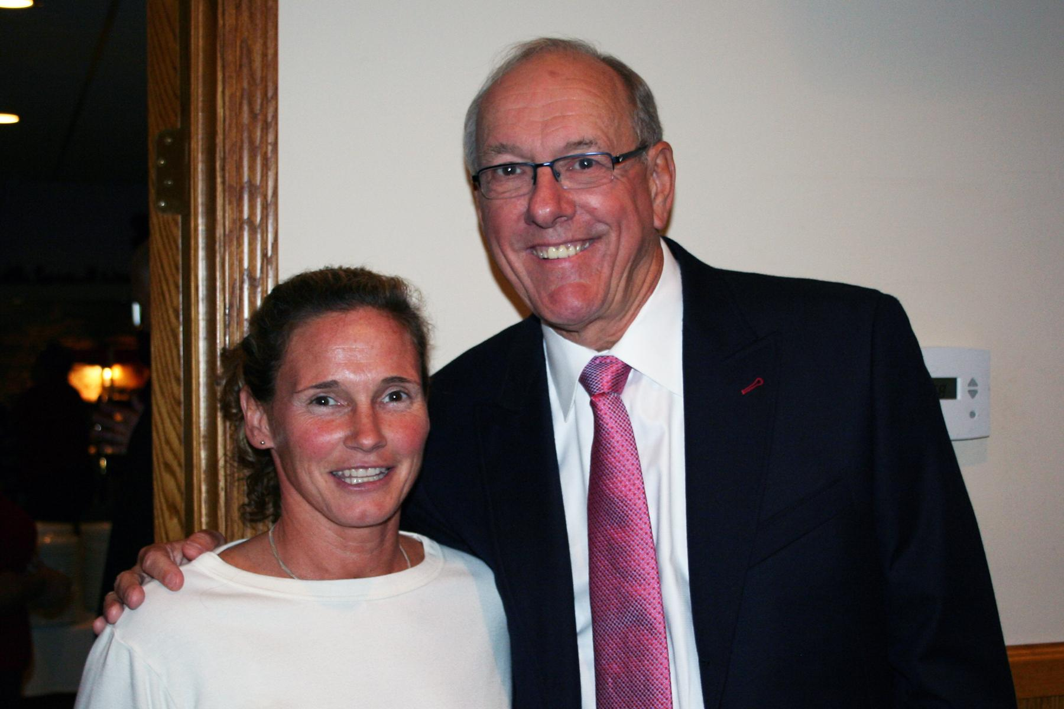
Inductees:
Dr. Myron Cramer
Don Murphy
Spencer DeVito
Jim Boeheim
Dick Blackwell
Maureen Nolan-DeCillis

Slide 7
Dr. Myron Carmer

Slide 8
Dr. Myron E. Carmer
Myron Carmer played on the 1933 basketball and football Championship Teams for Lyons Union School before going to Hamilton College. He was a 1934 Lyons graduate.

Slide 9
Dr. Myron E. Carmer
While at Hamilton College, Myron was one of six seniors awarded highest honors for scholarship in the Pentagon Society. All-around participation in campus activities and sports included starring in football, basketball and baseball. He continued on to earn his medical degree at Columbia University and served as an officer in the U.S. Naval Reserve during World War II.

Slide 10
Dr. Myron E. Carmer
Dr. Carmer returned to Lyons in 1947 to follow in his father’s footsteps by practicing medicine at the E.J. Barber Hospital on the corner of Lawrence and Phelps Streets. By the time he retired in 1980, he owned the Barber Hospital and had practiced medicine there for over 37 years. Dr. Carmer was well known to the students of Lyons as the school physician, and always showed compassion and interest in the athletes.

Slide 11
Dr. Myron E. Carmer
Wayne County residents have a high regard for Dr. Carmer who was active in the community. He served on the Board of Directors at the Lyons National Bank and in 1971 was presented with a plaque by the Lyons Chamber of Commerce as “Man of the Year.”

Slide 12
Donald Raymond Murphy

Slide 13
Donald Raymond Murphy
Beginning in the late 1940’s, Donald Murphy played 4 years of varsity football, basketball and baseball. The 1951-52 basketball season was a proud moment for Don Murphy as he played on the first Lyons team to win the New York State Section V Class A championship. He loved the fellowship and lifelong friendships that developed from sports.

Slide 14
Donald Raymond Murphy
His admiration and respect for all coaches was strong, especially for Dick Blackwell, who instilled in his players to be gentlemen both on and off the basketball court.
After graduating from Lyons in 1952, Don went on to St. Lawrence University.

Slide 15
Donald Raymond Murphy
Don returned to Lyons after college and served as the Business Manager for Lyons Central School for 25 years while following the many activities of his three children and grandchildren.
Upon his death in 1998 his family and friends contributed to the Lyons Field House in his memory.

Slide 16
Spencer DeVito

Slide 17
Spencer DeVito
Spencer DeVito lettered as a starter in varsity football, baseball and basketball for four years and played tennis for one year at Lyons Central School. He was and still is regarded by long time Lyons sports fans as the best football player to graduate from Lyons. He was also a stand out defensive player on Coach Dick Blackwell’s 1954 Class A Section V Championship team.

Slide 18
Spencer DeVito
Spencer went on to play football and lacrosse at Hobart College. He later furthered his education at SUNY Brockport with a BS degree in Education, then a Special Education degree from Syracuse University. He also earned two Master's Degrees from the University of Alaska. He became part of the education system for 25 years, serving as football coach, elementary teacher and school administrator. When he retired in 1985 he was directing programs in the area of correspondence in Alaska for 21 schools and over 10,000 students.

Slide 19
Spencer DeVito
Spencer was recently awarded Alaska’s “Pioneer Award” for being instrumental in playing a major role in the development of Alaska’s Tourism on the Kenai Peninsula. He was the first licensed professional fishing guide on the world famous Kenai River in Alaska.
Family life is important to him with his nurturing and supportive wife Judy, four children and seven grandchildren.

Slide 20
Jim Boeheim

Slide 21
Jim Boeheim
Jim Boeheim played for the Lyons Lions three years on the varsity level in both basketball and golf. His basketball career for Lyons High School culminated as the leading scorer in the league. The Lions won the Wayne-Finger Lakes Basketball League Championships both his junior and senior year with records of 15-1 and 14-0 respectively. The 1962 Class AA Championship game ended their 20-0 record when they lost by a point in double-overtime to undefeated East Rochester.

Slide 22
Jim Boeheim
After graduation from LCS in 1962, Jim’s talents took him to the court of NCAA Division I Syracuse University as a walk on, where he scored 745 points from 1963-1966. In 1969 he became a graduate assistant coach at Syracuse and coached the freshman team to a 16-2 record. He became a full time assistant in 1972 and took over the Head Coach position for the Orangemen in 1976.

Slide 23
Jim Boeheim
For the 28 years leading up to Jim Boeheim’s induction, his coaching record was 676-234 with his teams receiving 27 post-seasonal invitations (NIT or NCAA). His 23 NCAA appearances show 13 years attaining the Sweet sixteen, three Final Fours and the 2003 NCAA National Collegiate Championship. He won the Big East Coach of the Year honors in 1984 and 1991.

Slide 24
Jim Boeheim
Jim Boeheim is actively involved with the Kidney Foundation, and the Coaches vs. Cancer Program. He is married and the father of four children.

Slide 25
Richard G. Blackwell
“Coach”

Slide 26
Dick Blackwell
Upon his arrival at Lyons Central School in 1950, Dick Blackwell moved Lyons into Class A as a legendary coach in the Wayne-Finger Lakes League. His 16 years of coaching basketball created a record of 210 wins and 80 losses. His team went undefeated in his first season, winning the Class A Section V title in 1952 with a record of 18-0. By 1954, the Lyons Lions won their second Section V crown in three years. His teams won nine Wayne-Finger Lakes titles and were regular Sectional tournament participants, including a run of seven consecutive years.

Slide 27
Dick Blackwell
During that time, they made it at least to the semi-finals every year. The last six years of his coaching career, 1961-1966, resulted in outstanding teams with 110 wins and 13 losses. He was the recipient of Coach of the Year honors several times and coached several Lyons players who went on to play Division I college basketball.

Slide 28
Dick Blackwell
In addition to his coaching career, Dick was also president of the Wayne County Athletic Association for two years and the Athletic Director at Lyons for ten years. An avid golfer, he was Section V’s Golf Chairman for 12 years and coached the Lyons golf team to their only Section V title in the sport. In 1960 he became the first Pro at the new Wayne HIlls Country Club in Lock Berlin.

Slide 29
Dick Blackwell
Always known as the consummate gentleman both on and off the court, he was a fine role model for those he coached, setting the example for playing games of basketball and of life.

Slide 30
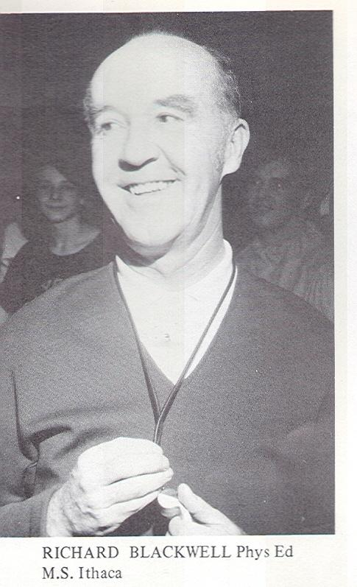

Slide 31
Maureen Nolan-Decillis

Slide 32
Maureen Nolan-Decillis
Maureen Nolan was a four-season athlete at Lyons Central School playing on the varsity teams for four years in basketball and track, and three years at the varsity level in soccer and volleyball. She made 1st Team All League for each of the four sports. Mo finished in 11th place her senior year at the State Qualifier for track in the long jump. Upon high school graduation in 1983, she received the Senior Female Athlete of the Year Award and the Lyons Teachers’ Association Scholarship.

Slide 33
Maureen Nolan-Decillis
At Ithaca College, Mo earned her B.S. in Physical Education while continuing her athletic endeavors in both soccer, as a forward, and track in the long jump, triple jump and 4x100 and 4x400 relay teams. During her sophomore year, her soccer team ranked 18th nationally and she became the school’s record holder for single game, season and career points. Collegiate honors included Dean’s List 1982-87. Mo furthered her education at SUNY Brockport with an M.S. degree in Health Education.

Slide 34
Maureen Nolan-Decillis
A two-sport student-athlete at Ithaca College from 1983-87, Maureen Nolan-Decillis was one of the top offensive soccer players in school history and a standout for track & field for three seasons. This earned her Induction into the Ithaca Athletic Hall of Fame Class of 2016 for Women's Soccer/Track & Field.

Slide 35
Maureen Nolan-Decillis
Maureen is married with one daughter and two step-sons.
Mo has taught physical education for 17 years, first at BOCES#1 Fairport and then Rush-Henrietta Central School. Post collegiate honors include 1995 Central Western Zone Adapted Physical Education Teacher of the Year, and in 2000 the Monroe County Division Girls Soccer Co-Coach of the Year. Her coaching experience for the last 17 years has been at East Rochester High School and Rush-Henrietta High School for field hockey, volleyball, basketball, soccer and track.

Slide 36
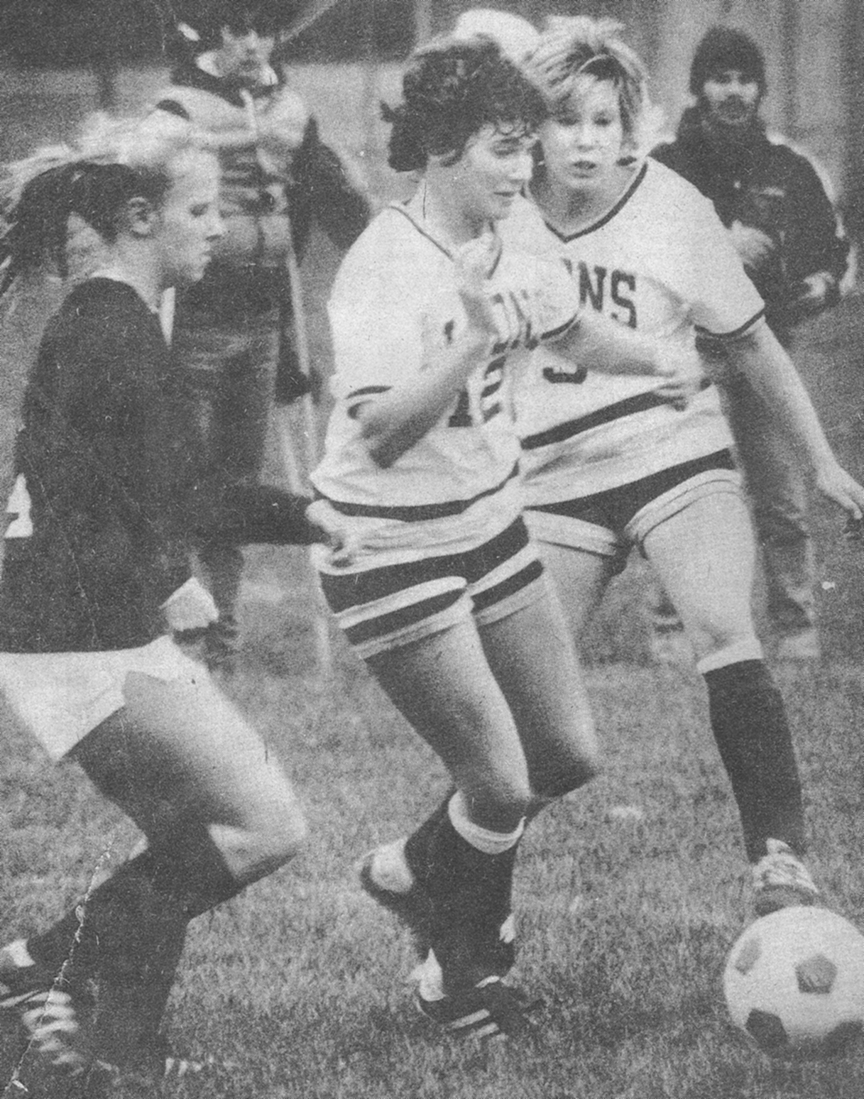
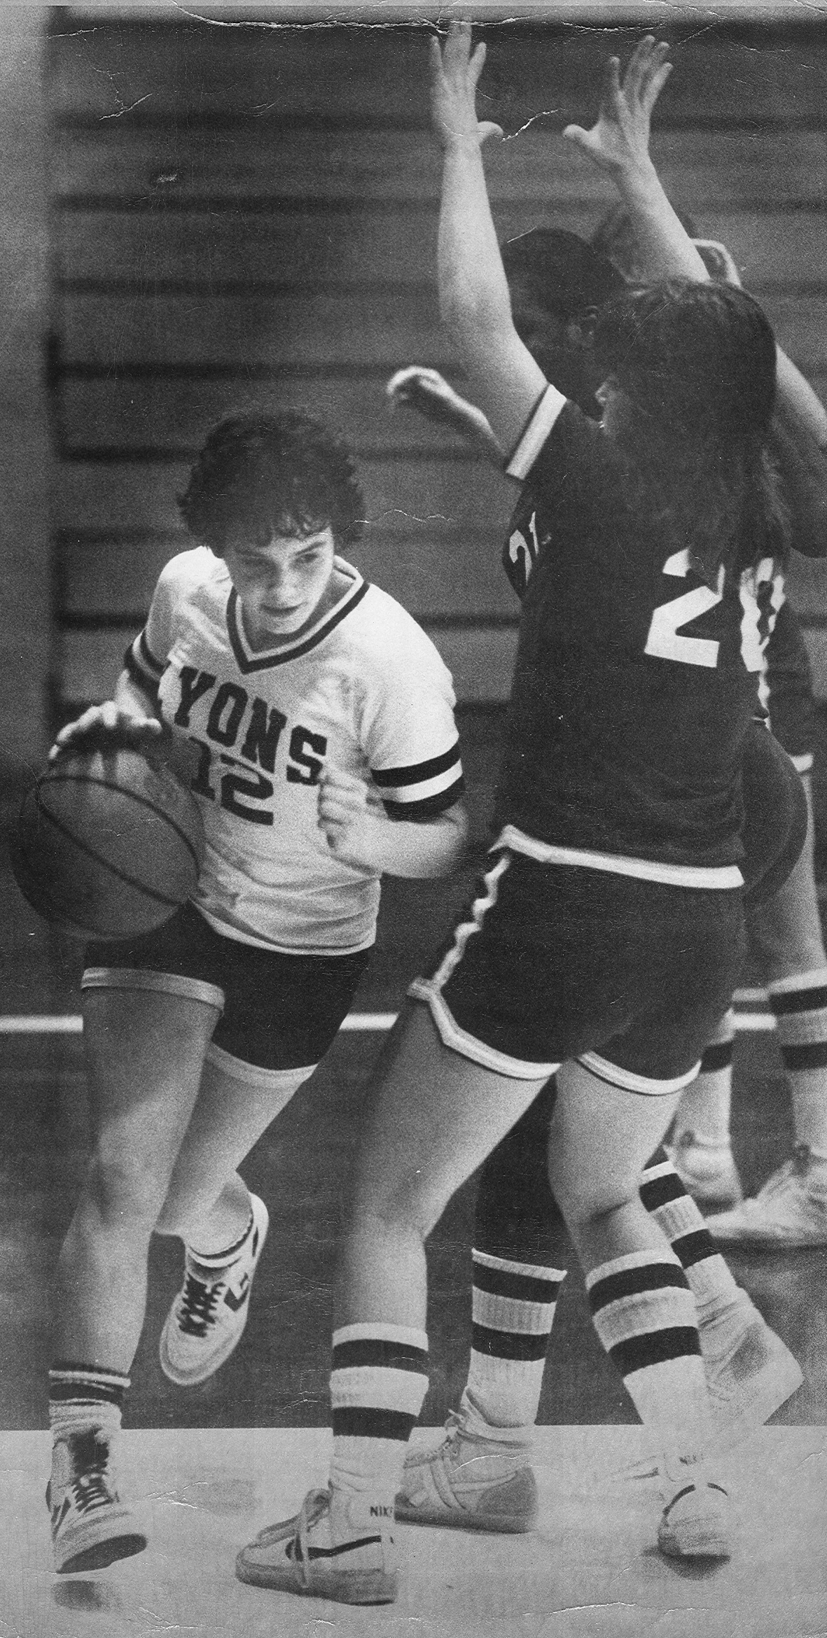
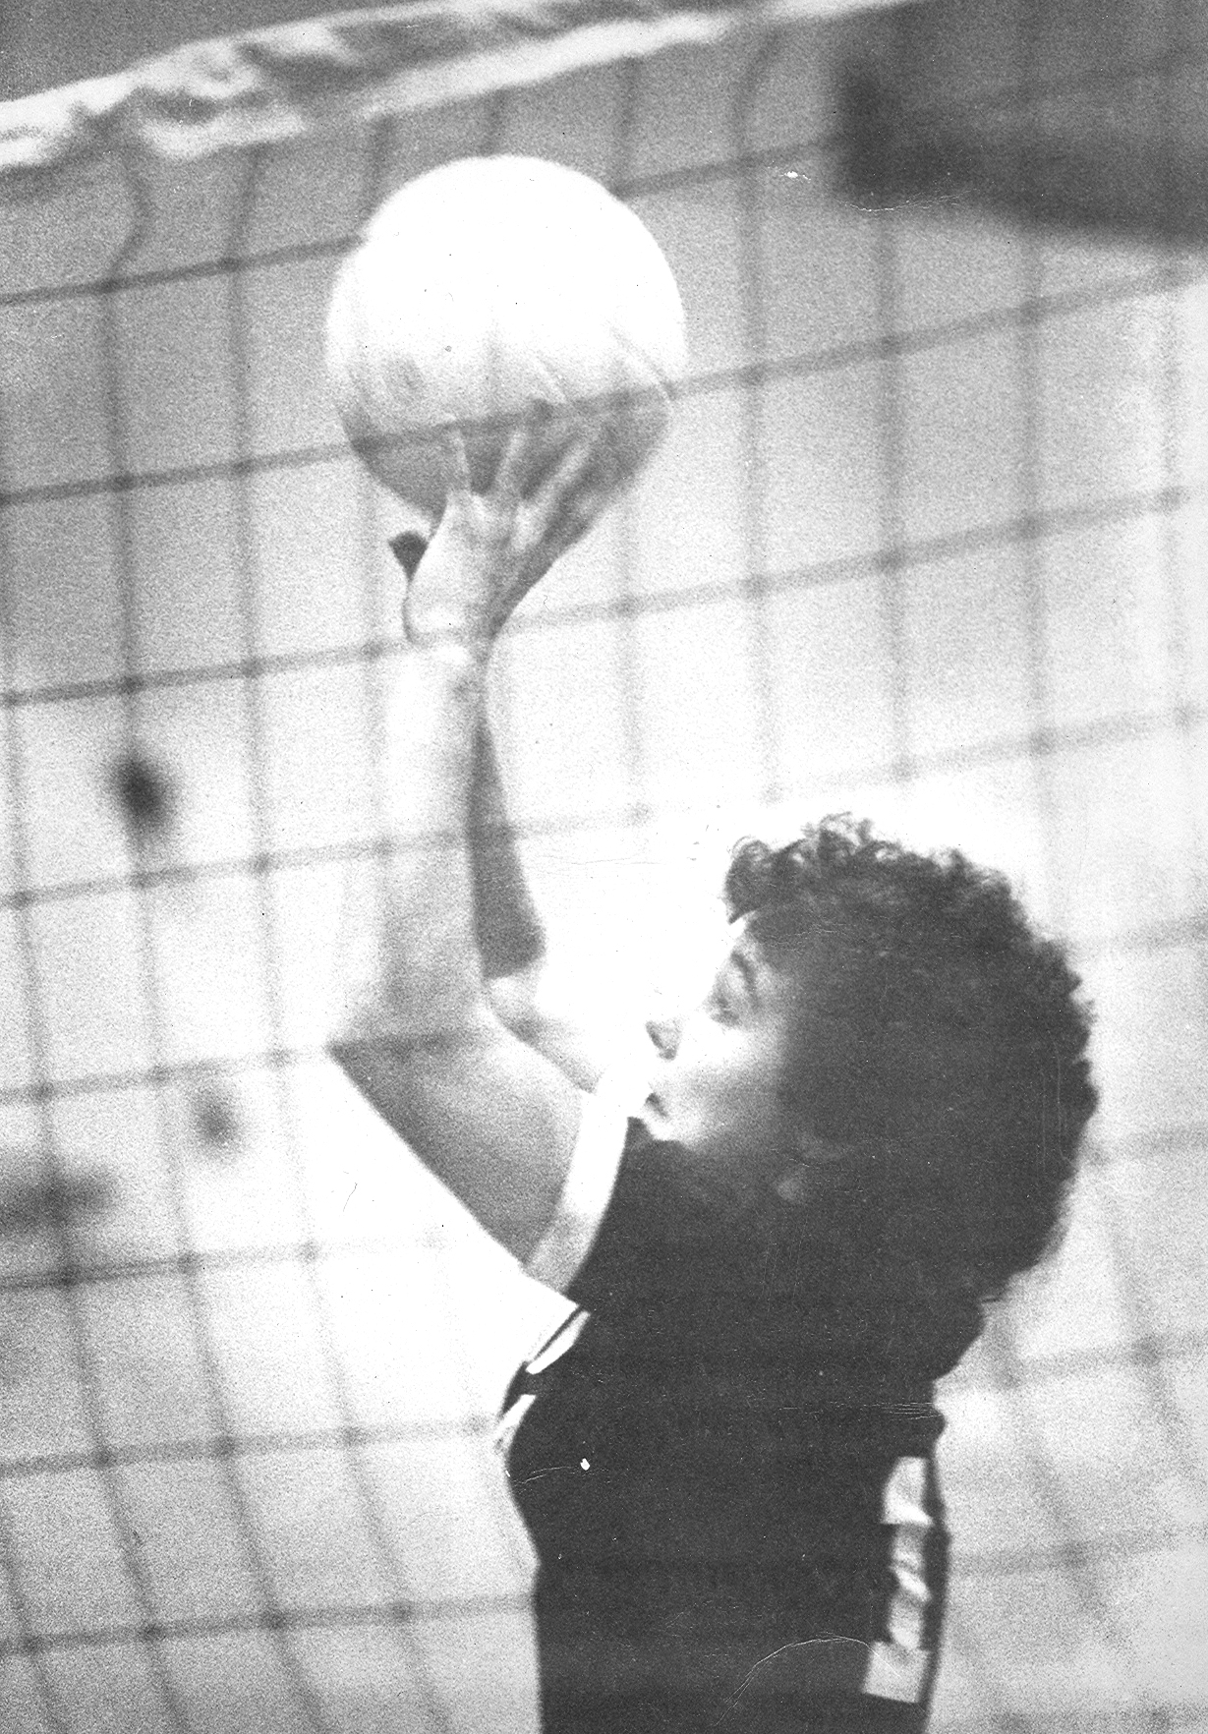
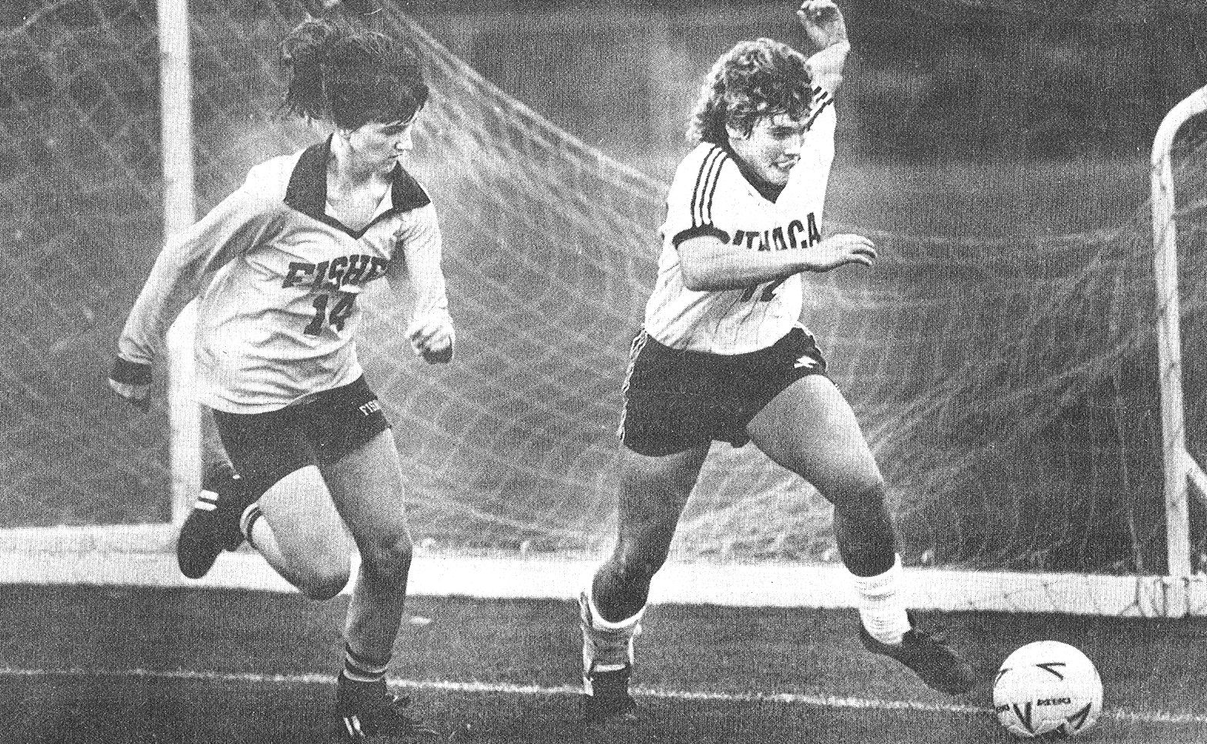

Slide 37
Class of 2005
Second Annual Athletic Hall of Fame Induction Dinner

Slide 38
Elbert S. Atwood

Slide 39
Elbert S. Atwood
Mr. Atwood began his teaching career at Lyons Central in 1929 as a physical educator. As coach for the football team, the Lions won eight Wayne County Football Championships. Under his guidance as a basketball coach, his teams won the Wayne County Basketball Championship six times during his 17 year coaching career. In Mr. Atwood’s final year of coaching in 1946, the Lions won the Tri-County Championship in basketball.

Slide 40
Elbert S. Atwood
Elbert took a leave of absence during the ‘46-47 school year with his wife and two children as they lived in Arizona and New Mexico. He returned to Lyons in the Fall of 1957 and resumed his vice-principal duties until his retirement in 1963.

Slide 41
Elbert S. Atwood
On February 13th, 1976, in commemoration of a faithful friend, and ideal coach, principal and educator, the Board of Education resolved that the Lyons High School Gymnasium be known as the Elbert S. Atwood Gym.

Slide 42
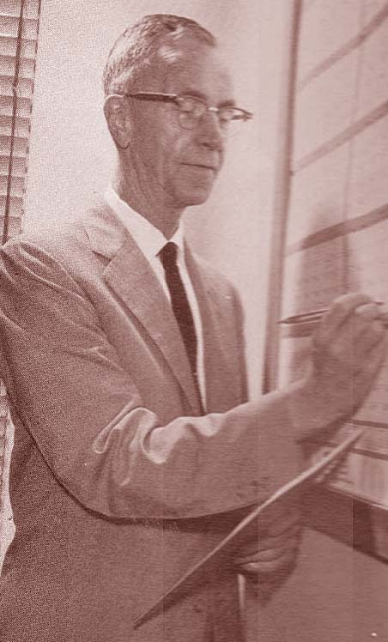
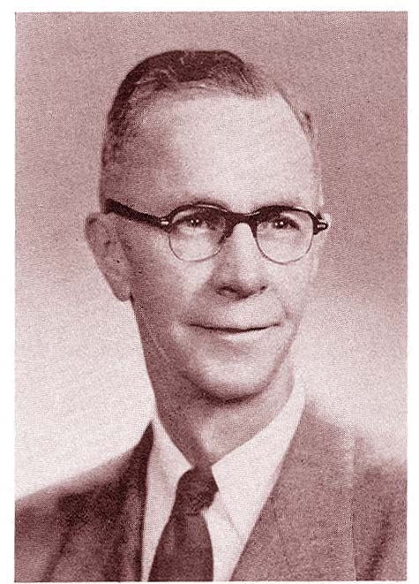

Slide 43
Myron Ohmann

Slide 44
Myron Ohmann
Myron Ohmann graduated from Lyons High School in 1934. He was a four sport letterman, including four years on the basketball team. As a player and team captain, Myron led his team to 30 out of 31 league wins in a three year span. One of the most memorable games for the team during that stretch was when he scored 15 points to lead Lyons against Sodus to clinch the league title.

Slide 45
Myron Ohmann
Myron was a two time Democrat and Chronicle Class A All-Star, as well as captain of the D&C’s “Dream Team”. At an All Star contest his senior year, he made 23 out of 25 free throws to share top honors. Myron was All-County in baseball, tennis and football. During his senior season of baseball, Myron had a perfect 1.000 fielding percentage.

Slide 46
Myron Ohmann
Myron was a four-sport varsity letterman at St. Lawrence University for football and baseball, and captained the basketball and tennis teams. For his accomplishments during his collegiate years, Myron was inducted into the St. Lawrence Athletic Hall of Fame in 1991. He attended graduate school at Columbia University for a year and a half until he was drafted to serve in the US Army in 1941. Myron was a member of the first convoy in the Pacific Ocean at the height of World War II, and served overseas until 1945.

Slide 47
Myron Ohmann
After years in family business, Myron taught math at Williamson Central for 23 years until his retirement in 1978. Myron lives in Lyons with his wife, Catherine, and is the the father of four children.

Slide 48
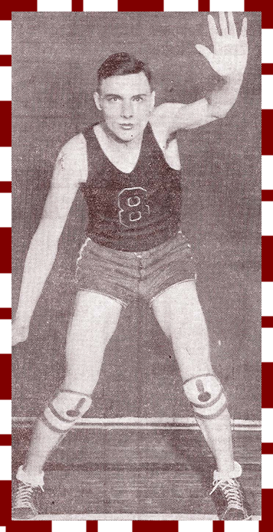

Slide 49
Nick DerCola

Slide 50
Nick DerCola
Nick DerCola lettered in four sports from 1942 until 1945. After his junior year of high school, he enlisted in the US Navy. He was honorably discharged and returned to high school for his senior year.

Slide 51
Nick DerCola
A stand-out athlete, Nick received ten varsity letters. He played three varsity seasons of football and captained the team his junior and senior years. The squad was the undefeated County Champion two years in a row. On the hardwood, Nick captained the basketball team, and was the catcher on the baseball team for three years.

Slide 52
Nick DerCola
After high school, Nick attended Ithaca College. He was awarded varsity letters for football, basketball and baseball. He garnered honorable Mention All-American honors for football. Nick was the 2nd leading hitter and leading base stealer for the baseball team his senior year.

Slide 53
Nick DerCola
After he graduated from college in 1951, Nick began a 32 year teaching and coaching career in Clyde. He coached varsity football, baseball, and both boys and girls basketball. As a football coach, Nick guided two football teams to sectional titles, three teams to undefeated seasons, and finished with a career record of 192-70-10. The football field at Clyde-Savannah is now named after Nick for his football accomplishments. He is the only coach in SEction V history to win titles in four different sports.

Slide 54
Nick DerCola
Along with this year’s induction, Nick was inducted into the Ithaca Athletic Hall of Fame in 1971, the National HIgh School Football Hall of Fame in 1985, the Section V Hall of Fame in 1998, and the Clyde-Savannah Hall of Fame in 2002.
Nick and his wife, Margaret, reside in Clyde and have five children and eleven grandchildren.

Slide 55
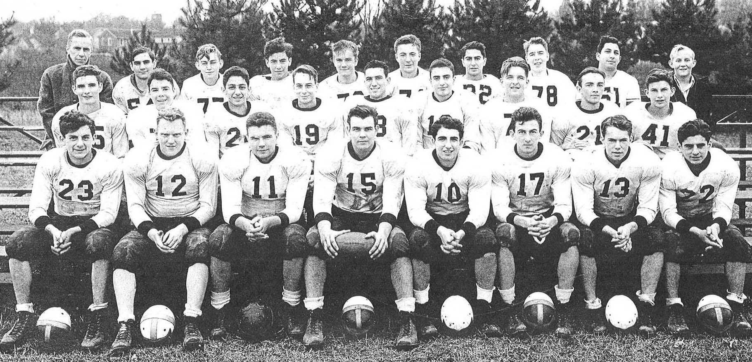
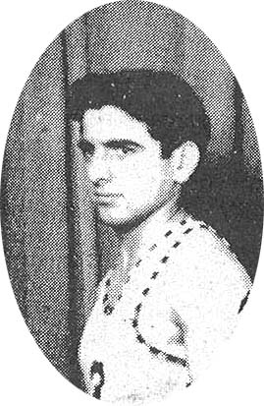
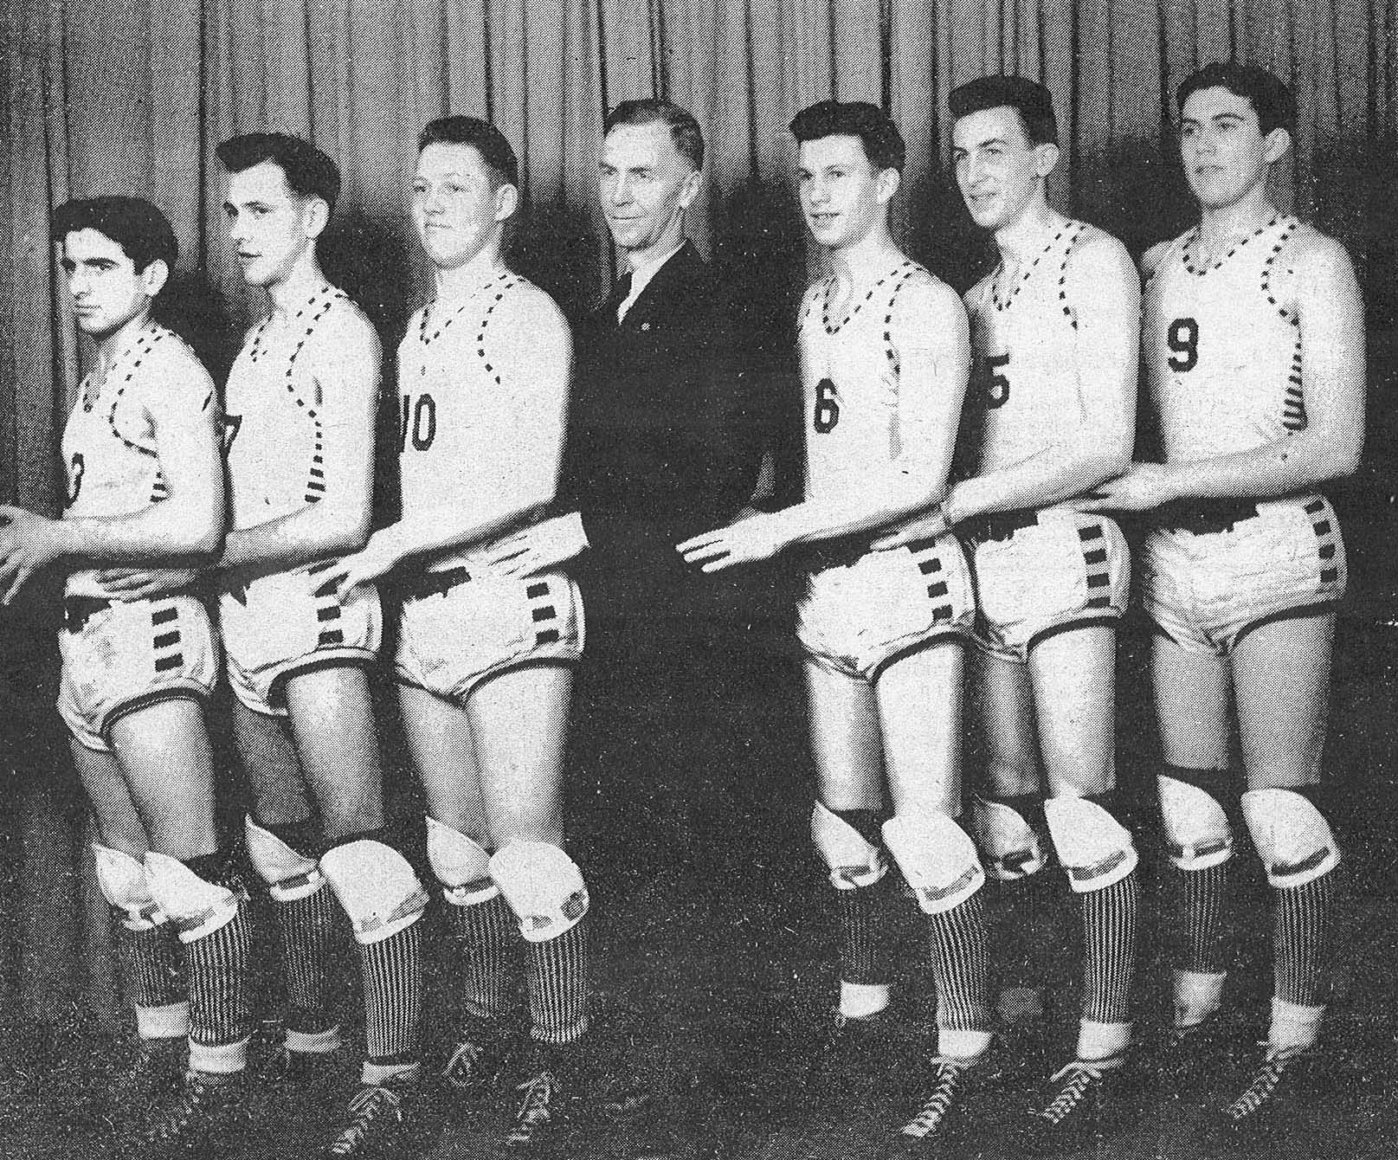

Slide 56
Bob Ohmann

Slide 57
Bob Ohmann
Bob grew up in Lyons and worked in his dad’s movie theater, selling tickets and popcorn and cleaning up the place. He was a member of the varsity football team for three years, and he also played basketball, baseball and tennis.

Slide 58
Bob Ohmann
After graduating in 1968, Bob studied marketing at Bryant & Stratton College in Buffalo, NY, but left school in 1970 and began wiring buildings for a contractor. He got a job as an assistant site supervisor in Buffalo for Virginia-based Ryan Homes in 1972 and worked his way into a sales job in 1976. He was hired by Key Homes out of Raleigh in 1983 as vice president. Bob started St. Lawrence homes in 1989 and the company was runner up Small Business of the Year for the state of North Carolina in 2003.

Slide 59
Bob Ohmann
The Lyons School District has been the beneficiary of many outstanding gifts from Bob over the years. He donated funds for a new Fitness Center at the High School in 2002. Other contributions include lights for the sports fields, press boxes, score clocks, concession stands, wrestling mats, and numerous upgrades for all athletic fields just to name a few.

Slide 60
Bob Ohmann
Bob has also purchased uniforms and warm ups for many of the sports teams at Lyons. Several local players have been sent to the North Carolina Wolfpack Youth Football Camp and last spring he hosted the varsity baseball team during their spring trip to North Carolina.

Slide 61
Bob Ohmann
Bob was instrumental in the development of the new Lyons Community Center that opened this past summer. His generous contributions to the town he grew up in include funding for youth sports, local churches, the Lyons Fire Department, Wayne County Literacy, and the Lyons Public Library.
Bob lives in Raleigh with his wife Leslie and their two children.

Slide 62
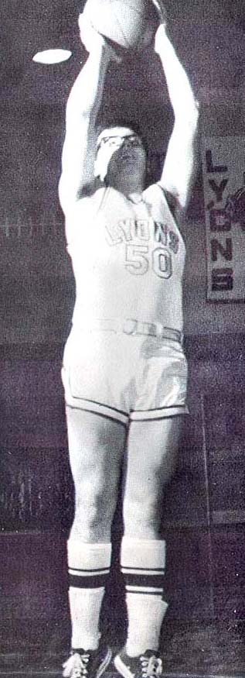
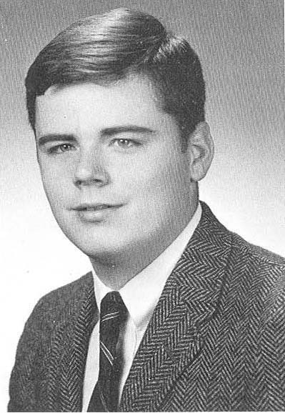
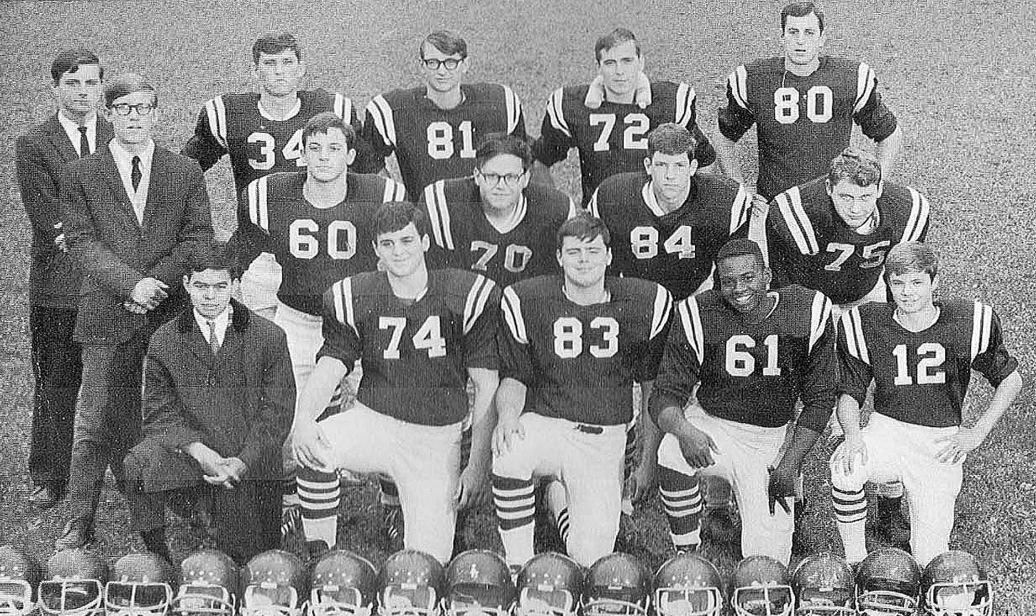

Slide 63
Roger Bernhardt

Slide 64
Roger Bernhardt
Roger played four years on the varsity basketball and football teams, and ran track his senior year. As a member of the basketball team his freshman year, his team won the league title during Coach Blackwell’s final season as head coach. Roger was named to All-League teams for basketball and football.

Slide 65
Roger Bernhardt
After he graduated from high school, Roger moved on to Butler Community College in Kansas where he played two years of football. He started his college career at tight end, but was moved to guard to help bolster the offensive line. After junior college, Roger transferred to Kansas University and played football for two more seasons. After his senior season in 1973, Roger’s tremendous play earned him spots in the Blue-Grey Game and the Senior Bowl that are still considered the most prestigious college All-Star games in the country.

Slide 66
Roger Bernhardt
After college, the Pittsburgh Steelers took Roger in the third round of the 1973 NFL draft. He became only the second player from the Wayne-Finger Lakes conference to be drafted into the NFL. Roger then moved on to play with the Jets in 1974 and the Chiefs in 1975. An unfortunate knee injury against the Denver Broncos in 1975 ended his NFL career.

Slide 67
Roger Bernhardt
Roger lives in Lawrence, Kansas and is the father of four children. He is a car manager in nearby Kansas City.

Slide 68
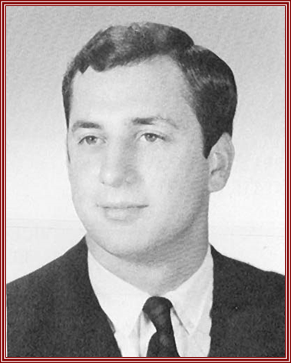
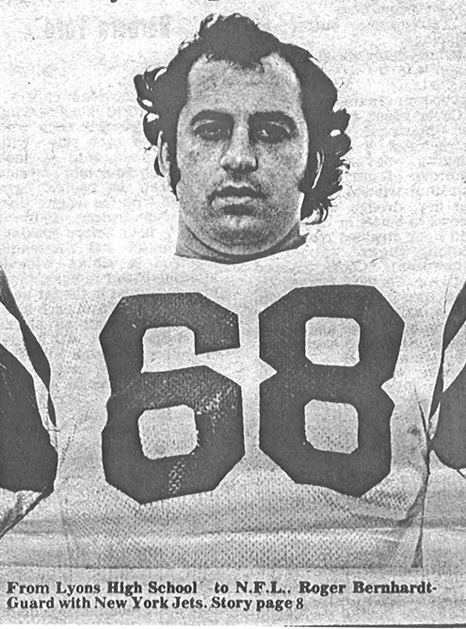

Slide 69
Pat Maddock

Slide 70
Pat Maddock
Pat Maddock was a 1977 graduate of Lyons Central School. During his high school years at Lyons, Pat was a three sport athlete in football, wrestling and baseball.

Slide 71
Pat Maddock
Pat was an All-Conference fullback for three years and led his team to the Wayne-Finger Lakes crown twice. He was the leading scorer in Section V with 17 touchdowns his senior year to lead Lyons to an undefeated league season. Pat finished his outstanding football career in lyons with 34 touchdowns and 2194 yards. His accomplishments yielded him 4th Team All State status, and he was names as one of the top 100 New York All Stars by the state’s sportswriters.

Slide 72
Pat Maddock
In addition to his football success, Pat had a career record of 25-5 and was a runner up in Sectionals his senior year as a wrestler. In the spring he produced on the diamond, where he became an All Conference outfielder for the baseball team.

Slide 73
Pat Maddock
Pat went on to play college football at Upper Iowa University. He was the first running back in school history to rush for more than 1,000 yards his junior season. Pat holds records for the most rushing yards in a season (1166), most career rushing yards (3042) and finished with 33 career touchdowns. In 1991, Pat was inducted into the Upper Iowa University Athletic Hall of Fame.

Slide 74
Pat Maddock
As the wrestling coach in Lyons from 1984-1990, Pat had six wrestlers win Sectional Championships. He also coached JV Baseball and football and was the offensive coordinator for the Lyons football team when they won back-to-back titles in 2002 and 2003.
Pat resides in Lyons with his wife Lauren and their three children.

Slide 75
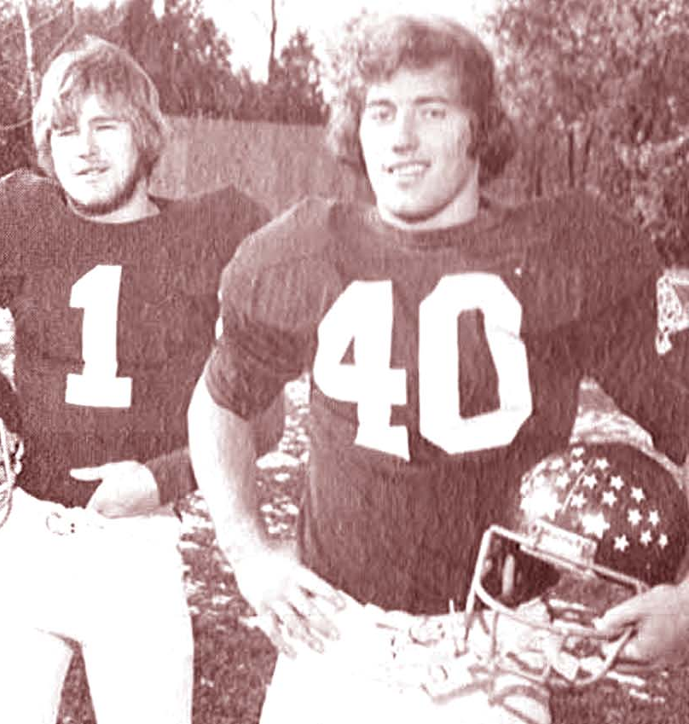
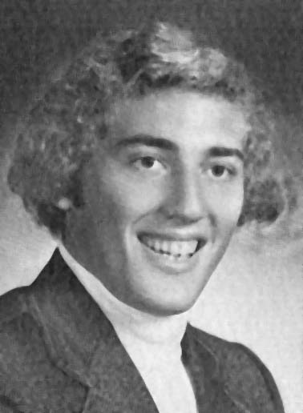

Slide 76
Michelle Lewis Logins

Slide 77
Michelle Lewis Logins
Michelle graduated as one of the most accomplished athletes to attend Lyons. She earned 11 varsity letters, including five in outdoor track and field. As a soccer player she earned 2nd Team All-League honors and won the Outstanding Offense award. As a senior she helped lead the lady Lions volleyball team to an undefeated county season.

Slide 78
Michelle Lewis Logins
In outdoor track and field, Michelle won numerous Wayne County Championship shields beginning as a freshman in the 100 and 200 meter dash, as well as a member of the 4x100 relay team. As a sophomore she duplicted her county seeps in the three events and qualified for States in the 100 meter dash. She was a member of the 4x100m relay team that won the New York State Championship.

Slide 79
Michelle Lewis Logins
In 1984, Michelle competed in the International Sports Exchange in Cologne, Germany, where she was named Most Outstanding Athlete in America. She was a State Qualifier in the 100m dash again as she led the team to another county crown. On the track during her senior year, she broke the school and county records in the 100m dash. She also broke the Section V Class C record in the 200m dash and was part of the Sectional winning 4x100m team. Michelle was name Lyons Female Athlete of the Year for both her junior and senior years.

Slide 80
Michelle Lewis Logins
After graduating from Lyons, Michelle enrolled at Ithaca College where she broke the school records in the 100m and 200m dash as a freshman. She won ECAC Division III Indoor and Outdoor Championships in three events and was named Division III All-American in both indoor and outdoor track and field.

Slide 81
Michelle Lewis Logins
Michelle currently resides in Newark with her two children. She is employed by Finger Lakes DDSO and has been a minister at the Mt. Zion Missionary Baptist Church since 1999.

Slide 82
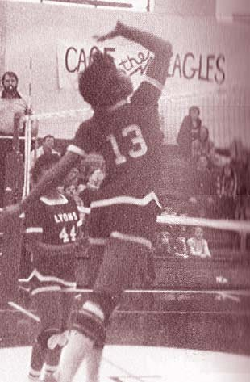
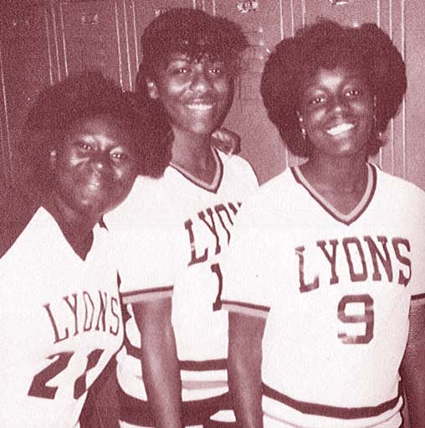
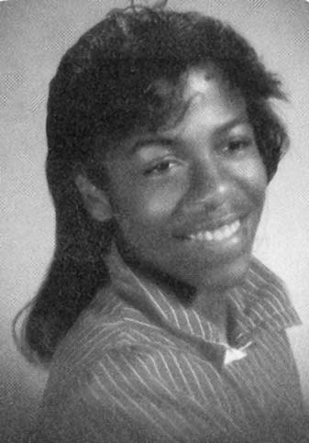

Slide 83
Class of 2006
Third Annual Athletic Hall of Fame Induction Dinner

Slide 84
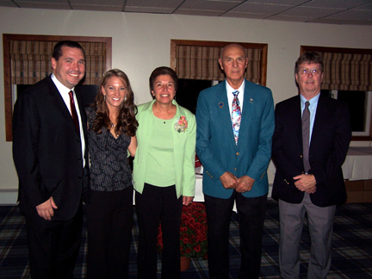
Inductees:
Albert Stoetzel
Nick Forgione
Joseph Holly
David MAine
Peter Sollenne
Mark Wetmore
Kristin Schott
Mary Lou Wheat

Slide 85
Albert “Buzz” Stoetzel

Slide 86
Albert “Buzz” Stoetzel
Buzz Stoetzel was a lifelong Lyons resident and pillar of the community. He is renowned for his tireless support and championing of the community. He was known throughout the county for his weekly article that included photographs and stories of the history of Lyons and its people. Buzz Stoetzel’s Scrapbook ran for twenty years in the Wayne County Star.

Slide 87
Albert “Buzz” Stoetzel
Buzz actually got started in the newspaper business after graduating from Lyons Union School in 1934. Buzz worked for Joe “Scoop” Berdel at the former Lyons Republican from 1934-36. He then worked nearly 40 years for the railroad prior to his start at the Wayne County Star in 1980. The Wayne County Museum has displayed a great collection of his research and photographs. His articles have contributed to some biographies for the dinner program for the Lyons Athletic Hall of Fame.

Slide 88
Albert “Buzz” Stoetzel
Known as “Mr. Baseball of Lyons” to many people, Buzz coached in many local leagues and spent several years as manager of the Little League’s Red Sox. He never tired of attending Lyons High School athletic events and was recognized in 1982 as “Lyons #1 Fan”.
Mr. Stoetzel passes away in June of 2005 and is survived by his two sons, Robert and Jim, and his four grandchildren.

Slide 89
Nicholas “Buck” Forgione

Slide 90
Nicholas “Buck” Forgione
Nicholas “Buck” Forgione was one of the most outstanding athletes during an era of great Lyons High School teams. He played four years of varsity baseball and football, and three years of varsity basketball. While in high school, Buck played on nine League Championship teams.

Slide 91
Nicholas “Buck” Forgione
In football, Buck was a powerful runner that could go inside as well as outside. He was the punter and placekicker. He was the team’s leading scorer and a 1st Team All Wayne-Finger Lakes League selection.
In basketball he was a prolific scorer. Buck’s accomplishments included captain of the Wayne-Finger Lakes League All Star Team, the league’s leading scorer, selection to the Democrat & Chronicle Class A Sectional All Star Team and named to the All Greater Rochester First Team.

Slide 92
Nicholas “Buck” Forgione
After high school, Buck continued to excel in sports. He was an outstanding bowler and a former Wayne Hills Country Club Champion. Buck also officiated football for 30 years. He served in the Korean War and was awarded the Purple Heart and numerous other medals.

Slide 93
Nicholas “Buck” Forgione
Buck married his highschool sweetheart, Cecilia Schraffenberger, and together they raised three daughters and one son.
Buck has held the position of Lyons Village Justice for the past 23 years. He previously was a member of the Lyons Board of Education, serving as both president and vice president.

Slide 94
Joseph Holly

Slide 95
Joseph Holly
Joe was a standout football player who eventually earned a pro tryout. His playing days at Lyons included two seasons on the varsity baseball team as a second baseman. Joe’s three years of varsity basketball will be remembered for dominant rebounding. His play on the football field is where Joe is remembered most. He played varsity for three years and served as co-captain during his junior and senior seasons. Joe credits Coach Burroughs and Coach Blackwell for modeling the lessons he learned during his years at Lyons Central.

Slide 96
Joseph Holly
Following graduation in 1962, Joe accepted a football scholarship from the University of Buffalo. He played four years of college football and served as captain of the 1965 squad. Joe’s position coach at UB was Buddy Ryan, who would later gain fame as the Defensive Coordinator of the World Champion Chicago Bears and as head coach of the Philadelphia Eagles.

Slide 97
Joseph Holly
After graduation form UB in the spring of 1966, Joe signed a free agent contract with the San Diego Chargers for the American Football League. Following his release from the Chargers later that summer, he began a career in the Binghamton City School District that would last for 36 years. Joe taught high school Social Studies and coached football, basketball and baseball for eight years before joining the administrative staff. Joe’s final years in education included HIgh School Principal and Director of Pupil Services.

Slide 98
Joseph Holly
Joe married former Lyons graduate Lorrie Gruschow in 1970 and together they raised two children who both work in education. He and his wife are enjoying retirement in Binghamton.

Slide 99
David Maine

Slide 100
David Maine
Dave played varsity basketball and baseball for the Lions. As a member of the basketball squad, Dave was a guard for Coach Blackwell’s teams that went 37-3 in two seasons. He was named Honorable Mention All Wayne-Finger Lakes after his senior season.

Slide 101
David Maine
As a pitcher for the baseball team, Dave was a member of consecutive Wayne County Champions in 1960 and 1961. The 1960 championship team defeated Newark 4-2 late in the season to clinch the title. The marathon game lasted three hours at Perkins Field where Dave had a run producing double in the 12th inning that secured the victory. The 1961 team went 11-3 to secure their second straight county title.

Slide 102
David Maine
AFter graduation, Dave went to Providence College where he played baseball in 1965 and 1966. He returned to Lyons and coached the American Legion team in 1967 foreshadowing his years to come.

Slide 103
David Maine
Dave was hired by Manchester-Shortsville Central Schools in 1970 and embarked on a 22 year career teaching Social Studies. During his coaching tenure, his teams compiled an impressive 354-178 record. His teams were Finger Lakes West Champions ten times and won five Section V titles between 1974 and 1999. Dave was inducted into the Manchester-Shortsville Sports Hall of Fame in 2004.

Slide 104
David Maine
Dave lives in Canandaigua with his wife Mary and son Corey. His nephew John is a starting pitcher for the 2006 Division Champion New York Mets.

Slide 105
Peter Sollenne

Slide 106
Peter Sollenne
Peter is considered one of the most talented basketball players to have donned a Lyons Lions uniform. He was 1st Team All-League for three years under legendary basketball coach Dick Blackwell. He was the individual scoring leader in the league during his junior and senior seasons. Following the completion of his senior year, he was voted High School Prep All-American by Coach and Athlete magazine.

Slide 107
Peter Sollenne
As one of Lyons most heavily recruited athletes, Peter was offered numerous scholarships. He committed to Boston College under the guidance of NBA Hall of Famer Bob Cousy, who coached the Eagles for six years in the mid 1960’s. Peter played four years of basketball at Boston College and was a member of teams that reached the NIT Finals and the NCAA Regionals in consecutive years.

Slide 108
Peter Sollenne
Peter resides in California and has been married to Patricia Gravino for 27 years. They have two children, Justin and Kristin.

Slide 109
Mark Wetmore

Slide 110
Mark Wetmore
Mark was a very accomplished runner during his high school and college years. HIs dedication to running today has made him renowned in the world of track and field.

Slide 111
Mark Wetmore
Mark was a member of the varsity track and field, cross country and bowling teams throughout high school. Mark was the Wayne County League Champion in cross-country and competed in the NYS Championships in 1980. He graduated with four school records for track and field, three of which still stand today. He was named MVP for both track and cross country and was named Most Outstanding Performer for track.

Slide 112
Mark Wetmore
After graduating as Valedictorian of his class n 1981, Mark aggended Cornell University where he was a four year member of the varsity cross-country, indoor track and outdoor track teams. He graduated in 1985 with a degree in HIstory and then attended Boston University’s School of Law, graduating in 1991. Mark has been a member of the Massachusetts’ Bar and US Supreme Court Bar since 1991.

Slide 113
Mark Wetmore
After a few years as a defense attorney, Mark started Global Athletics & Marketing, Inc. in September of 1993. The company is one of the leading athletic representation and event-marketing firms in the world. As President and CEO, his company manages more than 70 athletes from 11 countries, two-thirds of whom competed at the 2004 Summer Olympics, winning an impressive ten medals, including six gold. Its clientele has included more than two dozen Olympic and World Championship medalists as well as four World Cross Country champions and winners of 13 major international marathons.

Slide 114
Mark Wetmore
Mark’s company also produced the Reebok Boston Indoor Games, an annual event telecast on ESPN for the past eleven years. This event is known as one of the premier indoor meets in the world. In 2007, GM&A will produce the most prestigious track meet in the world as the Millrose Games celebrates its 100th Anniversary, which will telecast on NBC.

Slide 115
Mark Wetmore
Mark lives in Boston, although he spends more time traveling across the world promoting athletes and events. Mark’s donation of new track and field uniforms to the school last year reinforced the bond he still has with his alma mater.

Slide 116
Kristin Schott

Slide 117
Kristin Schott
Kristin was an all-league performer in basketball and track during her high school years at Lyons Central and made 2nd Team All-League in soccer her senior year. Her basketball accomplishments set the standard at Lyons where she graduated as the school’s all-time leading scorer with 1,187 career points. Kristin was team MVP twice, was named 1st Team All-League for three years and participated in the Ronald McDonald All Star game her senior year. She was also named All-Greater Rochester Honorable Mention twice.

Slide 118
Kristin Schott
Kristin’s varsity career in track began as a seventh grader and ended with multiple all-league honors and five individual Section V Class C Championships, two in the 400m, two in the 800m, and one 400m hurdles title. She was named Most Outstanding Performer during her junior and senior years. Kristin was a well-rounded student who was a member of National Honor Society, student council, chorus and participated in three musicals.

Slide 119
Kristin Schott
Following graduation, Kristin headed to Guilford College in North Carolina where she played soccer and basketball and was named Most Improved in both after her freshman year. She played one more year of soccer, but was the starting point guard for the basketball team all four years. Kristin still holds the school record for three-point percentage in a season.

Slide 120
Kristin Schott
Kristin’s love of sports continues as she serves as Physical Education teacher, Athletic Director ad Varsity Girls basketball coach at Saint Pius X High School in North Carolina. She also serves as league director and is president of the Lady Gators AAU Basketball Organization.

Slide 121
Mary Lou Wheat

Slide 122
Mary Lou Wheat
Mary Lou Carlineo Wheat taught in the lyons Central School District from 1970 until 2003. During her tenure at Lyons, starting with the 1971-72 school year, she was instrumental in the founding of the Girls Athletic Program not only at LCS but also in Wayne County.

Slide 123
Mary Lou Wheat
Mary Lou was the first coach for the Lady Lions soccer team, winning the League Championship in 1972. The early era of the girl’s basketball team did not lose in their first two seasons and won three consecutive league championships with Coach Wheat at the helm. Under her guidance, the Lady Lions won the school’s first League Championship in track. During her career she also led the cheerleading squad and coached the volleyball team, which reached two Section V Finals.

Slide 124
Mary Lou Wheat
As a teacher, Mary Lou was twice recognized as Lyons Teacher of the Year and had the LCS Yearbook dedicated to her in 2003. She was involved in the development of the modern day approach to Physical Education, which included the implementation of lifetime sports and introduction of Project Adventure, resulting in the creation of a climbing wall in the Atwood Gymnasium. She also served as president of the Lyons Teachers Association for more than ten years.

Slide 125
Mary Lou Wheat
Mary Lou remains in Lyons where she is enjoying retirement with her husband Ron. They have two children, Kelly and Casey.

Slide 126
Class of 2007
Fourth Annual Athletic Hall of Fame Induction Dinner

Slide 127
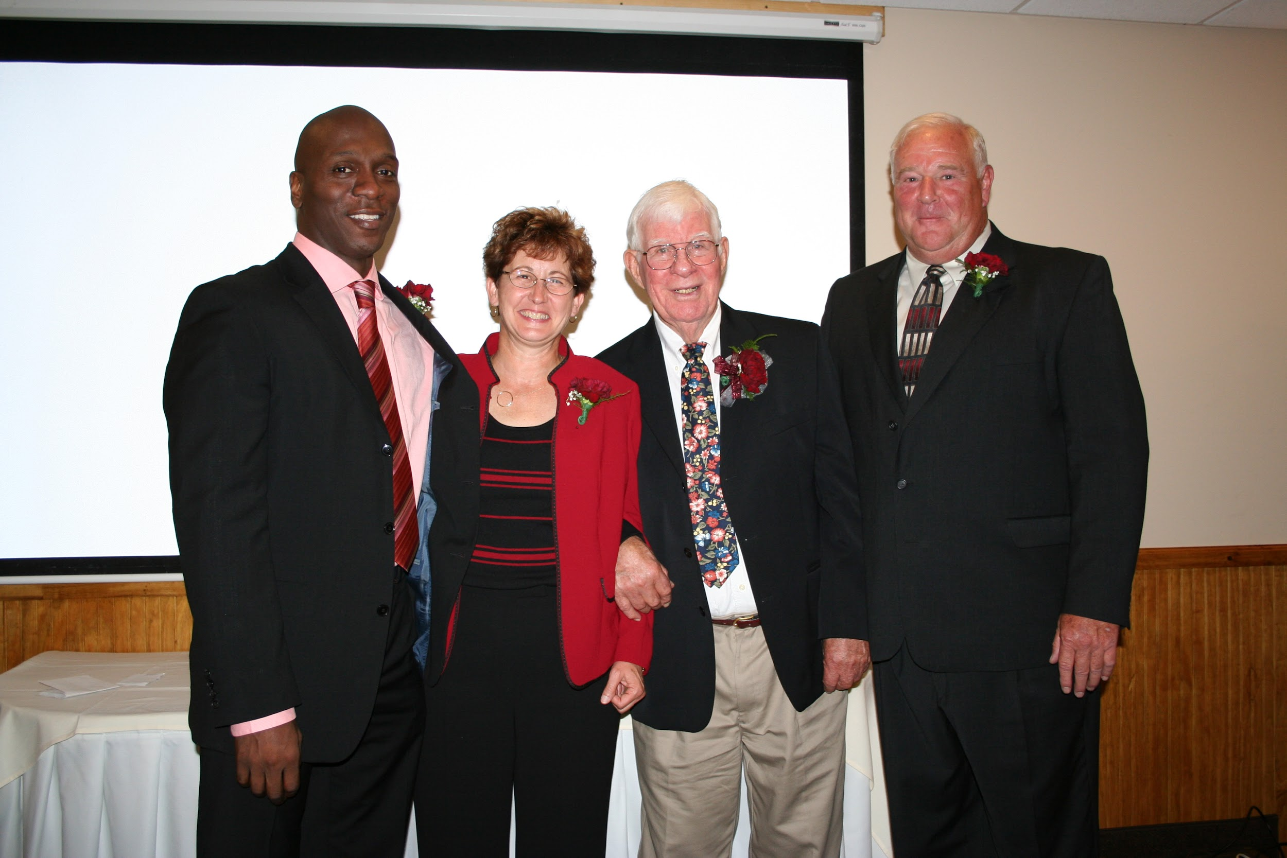
Inductees:
Chuck Austin
Lee Boice
Anne Dapolito
Collier Drayton
King Lewis Jr.
Rod Verkey
74-75 Boys Basketball Team

Slide 128
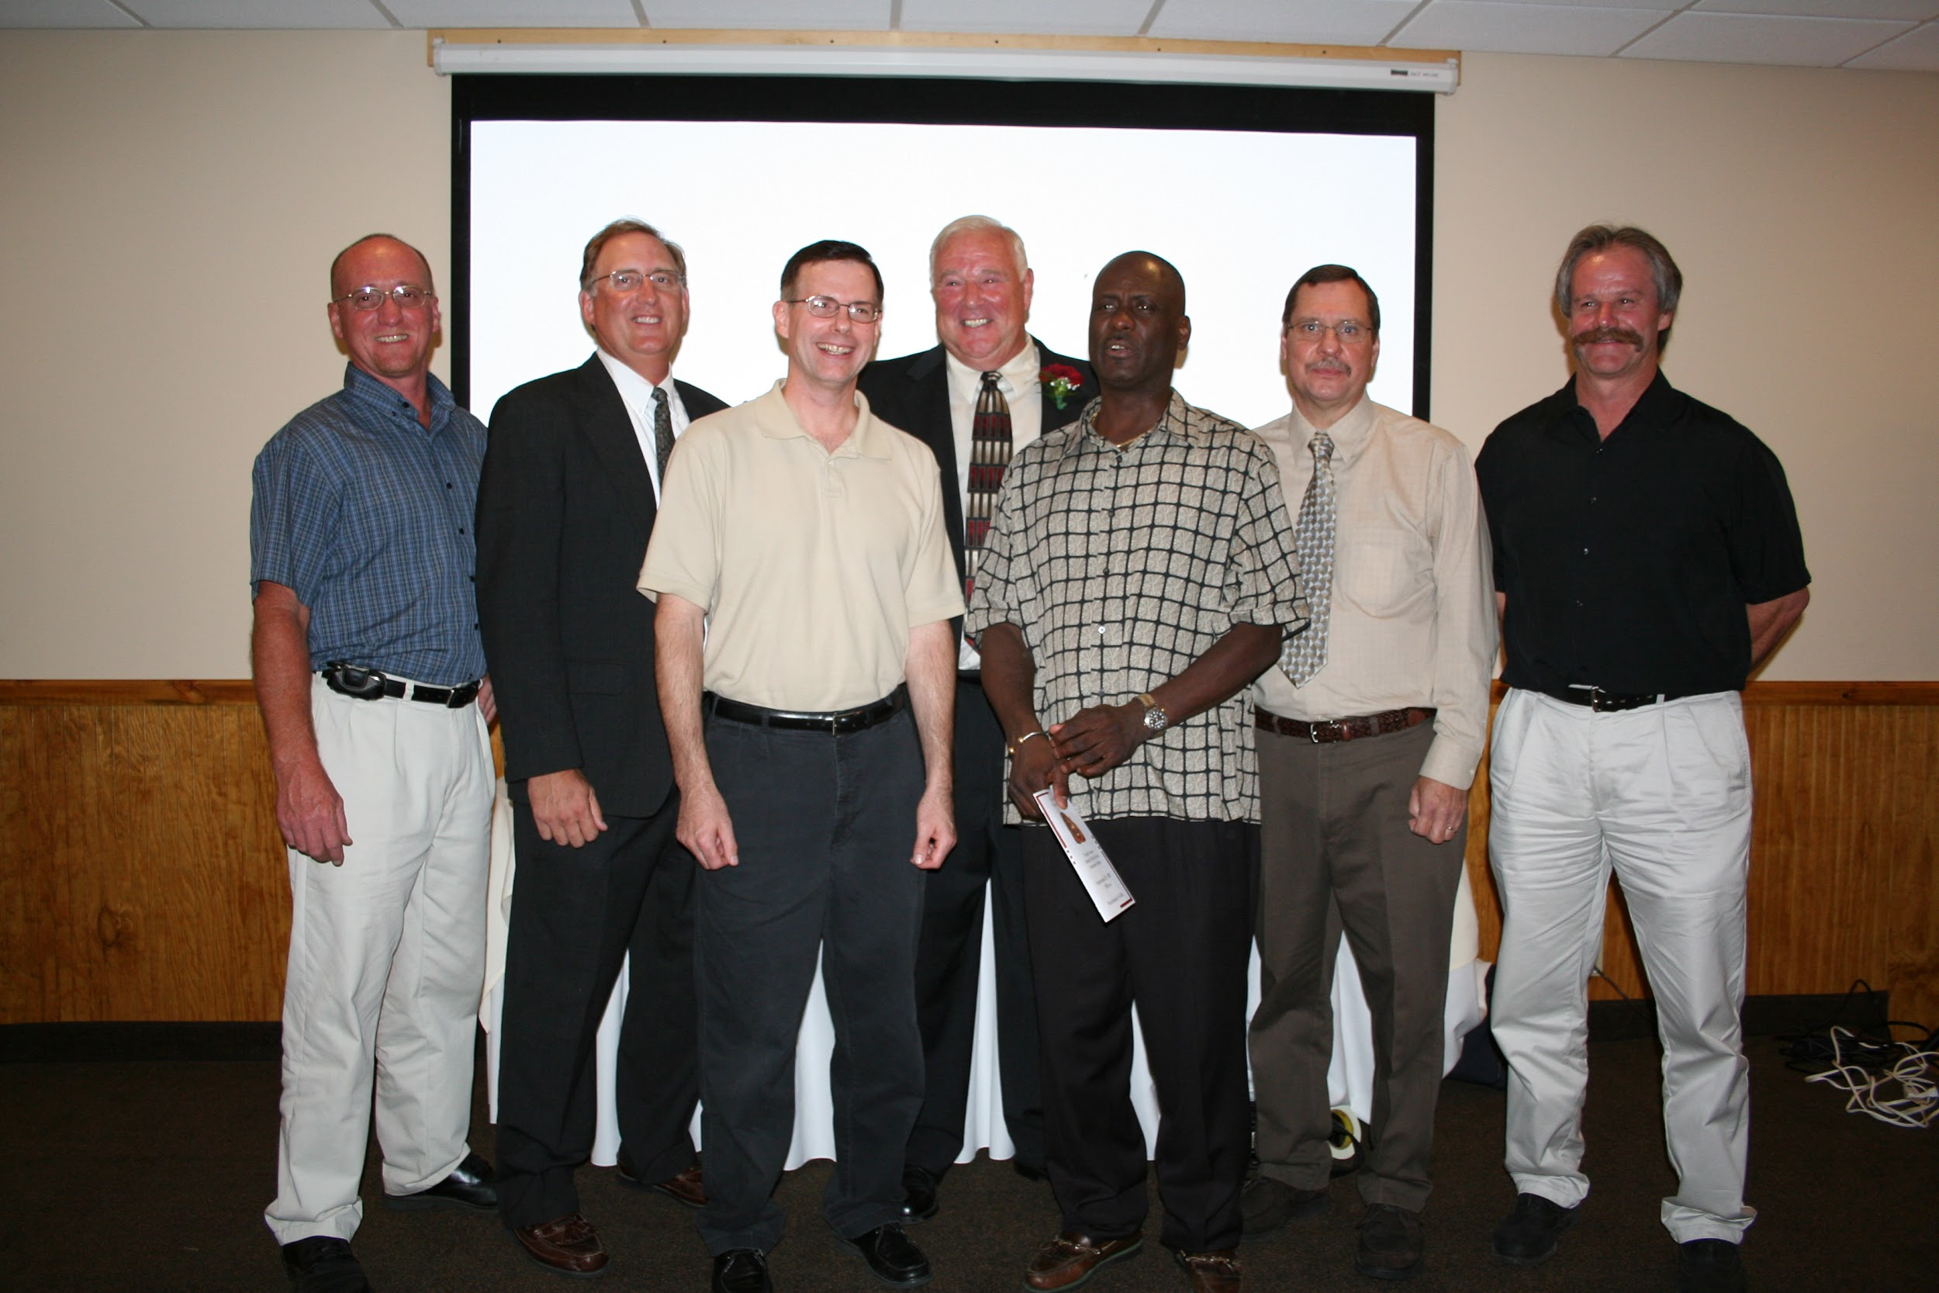

Slide 129
Chuck Austin

Slide 130
Chuck Austin
Chuck Austin started his high school basketball career as a freshman in 1949 and played varsity basketball from 1950-52. Chuck was an extraordinary player, teammate, and captain of his team. In 1952, the team went on to win the first Sectional crown playing against East Rochester as Chuck scored the tieing basket, taking the game into overtime. It was said that Chuck was “20 years ahead of his time.”

Slide 131
Chuck Austin
Chuck was employed at Clifton Springs Hospital. He was an exceptional artist and he make many of the hospital signs. He formed a sign company, Cla-Vet Signs, and many of his signs can still be seen around Wayne County.

Slide 132
Chuck Austin
Chuck was married to his wife for 43 years and had three daughters, Valerie, Vanessa, and Vaun. He also had two grandchildren, Christopher and Cara. Chuck passed away in 1997 and left behind his kindness, a unique sense of humor, and many memories. A Basketball Memorial Award has been established in his name for the most deserving Lyons high School senior boy and girl on the basketball team.

Slide 133
Lee Boice

Slide 134
Lee Boice
Lee Boice graduated from Kingston High in 1943. He played football for three years and golf for four. After high school, Lee served in the Navy for three years during World War II. He served on the USS Charger, Ticonderoga, Randolph and Princeton where he earned the American Theatre Medal, the Victory Medal, the Philippine Liberation Medal, and the Asiatic Pacific Medal with three stars.

Slide 135
Lee Boice
After serving in the military, Lee attended Ithaca College where he graduated with a B.S. in Physical Education and Health. While at school, he played football and golf, including a season with the undefeated golf squad. Lee took graduate classes at Syracuse and Ithaca while working in the Lyons Central School District.

Slide 136
Lee Boice
Lee taught at Lyons from September of 1949 until June of 1983. He originally worked as the 9th grade Social Studies teacher, but he wore many hats during his tenure at Lyons. He was the coach of the football, golf, basketball, bowling, wrestling, and tennis teams. Additionally, Lee served as athletic director for a time.

Slide 137
Lee Boice
Lee also served as president of the Lyons Teachers Association, president of the Wayne County Athletic Association secretary/treasurer of the Wayne Finger Lakes Football Association, and a Section V Wayne County Football Representative.He has been involved with St. Michael’s Church Council, the Lyons Community Center board, the Sodus Bay Junior Sailing Association Board, and has been a life member of the PGA of America. In 1980, Lee and his wife Mary were named Chamber of Commerce Citizens of the Year for their outstanding contributions to the community.

Slide 138
Lee Boice
Lee has been married to Mary for 61 years. They have raised eight college-educated children together. Lee says that Lyons was “blessed with a lot of fine coaches and teachers,” and that he commends Lyons for the preparation of his children because it let them “further their education and be successful.”

Slide 139
Anne P. Dapolito

Slide 140
Anne P. Dapolito
Anne P. Sapolito graduated from Lyons High School in 1974. Throughout her life, she has been a strong athlete and a successful coach. During her high school years, Anne received the MVP award for girls’ varsity track, soccer and basketball. She was also the first recipient of the Female Athlete of the Year Award in 1974 and was a member of the first girls’ interscholastic soccer and basketball teams. Additionally, Anne was a scholar athlete and was in Honor Society.

Slide 141
Anne P. Dapolito
After college, Anne began her teaching and coaching career at Lyons Jr.-Sr. High School as a teaching assistant from 1979 to 1984. During those years at Lyons she was the girls varsity basketball coach and the Junior High track coach. Since leaving Lyons Central School District, Anne has taught physical education at North Rose Wolcott Central School District.

Slide 142
Anne P. Dapolito
Anne coached high school girls soccer from 1985 to 1987, was the JV girls tennis coach in 1988, the varsity girls tennis coach in 1989, and the varsity boys golf coach from 1985 to 2007. In golf, she boasts a career record of 228-70-1. She became the Wayne County Golf League Chairperson in 1999 and remained so until 2004. Anne helped to write both the USGA Award Grant of $60,000 for NRW Campus Golf Practice Facility in 1999, and the Carol White Physical Education Grant Award for $225,000 for the NRW Physical Education Program in 2000.

Slide 143
Anne P. Dapolito
Anne is the daughter of Joseph and Gloria Dapolito, and the sister of Mark Dapolito. She resides in Lyons today.

Slide 144
Collier Drayton

Slide 145
Collier Drayton
Collier Drayton was one of the most highly recruited athletes to ever play sports at Lyons High School. He played varsity basketball from 1995-97, leading the team to a 72-5 record with three Section V Championships. In 1995-96, the team was ranked first in the state and finished as the state runner-up in the NYSPHSAA Tournament.

Slide 146
Collier Drayton
Under Coach Dean Schott, Drayton averaged 25 points, 8 rebounds, 7 assists and 5 steals per game as a senior. He was named Finger Lakes Times Fab 5 Player of the Year his junior and senior year and was named to the Section V Tournament Team all three years, culminating with the MVP award his senior year. He was second team All-State in 1996 and first team All-State in 1997.

Slide 147
Collier Drayton
Other high school accolades include being ranked as one of the top 25 players in New York State. Collier also participated in the Ronald McDonald High School All Star Game where he finished off his scholastic career with 18 points, 10 rebounds and 8 assists. He was also invited to the elite % Star Basketball Camp prior to his senior year. Collier also lettered for the baseball and football teams and was an honor roll student.

Slide 148
Collier Drayton
After a year at New Hampton Prep School, where he was named All-League in three sports, Collier went to college at Northwestern University. After playing little his first year, he went on to play in every game thereafter, including starting every contest his senior year. During his senior year, Collier led his team in assists, was 6th in the Big Ten in assists/turnover ratio and 7th in the Big Ten in steals. He scored thirteen points in a game, his career high.

Slide 149
King Lewis Jr.

Slide 150
King Lewis Jr.
King Lewis began his varsity track and field career as an 8th grader under the guidance of Coach Roer Clark. He participated in the long jump, triple jump and the 4x100m relay. His relay team was outstanding; they set the school record in their event. Throughout the years, he won ten Class C Championships and two Section V Championships. His personal bests of 22’11’ (long jump) and 47’2” (triple jump) are school and county records.

Slide 151
King Lewis Jr.
In 1986, King attended Slippery Rock University in Slippery Rock Pennsylvania. He was a member of the Men's Pennsylvania State Athletic Conference (PSAC) Championship team. King won individual honors and set a school record in the triple jump (49’10 ½ “). He also finished third in the long jump (23’4”).

Slide 152
King Lewis Jr.
King then transferred to Ithaca College in Ithaca, NY. In 1988, he matched the men’s program best NCAA finish with a 2nd place showing in the triple jump (14.89m/48’10 ¼ “) at the Indoor National Meet, helping the Bombers to a school record 15th place finish. He also twice earned All-American honors in the outdoor triple jump.

Slide 153
King Lewis Jr.
AFter college, King word for five years as a case manager withe the Wayne County ARC in Newark, NY. In 1995, he moved to New York City andhada brief modeling career with Guinness Stout Beer, Audi (Asia) and numerous photography books. King still resides in New York City and is employed at the Jumeirah Essex House Hotel.

Slide 154
Rod Verkey

Slide 155
Rod Verkey
During Rod Verkey’s high school days at Mynderse Academy, he played football, basketball and baseball. During his senior year he was voted Most Valuable Lineman in football and was 2nd Team All-State at end. Rod was the team captain in basketball. He was also second in the league in scoring and was named MVP his senior year. During Rod’s senior year he was voted Outstanding Senior Athlete.

Slide 156
Rod Verkey
Rod attended college at SUNY Cortland. During his freshman year, he participated in football, basketball and track. Rod played football for three years and was captain for his last two. During his football career at SUNY Cortland he set numerous records and was an All-American his junior year. Rod graduated with school records for most touchdowns in a season and in a career. Additionally, he captained the basketball team. He even won Outstanding Athlete of the Year. Before becoming a teacher, Rod spent two years in professional football playing for the Atlanta Falcons and the Buffalo Bills.

Slide 157
Rod Verkey
Rod taught Physical Education and coached at Cazenovia, Union Springs and South Seneca. He then became a physical education teacher and athletic director at Lyons until his retirement in 2001. While at Lyons he coached football, basketball and baseball. Most of Rod’s coaching success came from basketball, where he boasted a record of 128-29. He also won three county titles and three Sectional Championships. In 1980 his team won the New York State Class C Championship.

Slide 158
Rod Verkey
Rod has won numerous awards, including being inducted into the Section V Football Hall of Fame and the Cortland Athletic Hall of Fame. He was recognized as Section V Coach of the Year three times and named the SEction V Athletic Director of the Year in 2001. He has been involved with the Boys Basketball Committee since 1975.

Slide 159
Rod Verkey
Rod and his wife Charlene are the parents of three sons, Jason, Matt and Andrew. Rod continues to serve on the Mynderse Academy Hall of Fame committee.

Slide 160
1974-75 Boys Basketball Team

Slide 161
1974-75 Boys Basketball Team
After coming off a 10-9 season the previous year, the 1974-75 boys basketball team was picked to finish third in the Wayne County League. After beating league favorites Sodus and Williamson during the season, the Lions won the county title outright with a 15-1 record. They also avenged an early season loss by beating Mynderse Academy in Seneca Falls, which went on to win the Class AA Championship.

Slide 162
1974-75 Boys Basketball Team
With Coach Rod Verkey at the helm, the boys won their first Section V title since 1954 and spurred a tradition of excellence in Section V basketball that continues today. Dave Schlede, Ed Foster and Roy Brown were named to the All-Tournament Team. Schlede went on to garner All-Greater Rochester honors that season.

Slide 163
1974-75 Boys Basketball Team Members
Paul Bartishevich
Roy Brown
Brad Ellis
Brian Engels
Alan Felker
Ed Foster
Patrick Lunney
Pete Miller
Mike Maddock
Bobby Rouse
Doc Savage
Dave Schlede
Bobby Scott
Coach Rod Verkey

Slide 164
Class of 2008
Fifth Annual Athletic Hall of Fame Induction Dinner

Slide 165
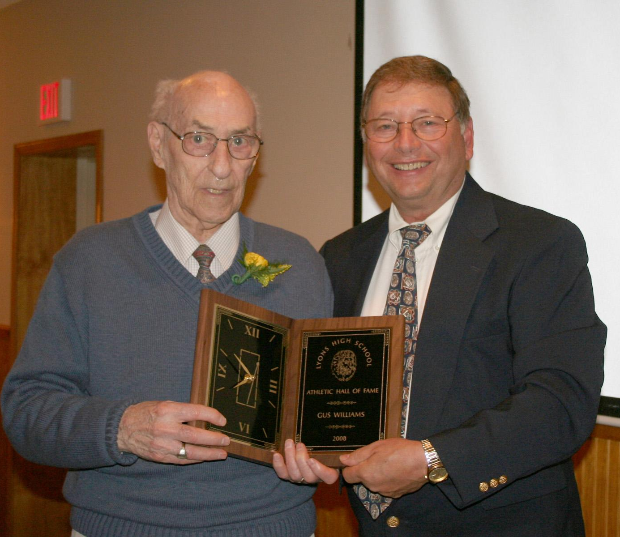
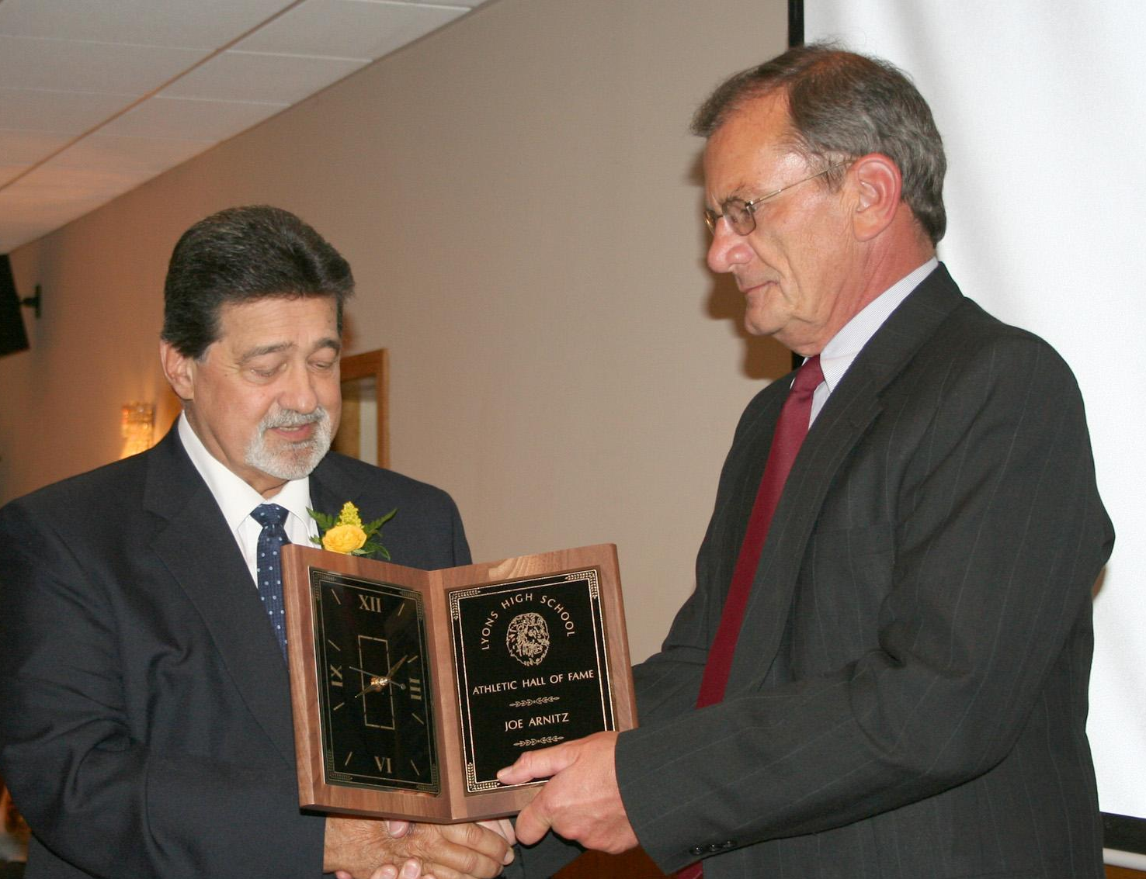
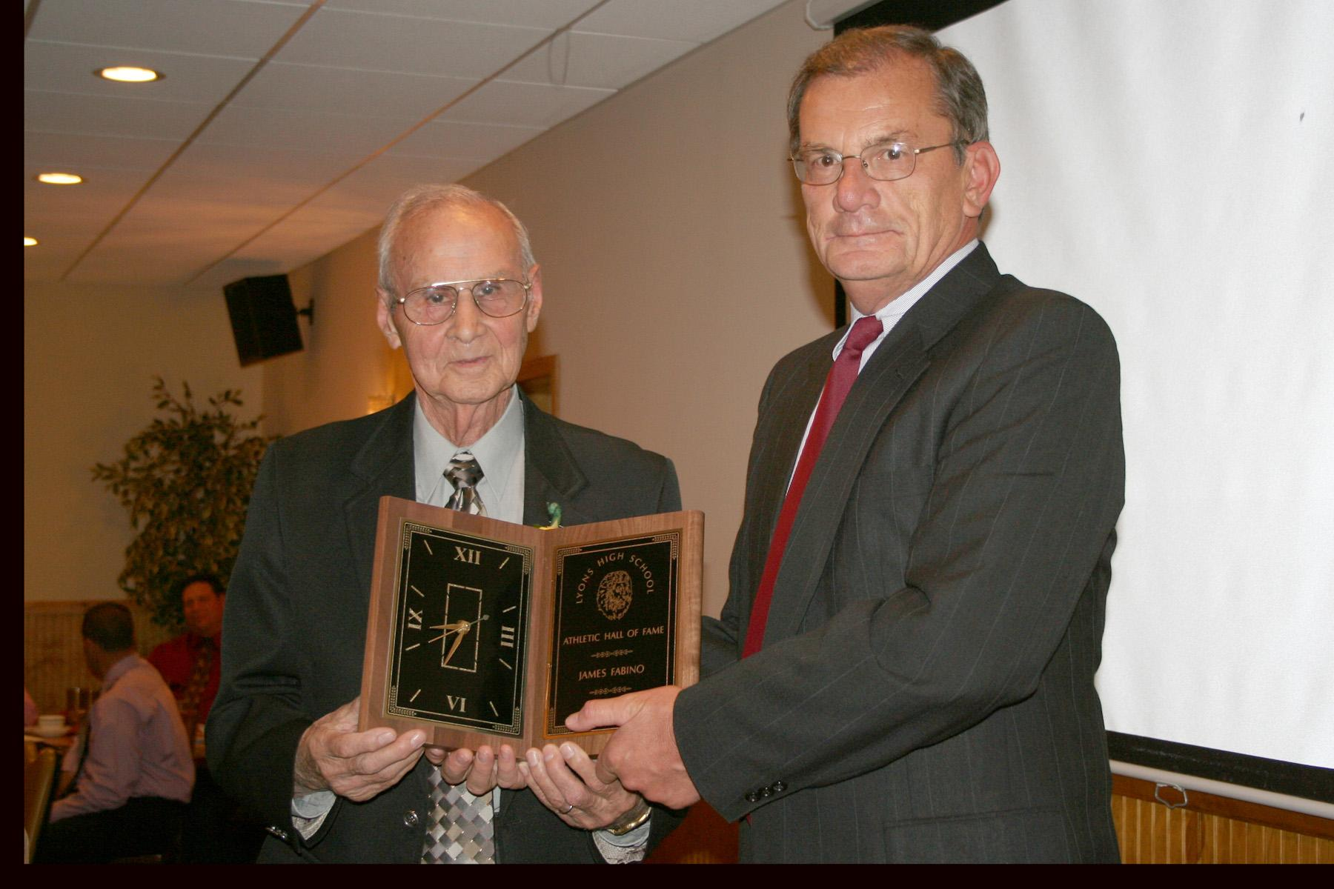
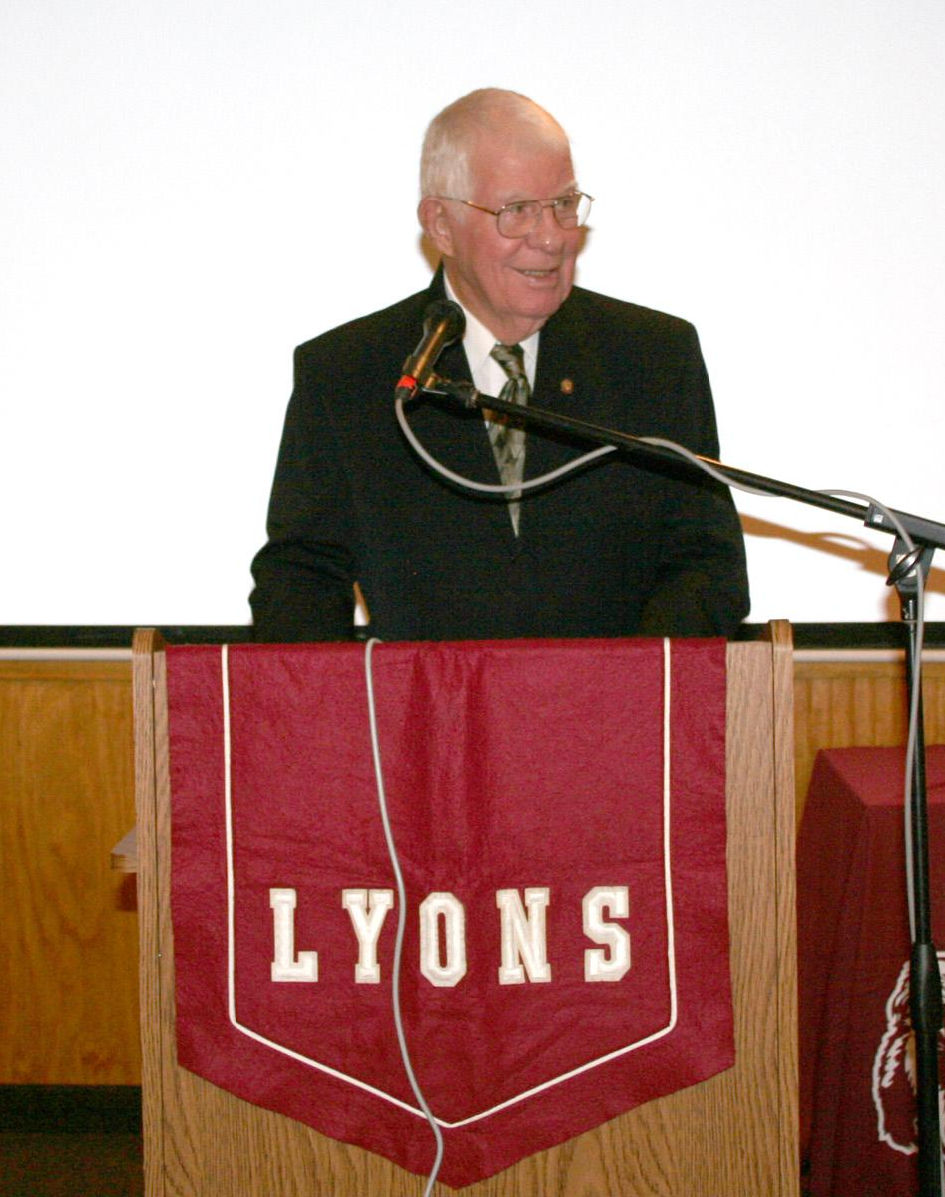
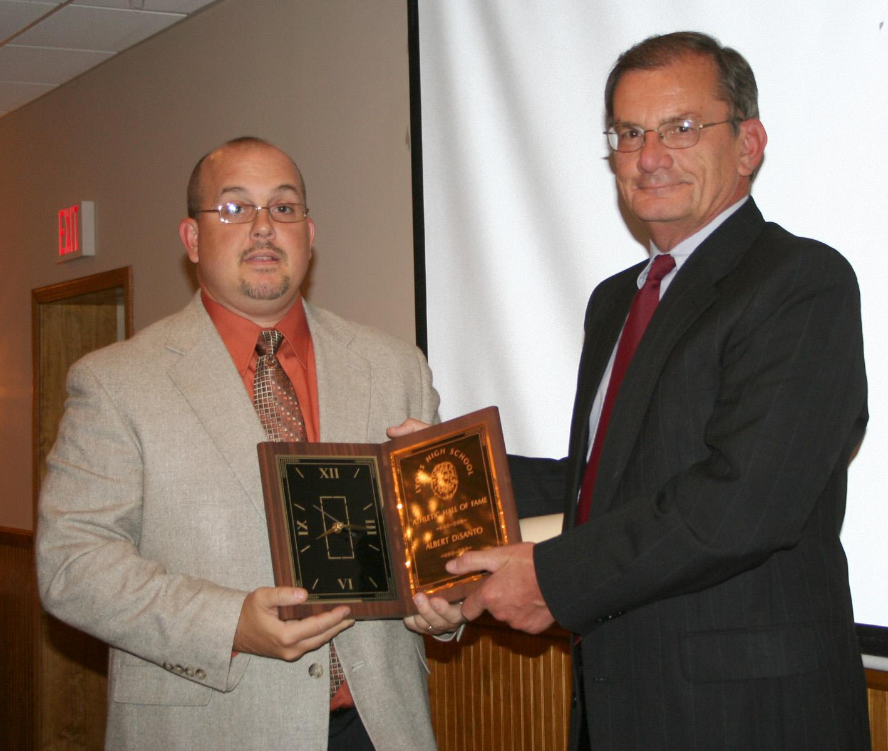
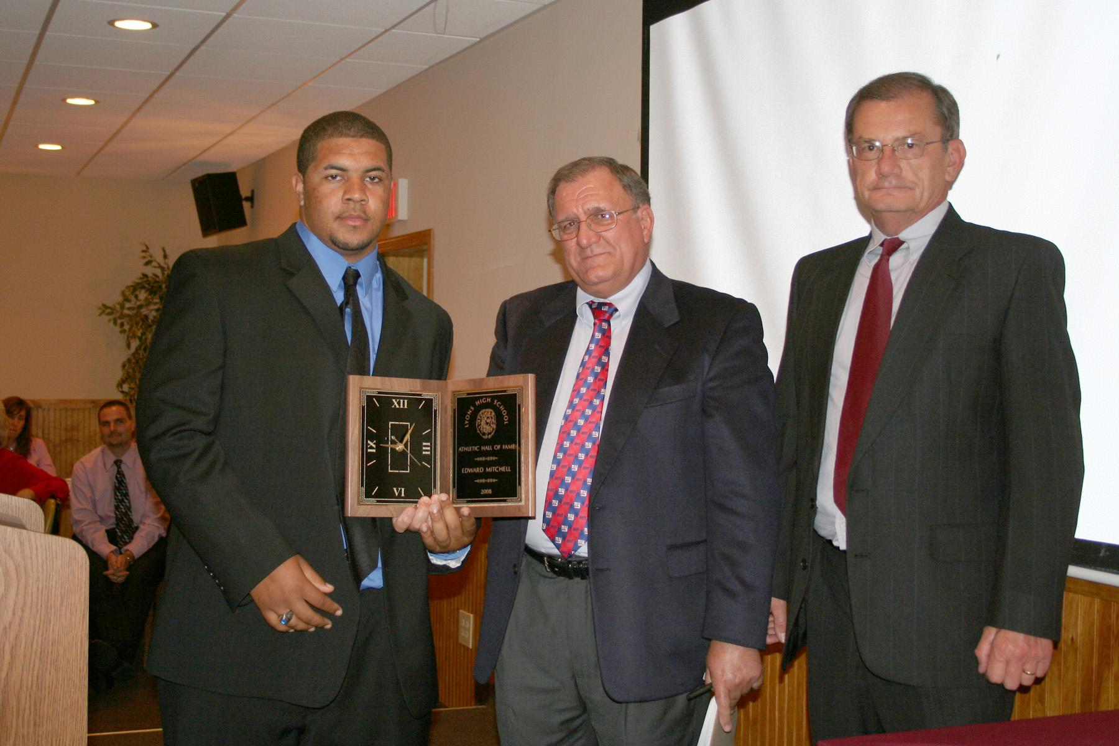
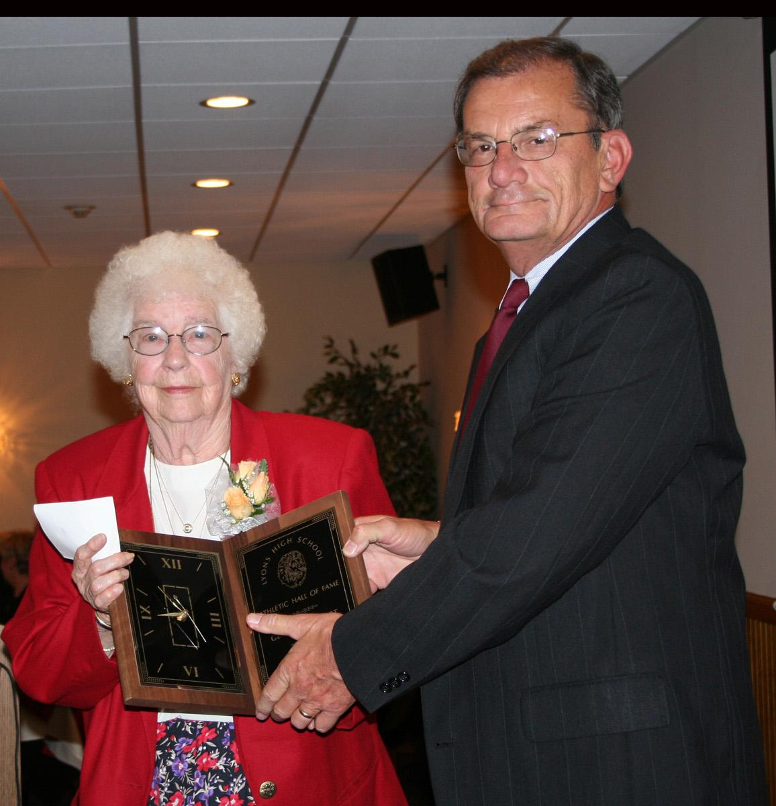
Inductees:
Joe Arnitz
Albert DiSanto
James Fabino
Genevieve Smart
Eddie Mitchell
Anthony Williams
1961-’62 Boys Basketball Team

Slide 166
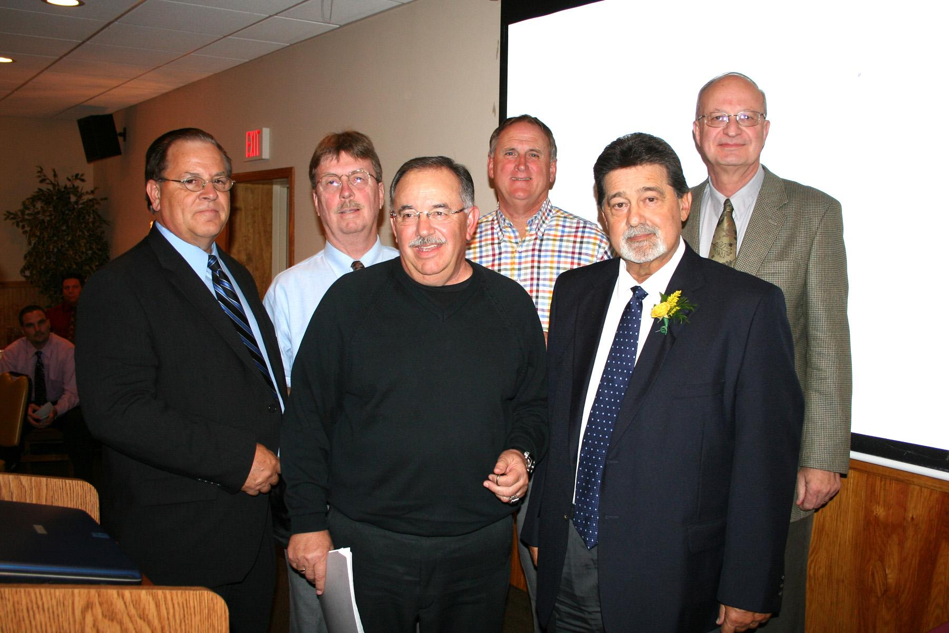

Slide 167
Joe Arnitz

Slide 168
Joe Arnitz
During his four years at Lyons HIgh School, Joe was a three sport athlete. He was a member of the varsity football team for three of the four years he played, and spent most of his time at the quarterback position. Joe also played four years of basketball and baseball.

Slide 169
Joe Arnitz
Under the supervision of Jim Fabino, Joe was catcher for the Lyons American League Baseball Team. He also played baseball for the Newark Wiltsie League Team for three years. In 1962, he was chosen to catch during a game in Auburn against the New York Yankee Rookie baseball team. During his junior year, he was invited to participate in a Los Angeles Dodger tryout camp.

Slide 170
Joe Arnitz
After high school, Joe attended Hobart College for four years and graduated with a B.S. degree in Math and Education. While at Hobart, he played one year of baseball and four years of football. Joe started at both offensive and defensive guard, and linebacker for his sophomore and junior years. As a senior, he was moved to tackle, where he made 1st Team All-Conference (ICAL) on offense.

Slide 171
Joe Arnitz
Upon graduation from Hobart in 1966, Joe accepted a position at Clyde Central School as a math teacher. He coached both the junior high and JV baseball teams for two yaears and was varsity line coach during the same period of time. In 1968, Joe accepted a junior high teaching job in Pittsford and spent the next 23 years as and assistant football coach at both Pittsford High School and Pittsford Mendon HS.

Slide 172
Joe Arnitz
Joe has been married for 41 years to Mary Rooke and resides in Fairport. Joe and Mary have three children and five beautiful grandchildren.

Slide 173
Albert DiSanto

Slide 174
Albert DiSanto
Albert DiSanto was a three sport athlete. He played football, basketball and baseball. He played point guard for Coach Rod Verkey for three years. When he was a junior, he was co-captain of the All-League team and part of the Section V Class A All-Touring team. Albert was part of the Times Union Fab 15 All-State, and named MVP of the Section B CLass B team. Albert’s team played in the sectional finals all three years and won in 1980 and 1981. He was a part of the first Lyons basketball team to with the NYSPHAA Championship.

Slide 175
Albert DiSanto
Albert also played football for two years under Coach Dave Alena, who held a 14-3 record and 14-0 in league play. He was quarterback his junior and senior years, winning a league title both years. During his junior year, Albert was 1st Team All League and had a 7-1 record. His senior year, he was named co-captain and 2nd Team All League after a 7-0 record his senior year.

Slide 176
Albert DiSanto
In baseball, Albert was a three year player for Coach Dana Ford. He was 1st Team All-League his junior and senior years. Albert threw three one-hitters his senior year in 1981 and ended the season with a 7-1 record. The squad lost in the semi-finals of sectionals. Albert was named Lyons HIgh School Athlete of the Year his senior year.

Slide 177
Albert DiSanto
After high school, Albert went to Nazareth College adn played basketball for two years. His sophomore year the team went 23-6 and advanced to the semi-finals of ICAC. Albert graduated with a degree in Business Administration and a minor in Psychology. He was an assistant coach for his brother Tim’s basketball team at Victor High School. The team reached the sectional finals twice. The team also won the Finger Lakes League for the 2002-03 season.

Slide 178
Albert DiSanto
Albert currently works as a supervisor at the Monroe County Children’s Center. He lives in Fairport with his wife Bethany and two children, Mitchell and Kendall.

Slide 179
Jim Fabino

Slide 180
Jim Fabino
Jim Fabino graduated from Lyons Central School in 1943. He played JV basketball and football, but could not play varsity sports because they were cancelled during World War II. After high school, Jim enlisted in the army and served for three years. Upon his return home, Jim began a long career of both coaching and supporting sports in the Lyons community. In the early 1950’s, he coached American Legion baseball, winning the District Championship in 1957. During that time, he also coached his church basketball team.

Slide 181
Jim Fabino
Because of his extensive knowledge of the building, Jim was asked to participate in the construction of the new Lyons High School in 1954. He worked for the school district for 31 years, retiring in 1980. During that time, his sports-related projects provided Lyons with some of the finest athletic facilities in the region. After completing his construction the of the football field, he worked with volunteers to raise money to install lights. He followed that with a fundraising effort for the new scoreboard.

Slide 182
Jim Fabino
Jim also built the school’s first field house, its first press box, its first concession stand and the baseball field. All of these projects were completed with little or no financial impact to the taxpayers of the school district because he was so successful at recruiting volunteers and soliciting donations. Because of his hard work and dedication to the school, Jim was honored with the 1980 school yearbook dedication.

Slide 183
Jim Fabino
Jim served on the Lyons Village Board for 13 years. He is currently the Lyons Town Supervisor, a position he has had for 23 years. He can be seen nearly everyday carrying out the duties of his position and even goes above and beyond the title by working at the town-owned cemeteries. Together with Pete Stripe, he led a community effort to construct the Lyons “Wall of Honor,” which will recognize local veterans that served in WWII, Korea and Vietnam.

Slide 184
Jim Fabino
Jim has been a member of the American Legion for 62 years. He is also a long-standing member of the VFW. He received the DeWitt Clinton Masonic Award for Community Service in 1994. In 1995, Jim was named the Lyons Chamber of Commerce Citizen of the Year for outstanding contributions to the community. In 2000, he was the recipient of the Proclamations of the Appreciation from the Wayne County Board of Supervisors.

Slide 185
Jim Fabino
Jim has been married to his wife Josephine for 59 years. They have two grown children, Jim Jr. and Jeanine, and three grandchildren: Brian, Matt and Justin.

Slide 186
Genevieve Smart

Slide 187
Genevieve Smart
After graduating in 1943 from Cortland State Teachers College, Genevieve went to teach 1st -12th grade at Naples Central School. While there, she carried on a very full and rewarding program. She was chosen Junior Class Advisor and the next year chaperoned their senior trip to New York City. In 1946, she had the yearbook dedicated to her. In the autumn of 1946 she came to Lyons where she taught 1st through 12th grade until June 1950. Besides her classes, she worked with the cheerleaders, Tumbling Club, intramurals, and play days with the schools. Organized teams started in 1971 under the guidance of Mary Lou Wheat.

Slide 188
Genevieve Smart
In late spring of 1960, Genevieve came back to teach grades one through six. She finished her graduate work mostly at Hobart and Ithaca Colleges. Genevieve enjoyed 16 years working with Lee Boice. Along with Lee, she enjoyed working with student teachers from Brockport andCorgland. Two of them were very outstanding, Jean Lyon who went on to teach at Sodus, and Ron Vitticore who went on to teach at Clyde and coach football.

Slide 189
Genevieve Smart
Both Gen and Lee carried on a very fun and rewarding time with the boys and girls. Besides teaching, she helped with intramurals, All-State games, cheerleading, tumbling, physical education programs for parents, and field days. After retirement in 1976, she came back for two years to help with the play days, managing the jump pit.

Slide 190
Genevieve Smart
Genevieve is proud of all the girls who decided to go into physical education Three of them have already been inducted into the Hall of Fame. They have accomplished so much. Those 23 years have always meant a great deal to her, to know that she had a great deal of influence in the shaping of their lives.

Slide 191
Genevieve Smart
Genevieve met her husband, Tom, in the summer of 1948. Genevieve was married to Tom for almost 58 years when he passed away in 2006. They were very proud of their two sons, David and his wife Debby, and Timothy and his daughter Grace.
Genevieve has been an active member of the Lyons United Methodist Church for nearly 60 years. She still sings in the choir.

Slide 192
Eddie Mitchell

Slide 193
Eddie Mitchell
Eddie Mitchell attended Lyons High School from 1974 to 1978. While there, he participated and excelled in football, wrestling and track. He was one of the top rushing fullbacks in school history, breaking touchdown and rushing records. He received numerous awards, including All-State and All-American.

Slide 194
Eddie Mitchell
After high school, Eddie embarked on a 20 year career in the US Army. While in the military he became a three time wrestling champion at Ft. Rucker, AL, and played semi-pro football for the USAF Ramstein Rams while stationed in Germany. He was named Offensive Player of the Year in 1989, and won two All-Star selections and championships. Eddie was a member of the All-Army wrestling team from 1987 until 1998. He received many accolades, including being a participant in the 1992 Olympic trials. He placed 6th in 1993 in the US Greco-Roman Nationals, and in 1996 was the East Regional Olympic Qualifier Champion in Greco-Roman.

Slide 195
Eddie Mitchell
Not only was Eddie an athlete in the World Class Athlete Program, he was also a coach and mentor to peers and young adults. In coaching, Eddie propelled fellow soldiers on their journeys, including a teammate attending the 2008 Olympics. He held many clinics for youth groups and various high schools, introducing them to wrestling, discipline skills and sportsmanship needed to be successful in both the sport and life.

Slide 196
Eddie Mitchell
Mitchell’s career has not just been in athletics. He served his country in Desert Storm from 1989 to 1991. He went to Somalia from 1992 to 1993 in an effort to bring humanitarian relief, and in 1993 helped bring relief to Hurricane Andrew victims at Homestead Air Force Base in Florida. He is now serving in Kuwait as a civilian with a contractor.

Slide 197
Eddie Mitchell
Eddie ended his military career well decorated. After 20 years of service, he retired to Georgia with his wife of 29 years, Karen. He has four wonderful children and five precious grandchildren who are very proud to call him father and Papa.

Slide 198
Anthony “Gus” Williams

Slide 199
Anthony “Gus” Williams
Gus Williams was an outstanding athlete at Lyons. He played varsity soccer, basketball, football and baseball. He was voted captain or co-captain of many of the varsity teams on which he played.
In 1929, Gus played on the last men’s soccer team at Lyons high School. The team ended their season by winning the League Championship.

Slide 200
Anthony “Gus” Williams
On September 26th, 1930, Lyons returned to playing football after a 12 year hiatus. In this game against Weedsport, Gus caught a touchdown pass from quarterback Robert Chapel. This was the first and only touchdown of the game. The team won 7-0, and went on to win every game that season, becoming undefeated League Champions.

Slide 201
Anthony “Gus” Williams
In a recent conversation with Gus, he recalled that his family owned a grocery store and that he attributed his good physical condition in high school to the fact that he would help out wherever he was needed. “Those were the depression years,” he stated, “and I was the delivery boy, either by bicycle, pushcart or on foot. I was on the go all over town.”

Slide 202
Anthony “Gus” Williams
When Gus ended his high school career, he had earned 12 varsity letters. Gus is 95 years old and still enjoys fairly good health. He is a resident of the Wayne County Nursing home and looking forward to attending the Athletic Hall of Fame Banquet in September.

Slide 203
1961-62 Boys Basketball Team

Slide 204
1961-62 Boys Basketball Team
The story of the “62 Team” really began six years earlier in the old Elementary School on William Street. Under Coach Blackwell’s early leadership starting with Saturday morning workouts at the Elementary School, and ultimately at the High School, a championship team was formed over the ensuing six years.

Slide 205
1961-62 Boys Basketball Team
Coach Blackwell was a stern taskmaster who believed in setting high standards on and off the court. We benefited from his passion and respect for the game. He believed in physical conditioning, using set plays, playing tough defense and running the fastbreak whenever the situation presented itself. The team once scored 40 points in an eight minute quarter against Canandaigua. Coach Blackwell passed away within the last year and will be missed by all who played for him.

Slide 206
1961-62 Boys Basketball Team
Many of the team’s basic skills and ability to work as a team were developed in pickup games throughout the years on the asphalt courts behind the Elementary School or Boeheim’s Funeral Home.

Slide 207
1961-62 Boys Basketball Team
All the physical conditioning and structured practices definitely paid big dividends as the team only lost three games in their junior and senior years combined, while playing in a higher classification. The lone loss in 1962 occurred against East Rochester in the SEction V Class AA finals. Both teams were 20-0 and game went into double overtime with ER winning 58-57. There was a record War Memorial crowd at the time of nearly 10,000 who witnessed a truly memorable game.

Slide 208
1961-62 Boys Basketball Team
Underclassmen played more than a supporting role in the team’s success and subsequently went on to achieve successful years as upperclassmen.
The players of the 62 Team have gone on to lead successful lives due in part to the discipline and structure developed during their years at Lyons High.

Slide 209
Class of 2009
Sixth Annual
Athletic Hall of Fame Induction Dinner

Slide 210
Inductees:
Paul Amrose
Colleen Tuffy
George Justino
Leslie DeWind
Dean Schott II
Melissa Kemp Volpe
1988-’89 Boys Basketball Team

Slide 211
Paul Amrose

Slide 212
Paul Amrose
Paul Amrose graduated from Lyons High School in 1982. He participated in basketball from his freshman year. As a junior and senior his teams had a combined 48-2 record, winning consecutive Section V Class B and Wayne County Championships. Having the distinction of not starting one game his junior season, Paul was named Honorable Mention All-Greater Rochester and the only junior named to the 1st Team All-Wayne County while leading the team in scoring (14 ppg/10 rpg). He was awarded the Sixth Man Award that year.

Slide 213
Paul Amrose
Paul’s senior season he averaged a team high 20 ppg/12 rpg and was named SEction V Class B MVP, 2nd Team All-Greater Rochester, 8th All-State, and a unanimous selection to the 1st Team All-Wayne County. The 1981-82 team finished 2nd in the Class C NYSPHSAA Championships and a season ending ranking of #2 in the NYS Sports Writers Association Polls for small schools.

Slide 214
Paul Amrose
Paul was a member of the golf team from 8th grade thru his senior year, being selected as the team MVP for three of those seasons. He participated in Cross Country his senior year, leading the team to a 12-2 record. Paul was selected 1st Team All-Wayne County, placed 21st in the Section V Championship, 11th in Class B and 6th in the Wayne County Championship Meet. Paul shared the 1981-82 Senior Athlete of the Year Award with Tim DiSanto.

Slide 215
Paul Amrose
Paul graduated 4th in his class with a 90.0 GPA and was a member of the National Honor Society. He attended Alfred University, graduating with honors and a dual major in Economics and Accounting. He was a member of Delta Mu Delta (National Honor Society) with a four year GPA of 3.10. Paul attained his Masters from Bridgeport University in 1992.

Slide 216
Paul Amrose
Paul played four years of Division III collegiate basketball. His junior year he averaged 12.3 ppg/6 rpg and was named to the All ICAC 2nd Team leading the Alfred Saxons to a 17-10 record, winning the ICAC Conference Championship and their first ever NCAA tournament appearance. His senior season Paul captained the best team in Alfred University history with a 25-3 record, won a 2nd consecutive ICAC Championship and made it to the Sweet 16 of the NCAA tournament before losing to the eventual NCAA champions.

Slide 217
Paul Amrose
Paul was a founding partner and the Chief Underwriting Officer of DirectFac, Inc. from 2004-08. In April of 2009, Paul joined Ascot, Inc. a Lloyds of London based firm, to lead their expansion into the US property insurance market. Paul is a Senior Vice President and manages the Hartford, CT office.
Paul currently resides in Canton, CT, with his wife of 14 years, Jennifer, and sons Nicholas and Thomas. Paul has been coaching basketball, baseball and football for five years and serves on the Board of he Canton Youth Basketball Association.

Slide 218
Colleen Tuffy

Slide 219
Colleen Tuffy
Colleen Tuffy was a standout athlete in five sports during her high school playing days for the Lady Lions. She ended up accruing 13 varsity letters before graduating in 1984. She made an impact in all sports that she participated in and was an endearing teammate to those she played with.

Slide 220
Colleen Tuffy
Colleen made 2nd Team All-League her junior and senior year of soccer and was voted the team MVP. As a member of the volleyball team, she made 1st team All-League her junior and senior year and was twice voted to the Section V All-Tournament Team. She was also named team MVP.

Slide 221
Colleen Tuffy
During her four varsity years on the hardwood, Colleen was recognized as All-League each year, culminating with a 1st team selection her senior year. She was named to the Section V All-Tournament team her sophomore and junior year. Again, Colleen was named team MVP at the conclusion of their senior season.

Slide 222
Colleen Tuffy
After participating in track for two successful seasons, including a 4th place finish in the discus at Sectionals, she was a member of the first varsity softball team at Lyons. She made 1st Team All-League and was voted the team MVP. Colleen was named the Most Outstanding SEnior Athlete in the spring of 1984.
Colleen went on to Cayuga Community College and played two more years of both volleyball and basketball. She graduated from SUNY Brockport with a B.S. degree in Recreation, and her Master’s Degree in Recreation from Cortland.

Slide 223
Colleen Tuffy
Colleen is currently the Director of Therapeutic Recreation and Community Partnership Program for St. Josephs Villa of Rochester. She has been employed there for 17 years.
Colleen resides in Walworth with her partner, Jane Wolford, and their two children, Ethan and Adia.

Slide 224
George Justino

Slide 225
George Justino
George Justino was an outstanding Lyons High School athlete from 1944-48. He earned 11 varsity letters and one JV letter. He was a starter all four years in football and baseball, as well as three years in basketball. George’s enthusiastic play and leadership was acknowledged by his teammates and coach as he served as captain at various times in all three sports. The teams he played on won four league championships in baseball, three in basketball and one in football.

Slide 226
George Justino
After graduation, George continued to be involved in sports. He played semi-pro ball for several years, and was also an avid golfer and bowler. He was a popular figure on the local sports scene as a certified umpire for high school and college baseball for 50 years, as well as for football and basketball for 35 years. Throughout the years, George served his community by volunteering his services as a coach, umpire and referee for youth sports.

Slide 227
George Justino
George retired from the Newark Developmental Center as a policeman/fireman after 30 years of service. He also worked as a part-time advertising salesman for over 36 years. George resides in Lyons with his wife of 58 years, Rita. They have two married daughters and one granddaughter.

Slide 228
Leslie DeWind

Slide 229
Leslie DeWind
Leslie DeWind, a 1989 graduate, was an outstanding athlete who played soccer, volleyball, basketball and softball for Lyons Central School. Leslie earned 14 varsity letters during her career.

Slide 230
Leslie DeWind
Leslie was a Wayne County 1st Team All-Star in volleyball in 1988 and 1989. In 1989 she was MVP of her team which won the Division II Championship. In basketball, Leslie played four years at the varsity level. She earned the Fireman’s Award in 1986, Top Rebounder in 1987 and Best All-Around Player in 1989.

Slide 231
Leslie DeWind
Leslie was a five year varsity softball player. She was selected to the Wayne County All-Star 2nd Team as a freshman, and was 1st Team All-Star as a sophomore, junior and senior. Her pitching record for four seasons was 67 wins and 13 losses. She holds a career batting average of .585 with 140 RBIs. In 1989 she led the team to a perfect 21-0 record. The team won the league title in 1987, 1988 and 1989 and Leslie was named MVP for the team all three years. In her senior year, Leslie was chosen as Female Athlete of the Year.

Slide 232
Leslie DeWind
After graduating from LCS, Leslie earned an Associates Degree from FLCC. While at FLCC she played two years of soccer and one year of softball. Recently, Leslie has coached Little League Girls Softball for five years and Community Center Basketball for six years. In 2008 she was the JV volleyball coach for Lyons Central School.

Slide 233
Leslie DeWind
Leslie currently works for the Wayne County Sheriff's Department. Leslie lives in Lyons with her two daughters, Jordan and Ryenn. The two girls attend LCS and are very active in sports, following in their mother’s footsteps.

Slide 234
Dean Schott II

Slide 235
Dean Schott II
During his athletic career at LCS, Dean, an all around outstanding athlete, participated in football, basketball and baseball. He earned 10 varsity letters and was named Senior Male Athlete of the Year in 1989.

Slide 236
Dean Schott II
A three time Wayne County All-Star in baseball, Dean truly was a versatile player, playing almost every position, including pitcher.
An outstanding quarterback and defensive back for Coach Chuck Meyers, Dean won All-League honors his junior and senior years and was named to the All-State team his senior year.

Slide 237
Dean Schott II
Starting all four years for his father’s varsity basketball team, Dean achieved his greatest success. He scored 1903 points during his high school career which also included his leading the Lions to the State and Federation tiles in 1989. No one will ever forget the “miracle” full court halftime shot Dean made aht the War Memorial during the Western Regional. He was named All-League three years, and All Greater Rochester two years and All-State his senior year.

Slide 238
Dean Schott II
Dean continued his basketball career at the University of Buffalo where he played in every game for three years, averaging 10 points and 3 assists per game. Dean then transferred to St. John Fisher for one year where he averaged 18 points and 6 assists per game. While in college he amassed over 1000 points and was named to several all tournament teams. He finished his career playing for team Adidas and had a tryout with the Westchester Stallions of the USBL.

Slide 239
Dean Schott II
Dean is currently employed at Lyons and has coached football, basketball and baseball at all levels. He lives in Lyons with his wife Renee and dog Barkley.

Slide 240
Melissa Kemp Volpe

Slide 241
Melissa Kemp Volpe
Melissa was a talented three sport athlete for Lyons Central School from 1987-91. She earned 13 varsity letters in volleyball, basketball and softball.
In volleyball, Melissa was a 2nd Team All-Star as a freshman and was named to the 1st Team the rest of her high school years. In 1990 she set a record for most consecutive serves against Marion.

Slide 242
Melissa Kemp Volpe
In basketball Melissa was also named a 2nd team All-Star her freshman year and to the 1st team for the rest of her seasons She was also named to the All-Greater Rochester Team her senior year. Melissa ended her career as the all time assist leader.

Slide 243
Melissa Kemp Volpe
Melissa started on varsity for five years in softball. She was a 2nd team Wayne County All-Star as an 8th grader and freshman. She was a 1st team All-Star shortstop for the remaining three seasons. Melissa was named MVP in the 1989 playoffs, batting .667 and scoring the winning run in the 8th inning of the Championship game, completing Lyons’ 21-0 season.

Slide 244
Melissa Kemp Volpe
Melissa went to Keuka on a volleyball scholarship and played one year before transferring to SUNY Brockport. Melissa is currently a Center Director of a federally funded program that is part of the Department of Labor, Job Corps. She assists disadvantaged youth ages 16-24 in obtaining their GED/HSD and in acquiring career skills. She finds her job very rewarding.
Melissa lives in Fairport and is married to J.J. Volpe. They have two children, Jadyn and Myles.

Slide 245
1988-89 Boys Basketball Team

Slide 246
1988-89 Boys Basketball Team
The 1988-89 Boys Basketball team, led by Coach Dean Schott, put together one of the greatest seasons in Section V history. Many high scoring, lop-sided games was the theme throughout the season. Opening the season with a rout against state ranked West Hill in the Lyons Cage Tourney was a glimpse of things to come.

Slide 247
1988-89 Boys Basketball Team
With a mild losing streak against Clyde entering the season, the Lions beat Clyde at home in front of a standing room only crowd, 98-78. While capturing the Midlakes Christmas Tournament with ease, the Lions won 19 in a row with virtually no close games until the season finale at Clyde. The host Eagles defeated the Lions 71-68 for the team’s only blemish of the season. The team meeting in the gym immediately after the Clyde loss, and the disappointment of not going undefeated, made the team even more hungry to meet their goals for winning the Sectional, State and Federation titles.

Slide 248
1988-89 Boys Basketball Team
After cruising to the school’s first Section V title since 1982, and winning the state qualifier game against Kendall, the Lions met Buffalo Burgard in the Western Regional Final. Buffalo Burgard, ranked #1 in the state and led by Marcus Whitfield, the nation’s leading scorer at 44 ppg, were no match for Lyons. Spearheaded by Dean Schott’s three-quarter court shot at the halftime buzzer, the Lions ran Burgard off the court in the second half for a convincing 98-82 victory.

Slide 249
1988-89 Boys Basketball Team
After beating Spa Catholic in the State Semifinals, Lyons faced Whitey Point for the state title. After trailing by double digits in the fourth quarter, Lyons, led by point guard Junior Kemp’s tremendous play down the stretch, won the State Championship in dramatic fashion. The Lyons traveled back to Glens Falls the following week and capped off a storybook season with a 77-70 victory over Nichols Academy for the Federation Championship. Lyons remains one of a few teams from upstate to capture a Federation title.

Slide 250
1988-89 Boys Basketball Team
Rich Vanderlinde, Dean Schott and Junior Kemp all made 1st Team All-League, with Joe Bell garnering 2nd Team honors. Coach Schott was honored as Coach of the Year by numerous basketball organizations following the “Dream Season.”

Slide 251
1988-89 Boys Basketball Team Members
Joe Bell
Johnny Brown
Jimmy Carter
Anthony Cataldi
Aaron Diehl
Jamie Downing
Brian Hartwell
Junior Kemp
Mike Nolan
Dean Schott II
Rhett Ticconi
Rich Vanderlinde
Mark VanHanehan
Lee Roy Waterman
Coach Dean Schott
Coach Dana Ford

Slide 252
Class of 2010
Seventh Annual
Athletic Hall of Fame Induction Dinner

Slide 253
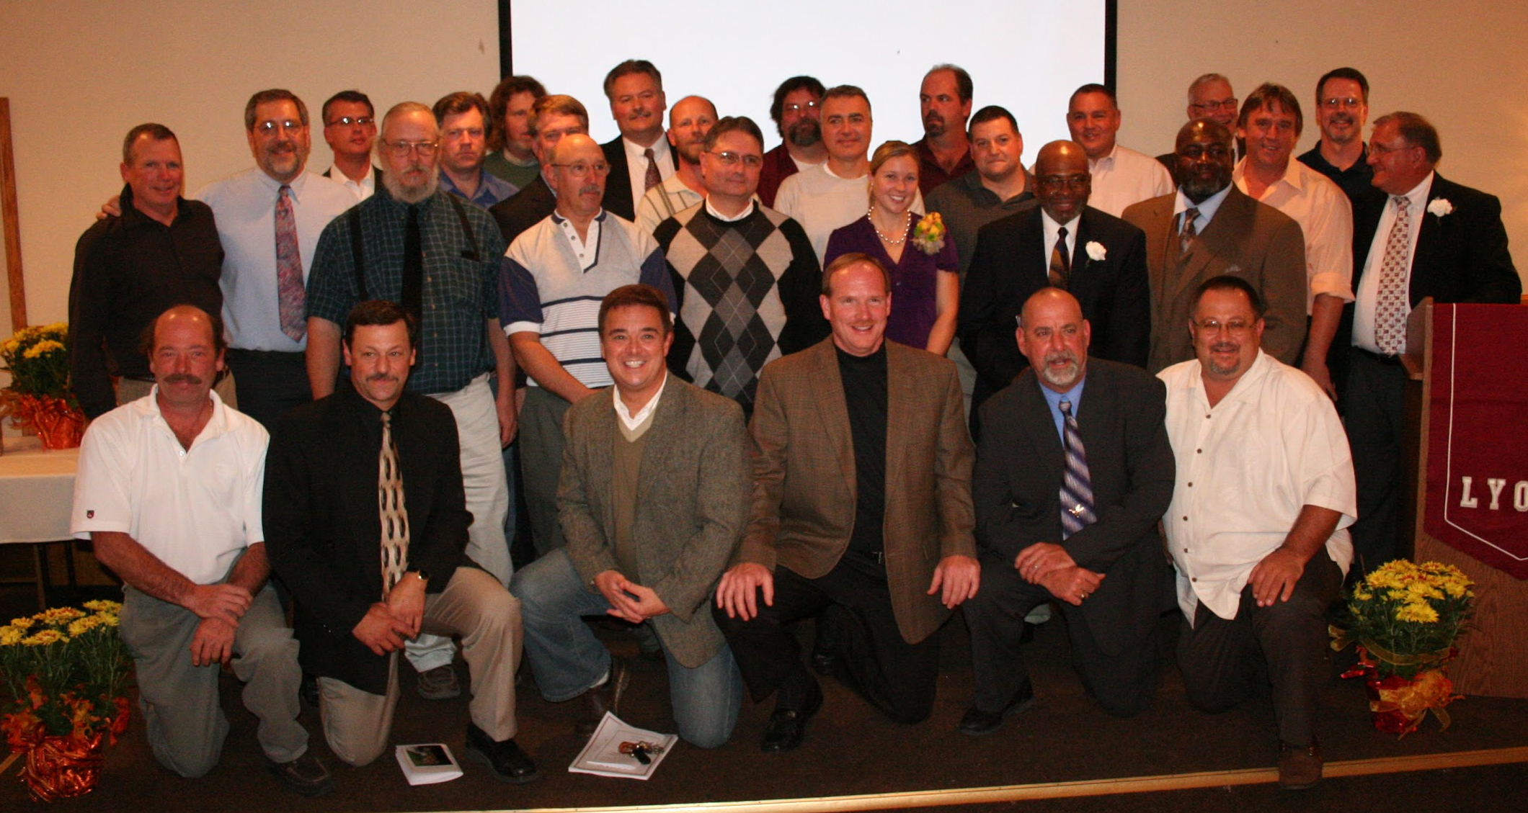
Inductees:
Andy Wunder
Laura Olson
Jerry Sollenne
Ken Chalker
Louis Morris Jr
1977 Football Team

Slide 254
Andy Wunder

Slide 255
Andy Wunder
Before graduating from Lyons high School in 2000, Andy Wuner was a standout football and track and field athlete. Andy excelled at offensive and defensive tackle during his football career. In both his junior and senior years, he was selected to the Finger Lakes West All-Star Team as both an offensive and defensive tackle; in 1999 he was selected to play in the Eddie Meath All Star game, which consisted of the best seniors in Section V.

Slide 256
Andy Wunder
But it was in track and field where Andy truly excelled. In the 1999-2000 indoor track season, the first year that Lyons participated in the sports, Andy was the overall Section V Champion, as well as the Class Champion, in the shot put. He went on to represent the Section V team in the state meet. During this season, he set both the SEction V Class C and Wayne County indoor shot put records. At the close of the season, he was chosen for the Section V Rochester Winter Track League All-Star Team.

Slide 257
Andy Wunder
In outdoor track and field, Andy was the Wayne County League discus champion in 1998, 1999 and 2000, setting the meet record in 2000. Andy represented Section V in the state championships in both 1999 and 2000; he still holds the school record in the discus and was selected as Track MVP in 2000, as well as being a four time Wayne County League 1st team All-Star.

Slide 258
Andy Wunder
After high school Andy continued his outstanding career at the University of Rochester where he set the indoor 35 lb. weight throw record, and in 2005 he was the New York State Collegiate Track Conference champion in the weight throw. He was selected to the 1st Team NYSCTC All-Star Team, was the U of R field event MVP and concluded the 2005 indoor track season by becoming and NCAA All American.

Slide 259
Andy Wunder
In outdoor track the success continued as Andy was the 2004 NYSCTC shot put champion, was selected as a 1st Team NYSCTC All-Star, U of R team MVP, team captain, and set school records in both the shot put and hammer throw. Andy went on to represent the U of R in the NCAA National Championships in the hammer throw in the spring of 2005.

Slide 260
Andy Wunder
Academically, Andy also excelled. He earned a chemical engineering degree from the U of R in 2004. In the following year, he entered an internship program at Eastman Kodak where he was able to perform his research and at the same time take graduate classes at the U of R and continue his track career. This work culminated in a technical publication, a patent, and a Master’s degree in Chemical Engineering in 2005. Andy was employed by Eastman Kodak upon graduation and is currently employed by Zotos International in Geneva.
Andy is married to Erica Gansz and resides in Lyons.

Slide 261
Laura Olson

Slide 262
Laura Olson
Laura Olson Botkins was a standout track and field athlete while at Lyons HIgh School before she graduated in 2000. Laura also participated in soccer all four years of high school, being named Wayne County All-League during the fall of 1999 But it was in track and field where she truly excelled. She was chosen All-League in 1999 in both pole vault and 100 m dash. Laura was also Section V Champion in the pole vault that year, first at the Meet of Champions, qualifying her for the state meet.

Slide 263
Laura Olson
During her senior year indoor season, Laura was the Section V Class Champion and the overall Section V Champion in the pole vault, qualifying her for the indoor state championships. Also, during that indoor season, she qualified for the National Championship meet where she placed 7th overall. Laura was the first athlete from Lyons to participate at the national level. During that season, she set the overall Section V record in the pole vault, as well as being named to the Rochester Winter Track League All League team.

Slide 264
Laura Olson
The following spring Laura was once again All-League, Section V Class Champion, and overall Section V Champion in the pole vault and once again a state meet participant. That summer she competed in the USATF Junior Olympics where she finished 20th overall in the national championships. Laura was selected as Lyons Female Athlete of the year 1999-2000

Slide 265
Laura Olson
After high school Laura continued her outstanding track and field career at Division I University of Buffalo. During her years at UB, Laura borke the indoor pole vault record 12 times and the outdoor pole vault record 8 times, which she still holds. She also set a new stadium record, breaking the record set during the World Games held at UB stadium in 1992. She was names All-East in both her junior and senior years, winning the ECAC Indoor Pole Vault Championship in 2004. Laura was the Mid-American Conference Outdoor Champion and conference runner up three times in the pole vault.

Slide 266
Laura Olson
During her junior season, Laura placed 3rd in the Eastern Regionals, qualifying her for the NCAA National Championships where she placed 13th from among 26 competitors. In her senior season, she was one of 15 athletes nationally that qualified for the NCAA Indoor National Championships. The following spring she was 2nd at the Eastern Regionals, qualifying her once again for the NCAA Division I National Championships. During her collegiate career, she won many invitationals, as well as setting numerous stadium and facility records. Laura was also NYS Empire Games Open Pole Vault Champion in 2002 and 2005. In 2005 she set the meet record which was broken this past summer.

Slide 267
Laura Olson
Laura did not just excel in track and field; she also excelled in the classroom. In 2004 she was the recipient of the SUNY Chancellor's’ Scholar Athlete Award, and was a member of UB’s honor society, Alpha Kappa Delta. She was also a member of Pi Theta Epsilon at D’Youville College where she recently completed her Master’s Degree in Occupational Therapy.
Laura currently resides in Cheektowaga, NY with her husband Nick.

Slide 268
Jerry J. Sollenne

Slide 269
Jerry Sollenne
Jerry Sollenne was a standout three sport athlete at Lyons High School from 1961-1964, playing football, basketball and baseball. During his junior football campaign, he was named All Wayne-Finger Lakes quarterback. During his senior season, Jerry threw 16 touchdown passes and was again named All Wayne-Finger Lakes quarterback. He led the Lions to a 25-20 victory over a Tom Coughlin (NY Giants) led Waterloo team and a Rod Verkey led Mynderse Academy team.

Slide 270
Jerry Sollenne
Jerry was co-captain of the ‘62-63 and ‘63-64 basketball teams. In his junior year, Jerry led the league in scoring, and set a single season assist record for Lyons. He was named to the All Tournament Team in the Rush Henrietta Christmas Tournament , was a unanimous 1st team All Wayne-Finger Lakes Team selection, and his team won the ‘62-’63 Wayne-Finger Lakes title. Jerry was also named to the Class AA All Greater Rochester Area First Team.

Slide 271
Jerry Sollenne
During his senior season, Jerry finished 10th in league scoring, set the two year Lyons’ assist record and was again named to the All Tournament Team in the Rush Henrietta Christmas Tournament. His senior team won the Wayne-Finger Lakes league title, and jerry was once again anmed to the 1st team All Wayne-Finger Lakes. Jerry also played varsity baseball for three years with a career batting average of .315.

Slide 272
Jerry Sollenne
After high school, Jerry attended SUNY Buffalo where he earned a Bachelor of Arts degree in History. He completed a Master of Science Degree in Educational Administration from SUNY Brockport in 1974, and a Certificate of Advanced Study from Brockport in 1975. Jerry also attended the University of Rochester, working toward a doctor in Education Administration.

Slide 273
Jerry Sollenne
From 1968-75, Jerry worked for the Romulus Central School District where he taught history and physical education. He was the head football coach for six seasons, head track coach for two seasons and the varsity club advisor for seven years.
Jerry retired in October of 2004 and currently resides in Sun Lakes, Arizona.

Slide 274
Ken Chalker

Slide 275
Ken Chalker
Ken Chalker graduated from Lyons High School in 1954 where he lived out his childhood dream of becoming a Lyons sports legend. In the final game of the ‘54 basketball season against arch rival Newark, Chalker scored 34 points, giving Lyons its 3rd consecutive Wayne=Finger Lakes League Championship. In the sectional qualifying game, again against Newark, Ken scored 32 points in a double overtime victory before a sellout crowd at the Rochester Sports Arena.

Slide 276
Ken Chalker
Lyons roared through the sectionals and into the Class A final against East Rochester, a team they had beaten in the ‘52 Sectional final. With 10 seconds remaining, East Rochester went ahead. With only three seconds left in the game, Ken Chalker sank the winning basket. In the three games against Newark, Chalker scored 96 points.

Slide 277
Ken Chalker
Chalker received many individual honors, including 1st team All-Section V MVP. He led the Wayne-Finger Lakes League in scoring and was a two time selection to the Wayne-Finger Lakes All League Team.
Ken also played offensive and defensive end in football and was named to the All-League team. In baseball, Ken was a member of the Wayne County League Championship team.

Slide 278
Ken Chalker
Ken worked as a brakeman for the New York Central Railroad. He passed away at age 52 and is survived by his wife, Judith, sons Kevin and Gary, and daughters Elaine and Doreen.

Slide 279
Louis M. Morris, Jr.

Slide 280
Louis M. Morris, Jr.
Louis Morris graduated from lyons High School in 1971. While in school, he participated in basketball, football, JV baseball and track. He had a lot of success on the hardwood at Lyons High School.
From 1968-70, Louis was the 2nd leading rebounder on the team. In 1969 he was awarded a Wayne County Basketball League Honorable Mention, and during the 1970 season, Louis received the Most Assists Award.

Slide 281
Louis M. Morris, Jr.
Louis also had a very successful track career. In 1970, he was the Wayne County Long Jump Champion, as well as the Section V Long Jump Champion. In 1971, Louis was named the Senior Male Athlete of the Year.

Slide 282
Louis M. Morris, Jr.
After high school, Louis joined the US Army Paratroopers at Fort Bragg. While at Fort Bragg, he boxed as a middleweight. Louis received an honorable discharge from the army in 1976 and went to work for the state of Florida until 1985. He then moved back to NY and is presently working for the US Postal Service.

Slide 283
Louis M. Morris, Jr.
Louis strongly believes that Coaches Blackwell, Wheat, Lawrence and Lisco, as well as his teammates, were all positive influences in his life and helped him become a more productive individual.

Slide 284
1977 Football Team

Slide 285
1977 Football Team
In 1977, Lyons High School fielded an undefeated championship football team. The Lions were League Champions as well as Section V Champions. However, this championship did not come easy.

Slide 286
1977 Football Team
The Lions toughest opponent came the first game of the season. In the opener they came from behind to defeat the Red Jacket Indians 7-6 on and Ed Mitchell TD and a Bob Hauf extra point. The team also won their non-league game against a heralded Waterloo squak picked to win their conference title. It was the first non-league win the Lions in a number of years.

Slide 287
1977 Football Team
Probably the most exciting win for the Lions that season was against DeSales. The wind was exceptionally strong the night of the game, but the lions ground game proved very successful. They dominated the time of possession in the quarters going into the wind. Beating the Wharf Rags was a major accomplishment for the Lions, as DeSales finished with a 7-1 record and placed 2nd in the league.

Slide 288
1977 Football Team
The 1977 Lyons Football Team set a school record for the longest winning streak at 16 straight wins! With their 9-0 record, the Lions were ranked 8th in the state and won the Section V Class B title. The ‘77 team also placed many players on the All-Conference Team, including 100 yard rusher Jeff Leonard.

Slide 289
1977 Football Team
This fabulous team gave up a measly 51 points on the season or less than one touchdown per game. On the offensive side of the ball, the team scored 257 points, a 28.5 ppg scoring average. The dominating offensive line opened holes for the powerful running attack that controlled the clock and the thes the outcome of the games. At that time, this 1977 team had the GREATEST season in Lyons’ history, a season that would long be remembered in the hears of the players, coaches, and the Lyons community.

Slide 290
Class of 2011
Eighth Annual
Athletic Hall of Fame Induction

Slide 291
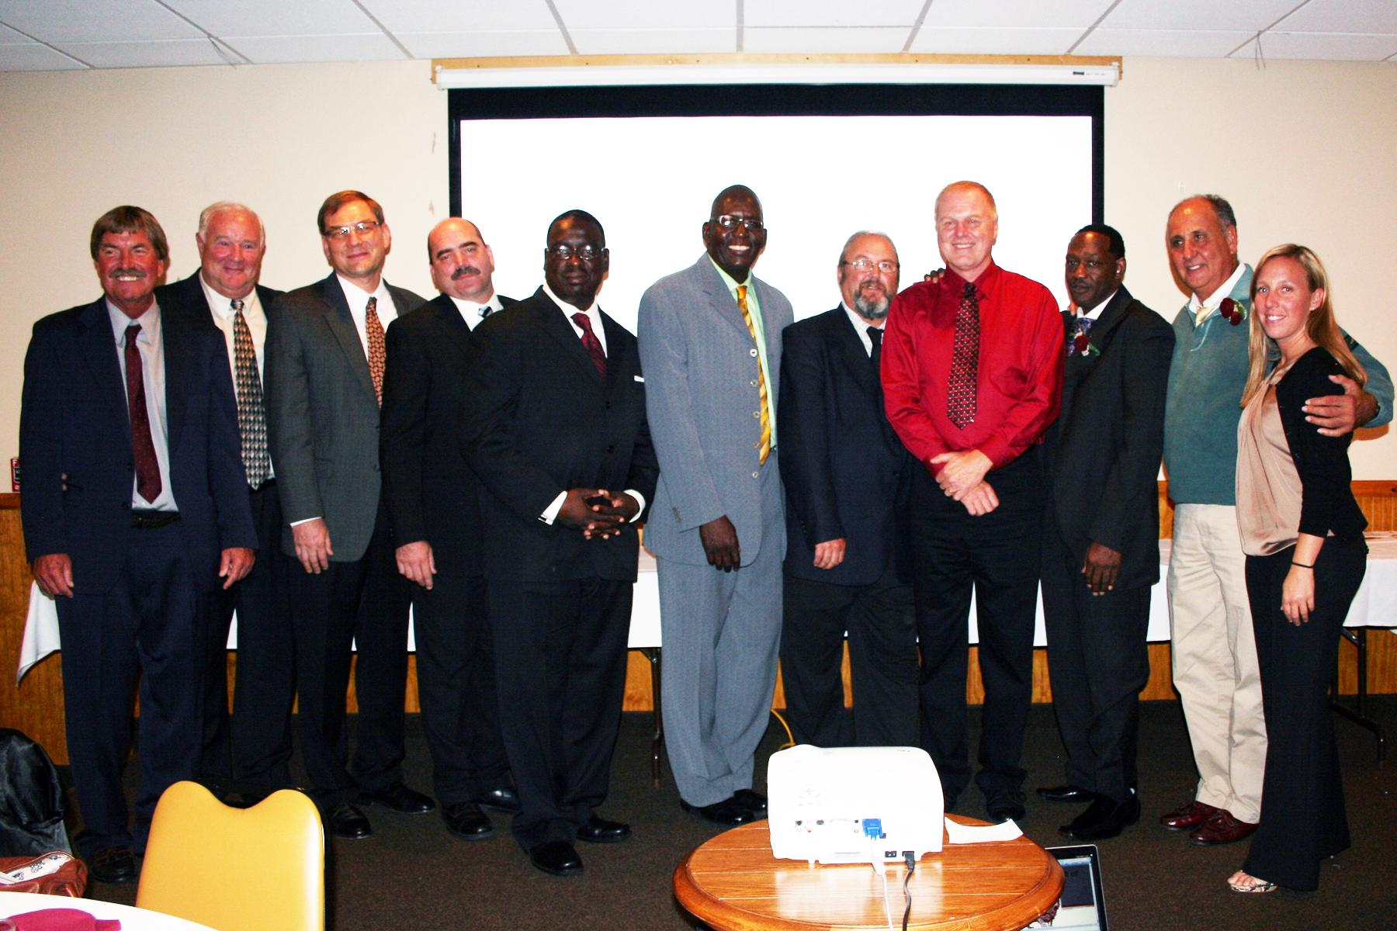
Inductees:
Mike Cassavino
Dave Fratangelo
Pete Kitchen
Clarence Potter
Alison Schott
Alan Simmons
1980 Boys Basketball Team

Slide 292
Mike Cassavino

Slide 293
Mike Cassavino
Sgt. Michael Cassavino was born April 24, 1915, the fourth of seven children born to Carmine and Philomena Cassavino. Mike was killed on September 15, 1943, during the landing operations at Salerno, Italy. He was the first Lyons man killed in WWII. The American Legion in Lyons, Collins-Cassavino Post 227, is named after Bert Collins, first Lyons man killed in WWI, and Michael Cassavino.

Slide 294
Mike Cassavino
Mike was an outstanding athlete at Lyons High School and later in amateur and semi-pro baseball as a player and manager. Principal Archie Bowler stated, “We in school admired him as a student as well as an athlete.” Coach Elbert Atwook commented, “Mike had a great fighting heart, but he was a square shooter.” Mike played guard on Coach Atwood’s 1931, ‘32 and ‘33 football teams. The 1932 and ‘33 teams were Wayne County Champions. Coach Atwood stated, “Those teams are what any coach would have been glad to call a coach’s dream.”

Slide 295
Mike Cassavino
Mike also played basketball and in 1932 and ‘33 , and was the captain for the St. Michael Ramblers. In 1932-34, Mike played on three Wayne County Championship baseball teams. Perhaps no high school ball player hit harder than Mike Cassavino. “Mike’s batting average throughout his high school career was exactly .440, and many of his hits were home runs or at least extra base hits,” Coach Atwood said. On the baseball field, Mike was a versatile player, being a splendid catcher, a great thrower, a good infielder and a very fine outfielder.

Slide 296
Mike Cassavino
Mike was a member of the St. Michaels’ baseball team which won the championship of the Lyons Republican League in 1934 and 1937. He also managed and caught for the Lyons team which won the championship of the Powers and Vail League in 1939 and 1940. Mike played baseball for area teams until his Army enlistment in 1942.

Slide 297
Mike Cassavino
Besides his widow, Rose Williams, and his parents, Mike had four brothers: Anthony, Thomas, Rocco, and John, and two sisters, Jennie and Josephine.

Slide 298
Dave Fratangelo

Slide 299
Dave Fratangelo
According to Dave, “I was truly blessed and privileged to play amongst a group of very talented athletes and coached by terrific people. From 6th grade on, we didn’t even approach a game thinking whether or not we would win. It was always a matter of by how much of a margin. What made it more rewarding was competing at Double AA level. If you look up Wayne-Finger Lakes Champions during our junior and senior years, I’m almost certain one will find either outright or shared championships for Lyons in football, basketball and baseball.”

Slide 300
Dave Fratangelo
“Though we didn’t win any championships in our sophomore year, a message was sent to powerhouse football teams such as Mynderse Academy, Clyde, Waterloo, Geneva, DeSales and Penn Yan to be prepared for what was about to come from the Lyons Lions,” continued Dave.

Slide 301
Dave Fratangelo
During high school, Dave was football All-Conference as a defensive and offensive end in 1961 and ‘62, as well as All-Conference guard for basketball the same years. For baseball, Dave was an All Conference 1st baseman in 1962.
Dave went on to study at the University of Buffalo, playing basketball on the freshman team, as well as two years on varsity. He graduated with a BS in Business Administration in 1966.

Slide 302
Dave Fratangelo
Dave served as a member of the US Navy, as supply officer for three years aboard the USS John King (DDG-3). During his Naval career, Dave was the quarterback on the US Navy Supply Corps 1968 Championship Football team.
After release from active duty, Dave played on many basketball and baseball teams in Italy and Japan, many of which involved either active duty personnel or ex-collegiate members of the International Community.

Slide 303
Dave Fratangelo
Dave has worked as an internal auditor (NYC), Contract Administrator (Europe), Retail Operations Manager (Japan) and in Real Estate (US & Japan). He captained the Yokohama Athletic Golf Section for 12 years and won numerous team tournaments throughout the Kanto Plain.
Dave has been married to his wife JoAnn for 38 years. They are the proud parents of two boys, Anthony and Christopher.

Slide 304
Pete Kitchen

Slide 305
Pete Kitchen
Pete graduated from Lyons Central School in 1975. During his varsity football years from 1973-75, Pete wore #14. During the 1974’75 football seasons, Pete was co-captain, selected as Wayne-Finger Lakes West All Conference quarterback, voted the team’s Most Valuable Running Back and received the Sportsmanship Award. He was second in scoring for the entire Wayne-Finger Lakes League, racking up 12 rushing TDs and 6 extra points. In a game against Red Jacket, Pete rushed for 137 yards on 13 carries, scoring 3 TDs. He ran for 101 yards on 8 carries against HF-L. Pete also threw for 8 touchdowns to a variety of talented receivers.

Slide 306
Pete Kitchen
During Pete’s high school athletic career, he also participated in varsity track where he ran the 100 yard dash, and the 220 yard dash and the 880 relay. Pete’s best time in the 100 was 10.2 seconds. He also recorded a time of 22.9 seconds in the 180 low hurdles. Pete was also a member of the 880 relay: 1:34.6 (Section V Class B record in 1972), Class B Champions (Dale Morris, Pete Kitchen, Larry VanHousen, Larry Bailey). He was voted Top Sprinter in the spring of 1975.

Slide 307
Pete Kitchen
In Pete’s words: “The thought that I am remembered for my sports enthusiasm and accomplishments is surreal to say the least. I loved playing football as #14 and running track. The coaches were always so encouraging and helpful, the student body and all the adults were also so enthusiastic. I can remember the stands being full of classmates, their parents and my family; everyone came out in full force to rally on the Lyons Lions. I can still hear roaring from the crowds. I remember the big pep rallies and parades and bonfires. I also

Slide 308
Pete Kitchen
Remember being the point of play on a float from another team where I was hanging from a noose, all in fun of course. Sports certainly meant a lot to me and helped me to become the man I am today. Not just the competitions but the sportsmanship that we all showed on the field. There was a true camaraderie among all of us players, and we became friends and allies for many years. But for sure my most memorable moment was winning a certain race that was as close as close could be.”

Slide 309
Pete Kitchen
In 1977, Pete married Diane Calabrese; they have two wonderful children, Kra and Grant. Kira was married on August 6, 2011, and Pete and Diane have welcomed a new son in law, Craig Wadsley into their family. Son Grant has a wonderful girlfriend, Leslie Hicks, and a beautiful baby boy Brayden Gregory Kitchen. Pete and Diane still live in Lyons. The Kitchens have many wonderful friends that have remained in Lyons; they take great pride in being able to say that their family and friends are some of he most important things that they are lucky to have.

Slide 310
Clarence Potter III

Slide 311
Clarence Potter III
Before graduating from Lyons Jr. Sr. High School, Clarence Potter III, or Pumpkin as his family and friends called him, was a truly gifted athlete and great young man. Clarence was a tough running back for the football team from 1980 thru the 1982 season. He received 1st team All-Conference honors, All-Greater Rochester Honorable Mention and Lyons Football Team’s Best Back Award all three seasons. Clarence also received the Times Union’s Super 22 recognition, as well as All-State 2nd Team recognition in 1982. In his senior season, he was selected to play in the Eddie Meath All-Star game.

Slide 312
Clarence Potter III
Clarence was the center on the high school basketball team from 1981 until 1983. During the ‘82-’83 season, he was awarded the Lyons Central School Firemant of the Year award and was a member of the ‘81-’82 team that finished second in the state tournament.

Slide 313
Clarence Potter III
During his high school track career, Clarence was a member of the 4x100 relay team that set the school and county record in 1983 at the Aquinas Relays that still stands at both the school and county levels. That relay team was also 1st Team All-League that year; he also ran the 200m and was long and triple jumper. In 1982, Clarence added the 800m relay to his events and was voted Most Consistent track team member. He finished off his high school career by being voted Most Athletic in the Class of 1983.

Slide 314
Clarence Potter III
Clarence continued his football career at SUNY Cortland, where he was a running back during the 1983 and ‘84 seasons.
Clarence and his wife Teresa have seven children and live in Georgia.

Slide 315
Alison Schott

Slide 316
Alison Schott
Alison was an outstanding three sport athlete during her years at LHS. From 1991-94, she started as a midfielder on the soccer team. In 1994 Alison was selected to 1st team All-County and participated in the Wayne County All-Star Soccer game. She was point guard on the high school basketball team from 1991-95. In her senior year, Alison was captain of the basketball team, made 1st team All-County and was chosen to play in the Ronald McDonald HIgh School All-Star Game. In the spring, Alison ran the 100, 200, 400 hurdles and was a long jumper for the track team.

Slide 317
Alison Schott
From 1995-99, Alison continued her athletic career at Guilford College in North Carolina. She was a midfielder in soccer and a point guard for the basketball team. In 1997, Alison was team captain in soccer, and in 1998 was captain for both the soccer and basketball teams. Alison was chosen 1st team All-Conference (ODAC) soccer in 1997 and ‘98 as well as soccer MVP during both seasons. In 1998 she was voted Best Undergraduate Athlete and Best Defensive Player in basketball.

Slide 318
Alison Schott
Alison was voted Best Senior Athlete and was awarded the Guilford English Athletic Leadership Award in 1999.
Alison graduated from Guilford College with records for goals in a season, points in as season, career goals and career points in soccer.
After college, Alison continued her career in soccer, playing five years in the W-League wit the Piedmont Spark/Greensboro Twisters/

Slide 319
Alison Schott
Alison currently lives in Greensboro, NC, where she works as an accountant at Forman Rossabi Black. She has also coached travel soccer for 13 years and currently has a U12 and U14 Classic team. Her brother Dean and her sister Kirstin were previously inducted into the Lyons Athletic Hall of Fame.

Slide 320
Alan Red Simmons

Slide 321
Alan Red Simmons
Alan was a three year All-League 1st team performer in basketball and baseball. In basketball his versatility allowed him to play all positions. He played guard and forward shi sophomore season averaging 14 ppg. He was named to the 1st team All-County. This 1971 Lyons team was undefeated and ranked #1 for several weeks in NYS for small schools. Winning most games easily by double digits, the #1 seeded Lions were upset in the sectionals. This was the only loss in a 19-1 season.

Slide 322
Alan Red Simmons
During his junior year, Alan was the only unanimous All-Star team choice in the league, Greater Rochester All-Star, and named to the NYS All-State team. He averaged 17 ppg, making his mark as a premier defender. He was often tasked to guard the opponent’s leading scoring threat, no matter what position the opponent played. As league champion with only one loss and the #1 sectional see, Lyons was again upset in the Sectional Finals. During his senior year, Alan was called upon to score more and responded by leading the league in scoring, averaging 24 ppg. He was again the only unanimous 1st team All-League selection.

Slide 323
Alan Red Simmons
Other awards earned by Alan during basketball were for best foul shooter, sectional All-Star teams, MVP of a Christmas Tournament, and Lyons Athlete of the Year. Christened “Big Red” by Coach Dick Blackwell, he honed his skills playing junior high basketball for the legendary coach.

Slide 324
Alan Red Simmons
In baseball, Alan was a hard throwing left handed pitcher. He was a four year starting pitcher with three no-hitters to his credit. In one game he struck out 17 batters. Alan had at least two one-hit games, including a no-hitter lost with two outs in the last inning. He had many games with double digit strikeouts. Alan also pitched one season at Erie Community College.

Slide 325
Alan Red Simmons
Alan was scouted by many major league team organizations that visited Lyons to watch him pitch, including the Philadelphia Phillies and the New York Mets. Being recruited by many colleges, Lyons native Santo DeSain was the head baseball coach at ECC. He convinced Alan to attend Erie, where he pitched a no-hitter against Buffalo State, and had other exceptional performances. Alan was tutored by Al Widmar from the Milwaukee Braves, who was pitching coach for the Newark Pilots, their farm team.

Slide 326
Alan Red Simmons
Alan served in the US Navy for ten years, earning two honorable discharges - one touring overseas, and the second as a Congressional Staff Writer in Washington D.C. He is now a manager for a global market research and consulting firm.
Alan is married to his wife Polly, a former Lyons ES teacher who now teaches in the marcus Whitman district. They have two daughters, Danielle and Rachel, and reside in Canandaigua, NY.

Slide 327
1980 Boys Basketball Team

Slide 328
1980 Boys Basketball Team
The 1980’s Boys Basketball team had a tremendous season. They were crowned Wayne County Champions, Section V Champions, Western Regional Champions and NYS Class C Champions while comprising a record of 25 wins and 2 losses. The team was coached by Rod Verkey, with JV coach Dean Schott, and JH coach Chuck Meyers assisting.

Slide 329
1980 Boys Basketball Team
The co-captains of this great team were Al DiSanto and Elgin Riggins. The team averaged 68 points per game, while only giving up 50 points per game.
Kenny Kemp and Elgin Riggins were selected 1st team All-League, while Al DiSanto was selected to the 3rd team All-League. Elgin Riggins was also honored by being selected to the 1st team All-Greater Rochester.

Slide 330
1980 Boys Basketball Team
This team was the second team in Section V to win a State Championship and the first of may Wayne County teams to achieve this goal.
What a wonderful experience for these young men and their coaches.

Slide 331
1980 Boys Basketball Team Members

Slide 332
Class of 2012
Ninth Annual
Athletic Hall of Fame Induction Dinner

Slide 333
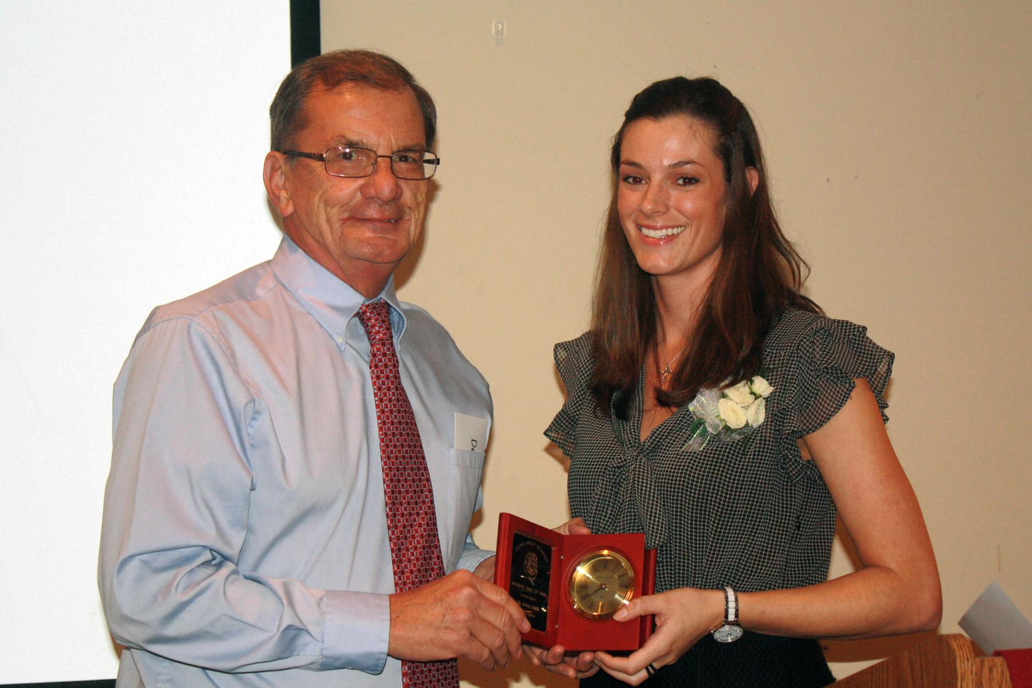
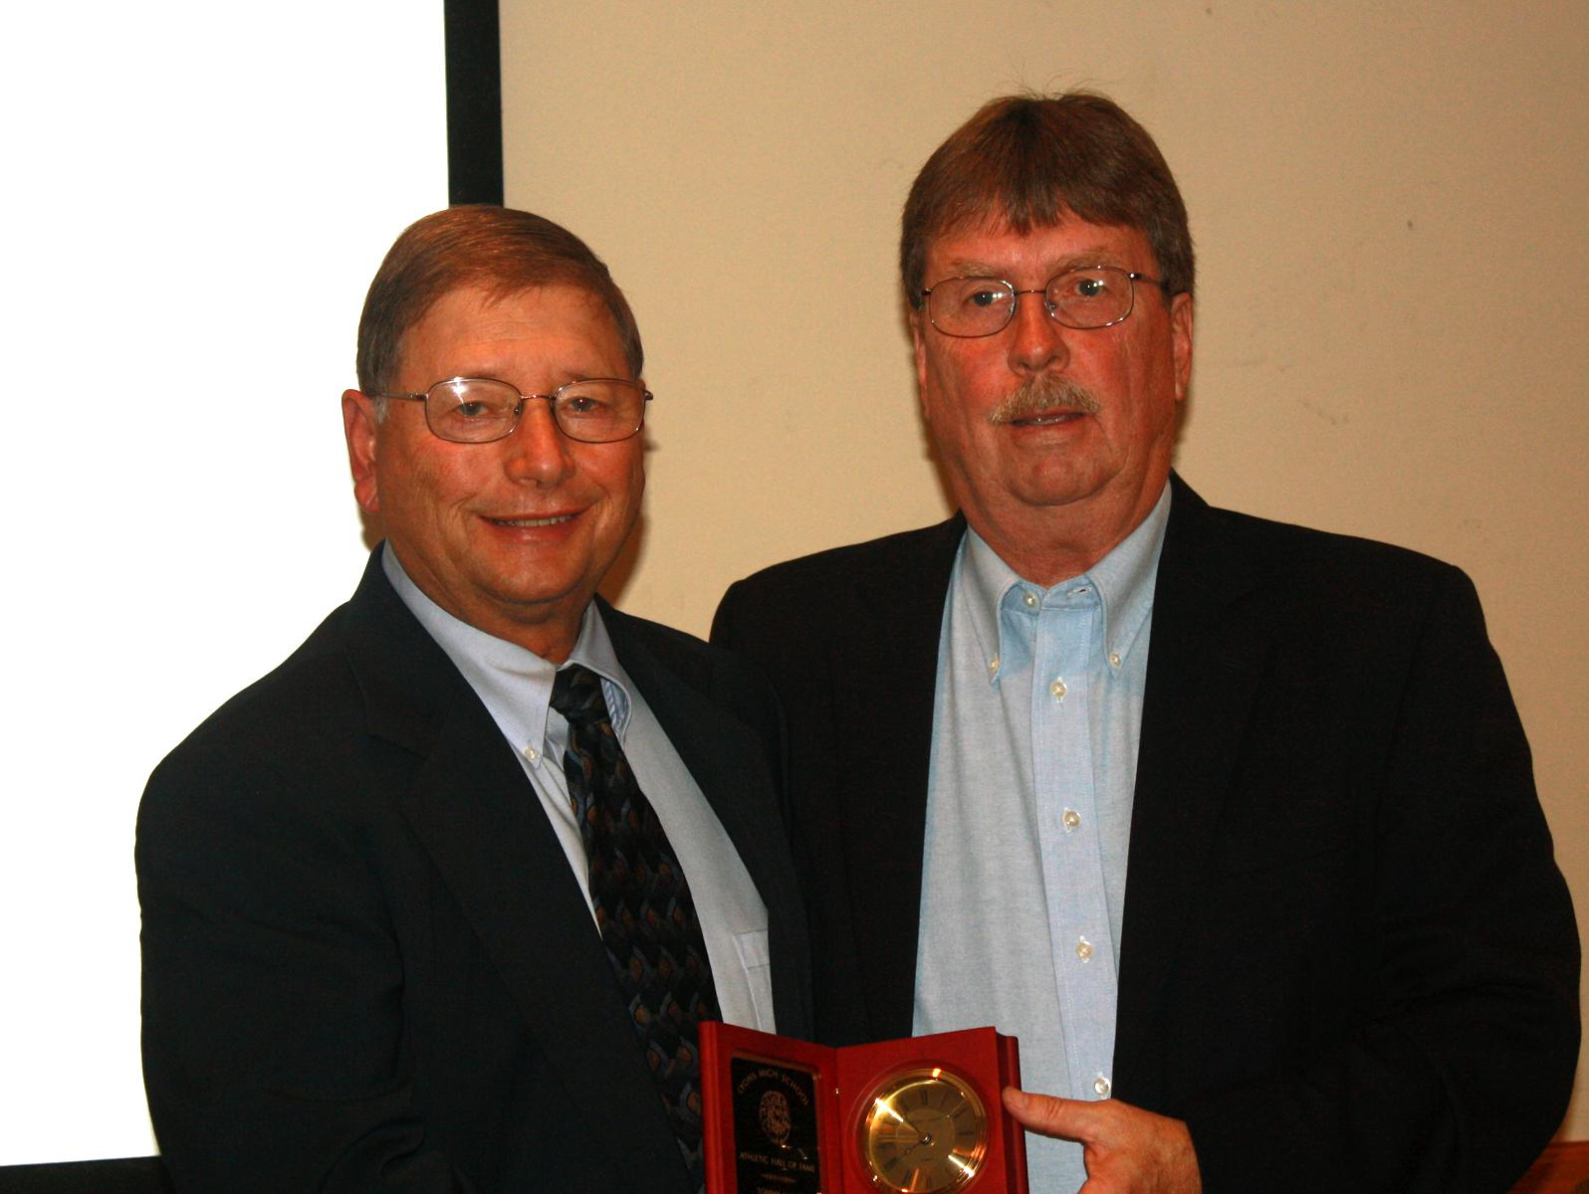
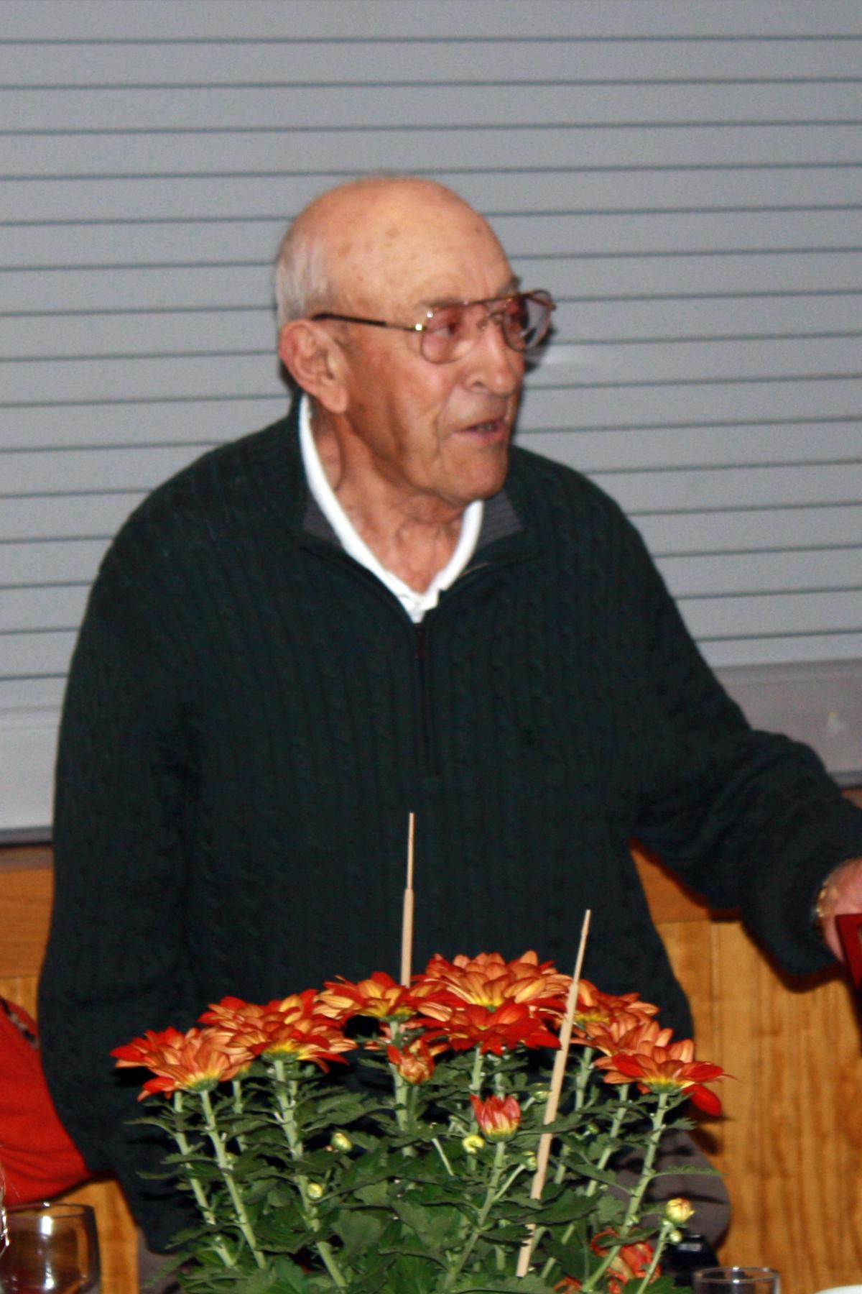
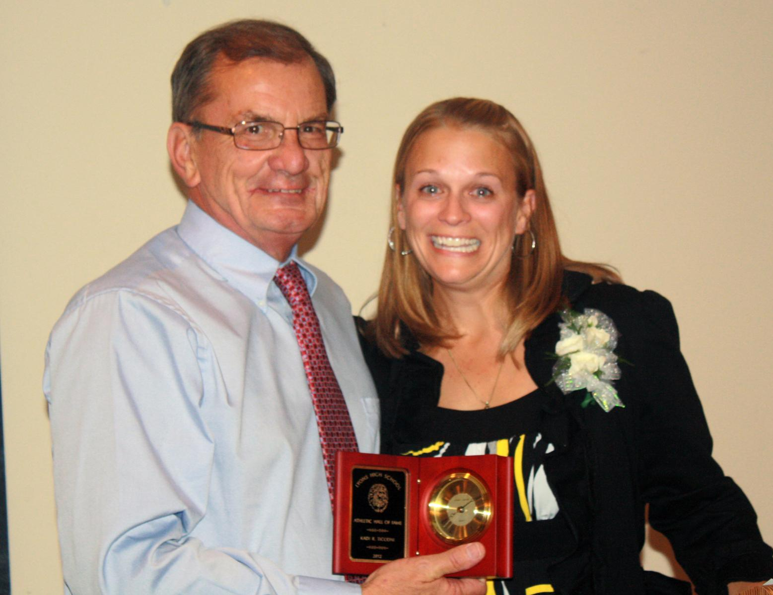
Inductees:
Dr. Anna Barbi
Tommy Maine
Dean Schott
Kadi Sholly Ticconi
Gary Tunnison
Kim Virts
1972-75 Girls Basketball Team
2000 Girls Track Team

Slide 334
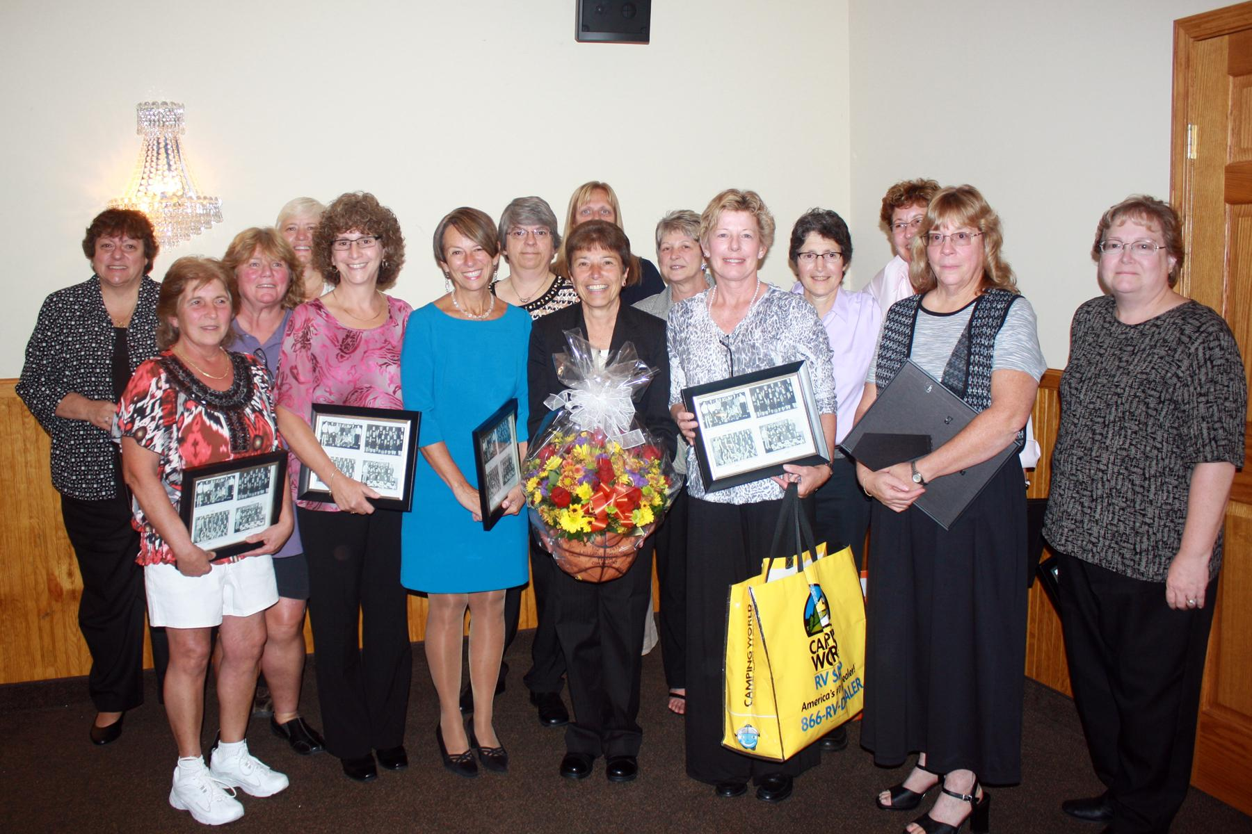

Slide 335
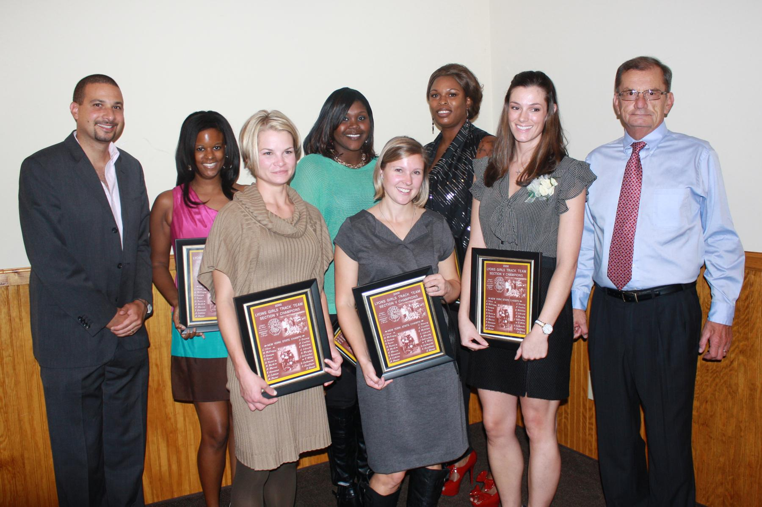

Slide 336
Dr. Anna Barbi

Slide 337
Dr. Anna Barbi
Annie Barbi was an outstanding athlete for Lyons. She was a three year varsity soccer player, and the team's leading scorer her junior and senior seasons. She was named to the Wayne County League All Star 2nd team her junior season and to the 1st team her senior year. Annie was captain of the team in her senior year, and was also named the teams Most Valuable Player.

Slide 338
Dr. Anna Barbi
Annie was also outstanding on the hardwood, starting three years on the varsity team. Her team was a three time Wayne County Champion and a three time Section V runner up. Annie was named to the Midlakes Tip Off Tournament Championship Team; she was a Finger Lakes Times three tiem “Fab Five” honorable mentions, a three time Wayne County All-Star, a 1999-2000 Section V Class CC Tournament All Star, and the MVP of the 2001 Wayne County Exceptional Senior game for most two point shots made and most points in a game.

Slide 339
Dr. Anna Barbi
Anne was a superb track athlete and excelled on the school's varsity track team for five seasons. She was a member of four Wayne County Championship teams, and captained the team her senior year. As an 8th and 9th grader, she was named to the Wayne County All Star 1st team as High Jump Champion. During her sophomore year, she made the 2nd team in the high jump, and during her junior and senior years she was named the Wayne County All Star 1st team Pentathlon Champion.

Slide 340
Dr. Anna Barbi
Anne’s contribution helped the 2000 track team to become Section V Track and Field Champions. Annie was a four time Section V Individual Champion in the high jump (‘97 and ‘98) and the Pentathlon (2000 and ‘01). In the 2001 Meet of Champions Annie was the overall Pentathlon Champion. She was a member of the 2000 New York State Class C/D Championship Team and a four time New York State Individual winner in both the high jump (4th and 2nd) and pentathlon (6th and 4th).

Slide 341
Dr. Anna Barbi
Annie was the Pentathlon School record holder 2000-01, two time recipient of the Leon Hill-Bob Jones Memorial Award, and the Wayne-Finger Lakes Chapter of Track and Field Officials Award for Outstanding Female Athlete in 1997 and 2001. She was a scholar athlete multiple times and received the 2001 LCS Outstanding Female Athlete of the Year Award and the US Army Reserve National Scholar Athlete Award.

Slide 342
Dr. Anna Barbi
Annie continued her athletic career at the University of Rochester, totaling eight varsity letters for Indoor and Outdoor Track. Se was Rookie of the Year and captain of both teams, earning multiple MVP honors. Her versatility allowed her to successfully compete in a variety of individual events as well as relays, the pentathlon and heptathlon. She placed 21 times at the NYS Collegiate Championships and qualified each season for the ECAC Championships, finishing in the top 7, six times.

Slide 343
Dr. Anna Barbi
Annie graduated from medical school with honors and is living and working in New York City as an OB/GYN resident at Lenox Hill Hospital. She has continued to enjoy organizing and participating in charitable walks and runs.

Slide 344
Tommy Maine

Slide 345
Tommy Maine
Tommy Maine was a very accomplished athlete at Lyons Jr. Sr. High School. He was a starter on the school’s basketball team for three years. In 1957, he was selected to the 2nd team All Wayne-Finger Lakes and to the 1st team All Wayne-Finger Lakes in 1958. During the ‘58 season, he was the team’s second leading scorer, averaging 17.4 ppg.

Slide 346
Tommy Maine
Tommy was a four year starter on the baseball team as a pitcher and outfielder. He was the #1 pitcher on the 1958 Wayne-Finger Lakes League Championship team. He also played football his freshman year.
Tommy continued his athletic career at the Rochester Business Institute as a guard on the basketball team. He then went on to play professional baseball.

Slide 347
Tommy Maine
From 1959-61, Tommy was a pitcher in the Cleveland Indians farm system where he pitched at the Class B level and in 1961 he was a pitcher in the NY Yankees farm system where he ended his baseball career. He became a family man and began a long career working for Xerox.

Slide 348
Tommy Maine
Tommy passed away in July of 1994 while living in California. Tommy’s wife Pam was a Williamson native. He has two children, a daughter Tracy and son Michael. All three currently live in the Phoenix, Arizona area.

Slide 349
Dean E. Schott

Slide 350
Dean E. Schott
Dean Schott coached basketball, football and golf in his tenure at Lyons Central School. Although he enjoyed and was successful coaching all of the sports, he is best known for basketball. Dean coached varsity basketball from 1981 to 2003, compiling a record of 417 wins and 103 losses. Over that time period, Lyons won nine sectional titles, played in three NYSPHSAA State final games, and winning both the NYSPHSAA and Federation Championships in 1989.

Slide 351
Dean E. Schott
Dean has been named SEction V Coach of the Year seven times, along with All Greater Rochester Coach of the Year in 1982 and New Your State High School Coach of the Year in 1989.He served as an officer and Section V representative to the Basketball Coaches Association of New York for over 25 years. Coach Schott was elected into the New York State Basketball Hall of Fame and Section V Basketball Hall of Fame in 2009.

Slide 352
Dean E. Schott
Dean and his wife Suzanne have three children, son Dean and daughters Alison and Kristin. All three of their children are precious inductees into the Lyons Athletic Hall of Fame. Dean and Sue now reside in Fort Myers Beach, Florida.

Slide 353
Kadi Sholly Ticconi

Slide 354
Kadi Sholly Ticconi
Kadi was a very accomplished high school athlete. She played forward and right win for the soccer team from 1995-97. In 1996 she was named the team’s Offensive Player of the Year and was named to the 2nd team Wayne County All-Stars. In 1997, Kadi was team captain, a recipient of the Golden Heart Award and participated in the Senior All-Star game. That year she was also named Honorable Mention for the All Greater Rochester team and was named to the 1st team Wayne County All-Stars.

Slide 355
Kadi Sholly Ticconi
Kadi was also the shortstop for the softball team from 1995-98. In 1995 she was named Defensive Player of the Year. She was named Offensive Player of the year in 1996. Kadi garnered MVP honors in 1997, and in 1998 was named team captain, received the Wayne County Coaches Award and received the US Army Reserve National Scholar Athlete Award. Kadi was named to the 1st team Wayne County All-STars in 1996, ‘97 and ‘98.

Slide 356
Kadi Sholly Ticconi
Kadi went on to SUNY Cortland where she participated in intramurals, playing indoor soccer, broomball, volleyball and softball.
After college, Kadi moved to Cooper City, Florida and spent two years with the Cooper City Cowboys as an assistant varsity softball coach.

Slide 357
Kadi Sholly Ticconi
Today, Kadi resides in Seneca Falls with her husband Rhett and their two children, Karter and Ava. kadi currently teachers physical education at the LaFayette Intermediate School in Waterloo, NY. Karter and Ava keep Kadi pretty busy as she is an official “soccer mom.”

Slide 358
Gary Tunnison

Slide 359
Gary Tunnison
Gary Tunnison was a three sport athlete from the 1957-62 era of Lyons Central athletics. As a football player, Gary was co-captain of the 1961 League Champion Lyons Lions. He had to change his position to quarterback when the starting quarterback was injured. He led the team to finish that undefeated season.

Slide 360
Gary Tunnison
As a basketball standout, Gary played point guard and was highlighted in an article by Norm Jellow of the Geneva Times as “it was Tunnison that left the fans speechless wit the kind of passing that you expect for Bob Cousy.” Averaging 9 ppg, Gary took pride in leading the team in assists and setting the shool record of 59 assists in 14 league games, including 10 in one game.

Slide 361
Gary Tunnison
Gary was voted the Section V floor leader at the Section V Tournament. Coach Blackwell referred to him as “one of the most underrated players on the club. Hooks, as he was called, was his ‘guts’ player, fast hands and feet and hustling every second.”

Slide 362
Gary Tunnison
Gary’s real athletic calling came in baseball. He was a leader on a remarkable baseball team, so much so that he was awarded a scholarship to a Division IA baseball school, the University of Nebraska. Gary finished his baseball career on the Nebraska Cornhuskers and is still living in Nebraska.

Slide 363
Kim Allen Virts

Slide 364
Kim Allen Virts
Kim was a four sport athlete during her career at Lyons Jr Sr High School. She was a four year goalie for the varsity soccer team where she recorded a record 621 saves at goal and received the 1986 MVP award. She was also named Wayne County League Goalie of the Year in 1985.

Slide 365
Kim Allen Virts
Kim was a two year starter for the volleyball team which lost in the Section V finals in 1985. As a freshman, Kim started on the 1982-83 basketball team. She also played varsity softball as a freshman and went on to be selected team MVP in 1985 and ‘86. She was a Wayne County 1st team All-Star in 1985 and ‘86, the 1986 Female Athlete of the Year at Lyons, recipient of the US Army Scholar Athlete Award, and the recipient of the Finger Lakes Chapter of the Industrial Management Council’s Lawrence J. McLaughlin Award.

Slide 366
Kim Allen Virts
Kim has three beautiful children and has been married to her husband Tom for 23 years. She has worked in the dental field for 25 years, 13 as a Dental Assistant and 12 as a Dental Hygienist. Kim has since taken a leave of absence from her professional career due to medical reasons. She is currently enjoying a new passion that has become her full time career. For the past 7 ½ years, Kim has worked for Silpada Designs Jewelry. She manages a team of 50 women form NY, NH, FL and GA. She empowers these women to be the best they can be and offers them life changing opportunities.

Slide 367
Kim Allen Virts
Kim recently received awards for Career Sales, Party Consistency, Exceptional Party Consistency and Exceptional Recruiter.
Kim has helped coach various your sports teams at the LCC, and she has been the treasurer and helped in various areas of the Lyons Youth Baseball and Softball leagues. Her hobbies include running and power walks to stay in shape, camping with her family, traveling around the country, gardening, spending time with girlfriends and going shopping.

Slide 368
1972-75 Girls Basketball Team

Slide 369
1972-75 Girls Basketball Team
The 1972 Girls Basketball team was the first girls basketball team in the history of Lyons Central School. The team bought their own uniforms, which consisted of a short sleeve sweatshirt with their name and number. The league consisted of nine Wayne County schools with no post league play. The girls posted an 8-0 record and captured the Wayne County League title.

Slide 370
1972-75 Girls Basketball Team
Members of the 1972 team included: Dawn Wadsworth, Kim Murphy, MaryAnn DeSain, Chris Stauch, Denise Darcangelis, Diane Darcangelis, Debbie Kelly, Anne Dapolito, Robin Brown and Jolene DeSain

Slide 371
1972-75 Girls Basketball Team
In 1973, the girls opened their second season with new uniforms and a chance to go to an open sectionals by winning 70% of their games. They were once again Wayne County League Champions with an 8-0 record. The girls played one sectional game, losing to Rush Henrietta.

Slide 372
1972-75 Girls Basketball Team
Members of the 1973 team included Dawn Wadsworth, Kim Murphy, MaryAnn DeSain, Chris Stauch, Denise Darcangelis, Diane Darcangelis, Debbie Kelly, Anne Dapolito, Robin Brown and Jolene DeSain from the ‘72 team, and adding Chris Aunkst, Cheryl Ochs and Katie Magill.

Slide 373
1972-75 Girls Basketball Team
Beginning in 1974, the team expanded to a longer playing season. The league was split into Large and Small School divisions. Each school played every other school in the own division twice, while playing each school in the other division once. This expanded the season for Lyons to 12 games. Co captained by Km Murphy and Anne Dapolito, the girls defeated Marion at the buzzer to go 11-1 and win the Wayne County Title for the third consecutive year. Once again the girls played in sectionals, losing to Franklin in a close game.

Slide 374
1972-75 Girls Basketball Team
The team added Cathy Smith, Kim Palmer, Chris Tricarico, Chris Mierke, Barb Cotie and Tara Quagliata. Lyn Washburn served her first year as a basketball manager.

Slide 375
1972-75 Girls Basketball Team
In 1975, with 11 returning letter winners, only Jill Johnson was added to the roster. Once again, for the fourth consecutive year, Lyons won the Wayne County League title with a record of 10-2. Sectionals were divided into four divisions, ABCD, with Lyons playing in Division B. The girls won their fam against Livonia, but lost to Midlakes in the next round.
From 1973-75, the Lyons Girls Basketball team was 37-3 in league play and won four consecutive Wayne County League Titles.

Slide 376
2000 Girls Track Team

Slide 377
2000 Girls Track Team
The 2000 Girls Track Team was a veteran squad on a mission, having fallen shor in 1999 in their quest for a Sectional and State Title. Led by senior stalwarts Dedria Foster and Laura Olson, alone with a strong supporting cast of talented veterans and young athletes, the Lady Lions went undefeated in the Wayne County League, won several invitational meets and then set eleven Section V Individual and Relay records in winning the Class CC Sectionals.

Slide 378
2000 Girls Track Team
Six girls then qualified in 11 events for the State Meet. The girls won five events at the State Meet, along with one 2nd, two 3rd and a 5th place finish, earning the Lady Lions the Class CD State Championship.
Their mission was accomplished.

Slide 379
2000 Girls Track Team
Team accomplishments:
Wayne County Champions (6-0)
Section V Class CC Champions
11 Number 1 seeds
11 Sectional Champions
11 Section V Class CC & School Records Set
Meet of Champions (State Qualifiers): 11 Qualifiers
NYSPHSAA: State Meet Class CD Champions
NYSPHSAA: Academic All State

Slide 380
2000 Girls Track Team
State Meet Competitors:
Champions:
Dedria Foster (100 & triple jump)
Celestine Coney (100HH & 400 HH)
400 m Relay Team (Olson, Wiles, McCray, Foster)
Second: Danielle McCray (High Jump)
Third:
Danielle McCray (Long Jump)
Celestine Coney (400m)
Fifth: Anna Barbi (Pentathlon)

Slide 381
Class of 2013
Tenth Annual
Athletic Hall of Fame Induction Dinner

Slide 382
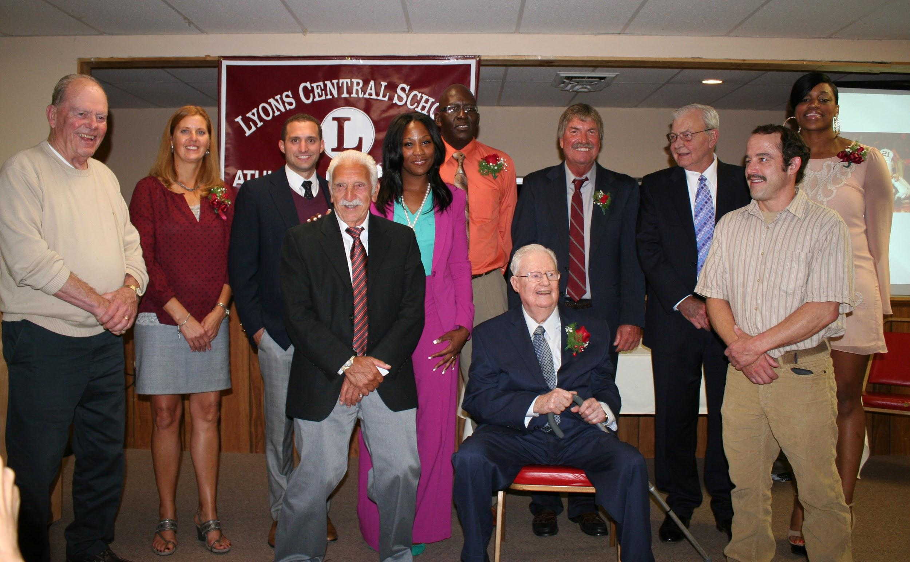
Inductees:
Nick Alena
Celestine Coney
Lucas Dobbins
Lauren Blaisdell Felker
George B. Fletcher
Janitha Knight
Elgin Riggins
1951-52 Boys Basketball Team
1953-54 Boys Basketball Team

Slide 383
Nick Alena

Slide 384
Nick Alena
Nick was a four sport athlete at Lyons High School. He participated in football, basketball, baseball and indoor track. Additionally, as an eighth grader, he started on the varsity bowling team. Nick was the 2003 Male Athlete of the Year at Lyons Central School.

Slide 385
Nick Alena
Nick’s major sports were football and baseball. In his freshman year, Nick started on the varsity football team as a defensive back. In his sophomore year he was added to the offense as a wide receiver while continuing to play at defensive back. Durgin his junior year he became quarterback, while still continuing as a defensive back. He started at quarterback in his senior year, but was switched to running back to five the team their best chance at winning a championship During his four years on the team he also served as a kicker and special teams returner.

Slide 386
Nick Alena
Nicks honors in football included: National Football Foundation and College Hall of Fame Golden Award as the top high school Scholar-Athlete in the All Greater Rochester Area, Section V Offensive Player of the year, 1st Team All-State Running Back, MVP of Section V Championship game, four years Finger Lakes All-Conference Team, 1st Team running back, 1st Team defensive back, All Greater Rochester 2nd Team running back, Lyons MVP for 2001 and ‘02, and the Black Glove Award for most interceptions.

Slide 387
Nick Alena
Nick was co-captain of his team in 2001 and 2002, and a scholar athlete throughout his high school career. He also played in the Eddie Meath Senior All-Star game of All Greater Rochester. Nick led his team to the 1st Section V Championship for Lyons in over 20 years. He and his teammates also played in the 2002 State SEctional Game at Wilson Stadium in Buffalo.

Slide 388
Nick Alena
In baseball, Nick started on the varsity team as a sophomore. His positions were shortstop, second base, pitcher and outfield. Highlights of his baseball career include: breaking the NYS Career Stolen Base record with 100 and most steals in a season, Lyons MVP in 2002, member of three Wayne County Championship teams, 1st team Wayne County All Stars in 2001 and ’02, and American Legion Scholar Academic Excellence Awards, 2001-2003. A special highlight was hitting a grand slam at Doubleday field in Cooperstown to capture a 7th inning victory against Wayne.

Slide 389
Nick Alena
After graduating from Lyons in 2003, Nick entered St. Lawrence University where he played on the varsity team starting on all four special teams and as a defensive back his freshman year. He was named Special Teams Player of the Week. Nick continued to play college football in his sophomore year as a wide receiver, but was hampered by an injury that held him out for the first five weeks of the season.

Slide 390
Nick Alena
Nick graduated cum laude from St. Lawrence in 1007 with a double major in Mathematics and Fine Arts, and a minor in Statistics. He continued his education and received a Master's of Science degree in Applied Statistics from RIT. Nick presently resides in Chicago, where he is a Senior Research Data Analyst in the Gardner School at Northwestern University. Nick is truly enjoying the benefits of big city living and continues his athletic activities by playing recreational basketball, beach volleyball and golf. He also attends many Bears, Bulls, Cubs and Blackhawks games.

Slide 391
Celestine Coney

Slide 392
Celestine Coney
Celestine Coney was a very accomplished athlete in high school and college. She played two years of varsity basketball, two years of indoor track, four years of varsity volleyball and five years of outdoor track.
Celestine was an excellent volleyball player. She was a 1st team All-Star for three years, beginning as a sophomore. She was selected to the Section V All-Tournament team as a junior, and led the team to a 14-2 record in her senior year.

Slide 393
Celestine Coney
Celestine's accomplishments in track, both indoor and outdoor, are truly amazing. In indoor track, there were no divisions, and all 48 teams competed together regardless of size. Celestine was All-League and Sectional Champion in the 55m hurdles, the 300m aash and the triple jump. She qualified for the state meet in the 55m hurdles and triple jump. In 2002, Celestine led the team to 2nd place in the Class C Championship and she was State Champion in the 55 hurdles and the triple jump.

Slide 394
Celestine Coney
As an 8th grader, Celestine was an All-Star in the 100 hurdles. In 1999, hse set a school record for the 100 and 400 hurdles and came in 3rd in the state meet in the 100m hurdles. In 2000, Celestine was the Sectional Champion for the 100 and 400 high hurdles and the 400m dash. She was State Champion in the 100 and 400 hurdles and 3rd in the 400m dash. In her senior year, Celestine was again a triple sectional champion and she went to States for the 100 HH, 400 IH, triple jump, and the 4x400 relay team. She placed 1st in the 400 IH.

Slide 395
Celestine Coney
Celestine set the school and Wayne County records for the 100 and 400 hurdles, and the 4x400m relay. All four of her years on the the team they were Wayne County Champions with an overall 28-0 record. The team was Sectional Champions in 2000 and 2002, and came in second the other two years.

Slide 396
Celestine Coney
Celestine continued her track career at Buffalo State. She was ECAC Champion in the pentathlon with 3195 points. She was SUNYAC Champion in the long jump, setting a school record of 5.5 meters. She also set a school record of 1.6 meters for the high jump. Celestine transferred to the University of Buffalo in 2003, where she was named Rookie of the Year. While there she set records in the 500m, 400m hurdles, 400m dash, 4.4 meter relay and the sprint medley.

Slide 397
Celestine Coney
Celestine graduated from the University of Buffalo with a Bachelor’s degree in Community Health and she earned an MBA from Ashford University.
Celestine lives in Lyons with her daughter, Sariah Tindal, and has recently been promoted to supervisor at Hillside Family of Agencies.

Slide 398
Lucas Dobbins

Slide 399
Lucas Dobbins
Lucas Dobbins graduated from Lyons in 1988. He started his high school wrestling career as a 7th grader in 1982. That year, despite missing most of the season due to a broken arm, he placed second in Sectionals. Lucas wrestled at many different weight classes during those years, and after that first year he went on to win the Sectional title each year from 1983 to 1987. On top of this accomplishment, he won numerous tournaments throughout New York State. Lucas also held the record for the most wins in the history of Lyons wrestling.

Slide 400
Lucas Dobbins
After high school, Dobbins wrestled for both Monroe Community College and the Rochester Institutes of Technology and had the opportunity to wrestle all over the US. He was within one victory of becoming an All-American wrestler while attending college. In one memorable and improbable match, Dobbins nearly defeated a two-time National Champion, Sammy Francis, losing by only a single point in the final seconds.

Slide 401
Lucas Dobbins
After college, Lucas moved to Rochester and worked in the Financial and Insurance markets. He moved back to Lyons in 1995. Today Dobbins lives in Lyons, has two children, Noah and Alyssa, and is the owner of Dobbins Painting & Contracting, Inc, which he founded in 1996. Lucas has employed many residents of Lyons wh under his guidance have renovated most of the historic buildings and homes in the Village of Lyons.

Slide 402
Lucas Dobbins
Lucas also owns and manages numerous commercial and residential rental properties in the Village of Lyons. In the eighteen years that Lucas has been in business, he has actively supported and promoted the Village of Lyons in many ways, through both monetary donations as well as donations of his time, materials and equipment.

Slide 403
Lauren Blaisdell Felker

Slide 404
Lauren Blaisdell Felker
Lauren was an outstanding Lyons High School athlete from 1978-1981. Lauren played varsity soccer for three years, volleyball for four years and track for four years.
Lauren played left wing in soccer. She was the Outstanding Offensive Player in her junior and senior years. She was team captain her senior year. Lauren was a hitter on the volleyball team. She was named Most Improved her freshman year, and MVP her junior and senior years.

Slide 405
Lauren Blaisdell Felker
As good as Lauren was in soccer and volleyball, she really excelled in track. She competed in a number of events: the 200m. 400m, 800m, 400 hurdles, shot put, and 1600 and 3200 relays. In 9th grade, the team came in 2nd place in Class B Sectionals. The 3200 medley team composed of Jordan, Blaisdell, Bernhardt and Wallace won sectionals in the time of 10:43.3. In 10th grade, the team was undefeated, Wayne County Champions and Class C Sectional Champions. The 3200m relay team composed of Jordan, Krusemark, Blaisdell and Wallace again won sectionals with a time of 10:31.1.

Slide 406
Lauren Blaisdell Felker
In 11th grade, the team was undefeated, Wayne County Champions and Class C Sectional Champions. The 3200m relay team of Nolan, Rainis, Blaisdell and Wallace came in 2nd in Sectionals. The 1600 relay team set a school record at 4:26.2 which stood until 2002. Lauren came in 6th in Sectionals in the shot put with a toss of 8.62 meters. In her senior year, Lauren was named Most Outstanding, the 1600m relay team came in 2nd in Sectionals, and she was named Female Athlete of the Year.

Slide 407
Lauren Blaisdell Felker
Lauren continued her athletic career at Cornell University. She rowed on the freshman crew in the four man shell.
Lauren currently lives in Lyons with her husband Steve and children Wes, Cal and Leah. She spent many years on the Lyons Little League Board of Directors and the concession stand. She has enjoyed coaching and cheering for her children in football, volleyball, cross country, soccer, track, basketball and baseball.

Slide 408
Lauren Blaisdell Felker
Lauren currently serves on the Wayne Hills Country Club Board of Directors. She and her sister, Steff, won the Wayne Hills CC Women's Invitational in 1998 and the Fox Valley Ladies Invitational in 2005. She teachers Special Education at Clyde-Savannah Elementary School.

Slide 409
George Fletcher

Slide 410
George Fletcher
George was born on November 17th, 1922 at his grandparents home in Williamson. When he was five years old, he moved with his family to their home in Sodus, where he lived until he was 39 years old.

Slide 411
George Fletcher
George graduated form high school in 1940 and went back for a P.G. course so he could play sports. He played soccer, football and basketball. After graduation he played semi-pro baseball for the Sodus Point Chiefs and basketball for the Beeftrust team in Sodus. He always loved sports.

Slide 412
George Fletcher
In 1945, George bought his grandfather’s farm in Sodus and married his wife Marian in 1947. The had two daughters, Linda and Roxanne. In 1962, they bought the Verne Barrett property on Route 14 in Lyons. He farmed Pine Hill Orchards and his farm in Sodus for a few years. George says he finally got smart and went to work for many chemical and farm supply companies. It was nice to have a steady paycheck and know every week what it would be.

Slide 413
George Fletcher
After George moved his family to Lyons, he and his daughters attended many games, following the teams all over. That was 51 years ago, and he has hardly missed a game since. This January, he had some health problems, but is slowly getting stronger. He was in the hospital twice and nursing home for rehab. He has a pacemaker and is doing much better and hopes to be going to a lot more games.

Slide 414
George Fletcher
George is thankful for his good friends Alan Simpelaar, Jim Pacello and many others who have attended games with him. The helped to make this honor possible. Thank you all very much.

Slide 415
Janitha Knight

Slide 416
Janitha Knight
Janitha Knight was a standout athlete in both volleyball and basketball during her playing days at Lyons.
Janitha played varsity volleyball for three years. She was named to the 1st Team All-County during her sophomore year, and the team made it to the semifinals in sectionals, when she was named to the Section V All-Tournament Team.

Slide 417
Janitha Knight
During her junior year, Janitha was again a 1st team All-County selection, and was named MVP with 127 kills, 109 blocks, 109 points and 31 aces. The team again lost in the sectional semifinals, but Janitha was again named to the All-tournament team. In her senior year, Janitha was 1st team All-County, and named to the Section V All-Tournament team, with the team being the runner-up to the Section V champions.

Slide 418
Janitha Knight
Janitha was dominant in basketball. She played on the varsity team for five years. In 8th grade, the team won the first sectional title ever and she was named as honorable mention to the Wayne County All League team. As a freshman, she was MVP of the Midlakes Basketball Tournament. She was also 1st team All County, and averaged 19.2 ppg, 16.1 rebounds and 3.1 blocked shots. In her sophomore year, the team had a perfect 16-0 Wayne County record and Janita was 1st team All County. The team made it to the finals in sectionals and Janitha was named to the Class CC All-Tournament team.

Slide 419
Janitha Knight
In her junior year, the team again had a perfect league record of 14-0, and Janitha was names 1st team All County, and All Greater Rochester. She reached the 1000 point plateau in scoring. The team lost in the Sectional finals to Bloomfield, and she was again named to the All Tournament team. During her senior year, Janitha was again 1st team All County and a member of the Class CC Sectional All-Tournament team. She was also on the All Greater Rochester 1st team.

Slide 420
Janitha Knight
Janitha was the first woman in Lyons history to compile a quadruple double. She was a Finger Lakes Times Fab 5 selection three times and was named the Player of the Year in 2001. During her five years on the varsity team, the team had a record of 97-16 and was Wayne County Champion all five years. She was team captain all four years of her high school career. Janitha is the all-time school leader in scoring with a total of 1853 points and 1363 rebounds.

Slide 421
Janitha Knight
Janitha was recruited by a number of colleges and chose to attend MCC where she was awarded the Pete Pavia Scholarship. In 2001-01, Janitha was named Region II Division II Player of the Year. She led the team to the NJCAA Division II title. She was the first woman in NJCAA to compile a quadruple double. In 2002-01, Janitha led the team to the NJCAA division championship and was named 1st team Conference All-Star.

Slide 422
Janitha Knight
Janitha graduated from college with a degree in liberal arts and science. She went on to become a certified nursing assistant. She is employed at the DeMay Living Center in Newark. She has one son, Dwayne Wollfolk Jr.

Slide 423
Elgin Riggins

Slide 424
Elgin Riggins
Elgin Riggins was an outstanding athlete at Lyons Junior-Senior High School. He was a starter on th varsity basketball team for three years. He also played varsity football and varsity tennis.

Slide 425
Elgin Riggins
In basketball, Elgin was 1st team All-League his junior year, All Greater Rochester his senior year, 1st team All State his senior year, Super 16 All Tourney in 1980, and Class A MVP for Sectionals in 1980. He also played on the Empire State Team in 1979. Elgin was team captain his senior year and the team was 43-6 for his last two years. He averaged 69% shooting from the field and 75% from the foul line.

Slide 426
Elgin Riggins
Elgin held the following Lyons season records at graduation: 437 rebounds, 88 jump balls won, 564 points scored, 205 offensive rebounds,90 free throws made, 237 field goals made, and blocked shots - 216 season, 18 single game and 359 career. He also held the regional scoring record of 34 points in a game, 24 in the second half.

Slide 427
Elgin Riggins
Elgin was recruited by many college teams. He went on to play at St. Bonaventure from 1981-82, and at Waynesburg College from 1982-84.
Elgin now lives in Webster with his wife Jannette and their two children, Taylor and Abbie. He has coached Webster Wildcats youth football, Webster North Coast Youth basketball and Rochester Area Players AAU youth basketball. He has worked at the state and federal level for 25 years. Elgin is currently working at USPS as a city carrier and as a part-time supervisor for Aquinas Institute.

Slide 428
1951-1952
Boys Basketball Team

Slide 429
1951-1952 Boys Basketball Team
The 1951-52 Boys Basketball Team led by Coach Dick Blackwell had an outstanding season. The team was undefeated (18-0) and won the Wayne County Class A, Wayne-Finger Lakes Conference Class A and Section V Class A Championship. In the Section V finals, Lyons defeated East Rochester 53-49 in overtime.
All five starters were Wayne-Finger Lakes Conference All Star selections.

Slide 430
1951-52 Boys Basketball Team Members
W. Stauch
E. Paliotti
D. Murphy
C. Austin
D. Johnson
M. Gensler
R. Chalker
R. DeSain (manger)
C. Loucks
J. Bucholz
P. Hess
G. Reed
R. Snell
Coach Blackwell

Slide 431
1953-1954
Boys Basketball Team

Slide 432
1953-1954 Boys Basketball Team
The 1953-54 Boys Basketball TEam enjoyed tremendous success. Coach Dick Blackwell’s team won the Wayne County Class A, Wayne-Finger Lakes Class A and Section V Class A championships. The team record was 18 wins and 2 losses. In the Section V Final, Lyons defeated East Rochester 45-43.
The starting five, all seniors, were Wayne-Finger Lakes Conference All Star selections: Gerald Incarnato, Bruce Lester, Kenny Chalker, John Cucholz and Paul Hess.

Slide 433
1953-54 Boys Basketball Team Members
R. Justino
G. Incarnato
J. Bucholz
B. Lester
S. DeVito
R. Ticconi (manager)
D. Cataldi (manager)
R. Lester
P. Hess
E. Doyle
K. Chalker
P. Hallock
G. Larkin
C. Hirner
Coach Blackwell

Slide 434
Class of 2014
Eleventh Annual
Hall of Fame Induction Dinner

Slide 435
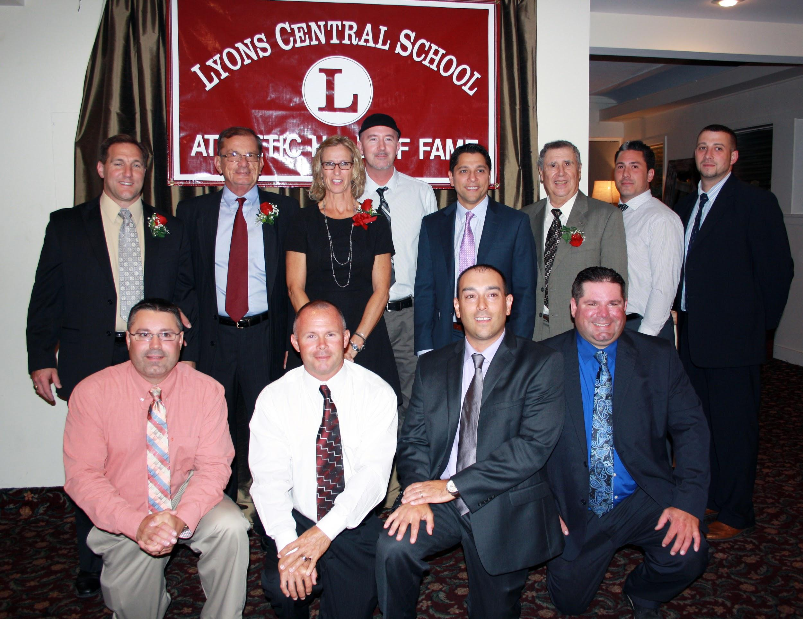
Inductees:
Heidi Blackwell
Gene Comella
Matthew Herbst
Danielle McCray
Frank Lisco
Ron Wheat
Finger Lakes Times
1990-93 Golf Teams

Slide 436
Heidi Blackwell

Slide 437
Heidi Blackwell
During her years at Lyons Central School, Heidi Blackwell participated in five different sports. She was a member of the first Cross Country team in 7th grade, and a member of the polar bear/indoor track team in 1979 and ‘80. Heidi was on the varsity track team in grades 9-12 and was co-captain her senior year.

Slide 438
Heidi Blackwell
She was a member of the 1979 track team that went 11-0, and was Invitational and Sectional champions. She came in 1st place in both the Wayne County Championships and Sectional Qualifiers in the Mile Walk in 1979 and ‘80. Heidi woan the Section V Class C Championship in the mile walk in 1979. She was also a member of the mile relay team that set a school record at 4:35.3.

Slide 439
Heidi Blackwell
Heidi played right half-back for the varsity soccer team all four years in high school. She was co-captain her senior year. She played varsity volleyball grades 10-12 and was co-captain her senior year. Heidi was the leading server in 1979 and 1980, and the 1980 team placed 1st in the County Tournament. Heidi ended her high school career by being named Female Athlete of the Year in 1980.

Slide 440
Heidi Blackwell
After college, Heidi moved to Albany and resumed her love of running by participating in 5K races around New York State. She also fell in love with endurance cycling events, raising money for the Tour de Cure, the American Heart Association and the American Cancer Society. Her love of health and fitness eventually led to a full time career as a Personal Trainer/Group Fitness Instructor, a position she held for over 10 years.

Slide 441
Heidi Blackwell
Today, Heidi divides her time between running, cycling, and kayaking and is currently training for her first half-marathon in October. Heidi has worked 13 years with the Department of Graduate Medical Education at Albany Medical Center, the last four years as its Assistant Director. She recently obtained her B.S. in Health Science/Health Education from Excelsior College, graduating with high honors. She has a daughter who lives in Wyoming and a son who lives at home.

Slide 442
Gene Comella

Slide 443
Gene Comella
Gene Comella was a 1965 Lyons High School Graduate. During his high school career he earned eight varsity letters. He was a three year varsity football starter and received he Benny Jelamono Football Award as a sophomore. The team was 12-2-1 during his junior and senior years and Gene won the American Legion Football Award his senior year. He was co-captain in football and baseball his senior year and was names All Wayne-Finger Lakes Football. Gene was Co-Athlete of the Year in 1965 with Peter Patanzo.

Slide 444
Gene Comella
After graduating from Lyons, Gene attended Bordentown Military Institute (BMI) in New Jersey, which was a very prestigious prep school. He was starting fullback on an 8-0 team which won the Eastern Prep Championship in 1965. He was selected to the All Prep Team.

Slide 445
Gene Comella
After graduating from BMI in 1966, he chose to attend Boston College over Syracuse University. He was awarded a NCAA Scholarship to Boston College. Gene was the starting fullback on the 8-2 Boston College team in 1970. He was awarded the game ball for rushing 125 yards in a win over the University of Pittsburgh.

Slide 446
Gene Comella
Gene went on to be a very successful businessman. He was twice awarded District Manager of the Year for Chrysler Corporation in 1972 and ‘73. In 1987, he was named Most Improved Sales Performer for Winthrop Financial. In 1988, Gene had the idea that Bosong and the suburbs needed a family oriented food retailer where anyone could buy homemade Italian foods at an affordable price. It has been very successful, and today Gene and his sons run Comella’s Restaurant Group which has 12 locations in the Boston area.

Slide 447
Gene Comella
Gene considers his four children his biggest accomplishment in life. Daughter Erin played Division I soccer at UMass and has run 12 marathons. Greg was a starting fullback for the NY Giants in Super Bowl XXXV. He was the first NFL player to graduate from Harvard Business School. Matt was starting fullback at Northeastern and drafted by the New York Jets. JP was starting fullback for Boston College and was drafted by the Arizona Cardinals. Gene says the best gift of all is his 13 wonderful grandchildren.

Slide 448
Matthew Herbst

Slide 449
Matthew Herbst
Matt Herbst was a two sport athlete at Lyons playing three years of varsity baseball under Coach Rod Verkey and two years of varsity football under Coach Chuck Meyers. He started in the outfield all three years of baseball earning 1st Team All-League his senior year.

Slide 450
Matthew Herbst
In football, Matt was one of only two under classement to start on defense his junior year. His senior year he played inside linebacker and fullback. Matt led the team in tackles and earned 1st Team All-League honors at linebacker and won the PUF award. He was also selected to play in the Eddie Meath All-Star game which was coached by fellow hall of famer and Ithaca alum Nick DerCola.

Slide 451
Matthew Herbst
After a year away from football and studying at RIT, Matt decided playing college football, and the chance to play against his brother Greg, were two goals worth pursuing. He transferred to Ithaca College with the help of Coach Chuck Meyers, and played on the JV team his first year. After an offseason of strength and agility tests and being evaluated by the coaches, Matt was selected to the varsity team. In 1987, Matt was the backup at the strongside inside linebacker position and was able to play against Greg when Ithaca played St. Lawrence University.

Slide 452
Matthew Herbst
In 1988, Matt became a starter and registered 70 tackles during the regular season. The NCAA Division III playoffs were another story. In four playoff games, Matt finished with 53 tackles, leading the team in every game. His most important contribution came in the first round against the defending national champion Wagner Seahawks. Matt had 14 tackles and two interceptions, the second coming with only 3:09 left in the game and Ithaca trailing by a touchdown.

Slide 453
Matthew Herbst
Ithaca went on to play in the Amos Alonzo Stagg Bowl, where they would bring home the Division III National Championship. Matt was encouraged by the coaches to come back for another year and proceeded to lead the team in tackles with 103, and to earn Honorary Defensive Captain, 1st team All-ECAC, and 3rd team Football Gazette All-American honors.

Slide 454
Matthew Herbst
After graduating from Ithaca College with a physics degree, Matt enrolled at Albany College of Pharmacy and graduated in 1995 with a BS in Pharmacy. He has been a pharmacist since 1995 and in 2011 established Herbst Pharmacy, Inc. in Port Byron, NY. Matt resides in Skaneateles with his wife Julia and four children; Makenzi, Benny, Owen and Kellen. To fulfill his continued desire for competitive sports, Matt has replaced his cleats with a pair of hockey skates and laces them up three days a week.

Slide 455
Danielle McCray

Slide 456
Danielle McCray
Danielle McCray was a very accomplished athlete in high school and college. She earned varsity letters in volleyball, basketball and track.
Danielle played varsity volleyball her junior and senior years. The 2002 team had a great season, winning their first six matches before losing to Wayne, then winning 14 straight matched to advance to Sectional Finals. Along the way, the Lady Lions won their first league title since 1984. Danielle was named 1st Team All-County and League MVP. She was named to the Section V All-Tournament team.

Slide 457
Danielle McCray
Danielle played varsity basketball for four years. During that time, the team won four consecutive Wayne County Championship titles and Danielle was named league MVP three times. She was a 1st team All-County selection all four years. The team’s overall record was 79-12. Danielle was named to the Section V All-Tournament team three times, the All-Greater Rochester Super 15 twice, the Finger Lakes Fab Five 1st team twice and the Class C All-State team once.

Slide 458
Danielle McCray
Danielle is the all-time Lady Lions leader for points in a single season with a total of 516 points. She is tied for first for points in a single game with 37 points against Clyde-Savannah and North-Rose Wolcott. Danielle is second on the list for career points at 1813.

Slide 459
Danielle McCray
Danielle participated in varsity track for five years, starting in 8th grade. The team was Wayne County Champion all five years with 39 straight wins. They won the NYS title in 2000. Danielle holds the school record for high jump at 5’6”. She was the Section V Class C high jump champion in 2001. Danielle participated in the NYS Tournament all five years. She was a member of the State Champion 4x100 relay team in 2000. Danielle was named Athlete of the Year her senior year.

Slide 460
Danielle McCray
Danielle continued her athletic career playing basketball at Genesee Community College. She tied the school record for defensive rebounds in a game at 14, broke the GCC record for most blocked shots in a game, most rebounds in a season and most rebounds in a career. Danielle ranked 17th in the nation in field goal percentage and 7th in the nation in rebounds per game. She was named to the GCC Tip Off Tournament and Cincinnati State Class All Tournament teams. Danielle was named 1st team All-Conference in 2004-05, and 2nd team All-District C Honors in 2004-05.

Slide 461
Danielle McCray
After graduating from GCC, Danielle played one year for Division I Marist College, which was the 2006 season and tournament champion.
Danielle is the proud mother of a son, A’Karri Makhi. She recently accepted a new position as Supervisor of the Special Services Team at Hillside Children’s Center where she has been employed for eight years helping at-risk youth. Danielle is currently finishing her degree in Community and Human Services.

Slide 462
Frank Lisco

Slide 463
Frank Lisco
Frank Liso has been involved in athletics his whole life as a player, coach and official. Frank attended Fort Plain Central School where he was a three year varsity starter in soccer and was named as a 1st team Mohawk Valley All-Star his junior and senior years. They were Section 2 ABC Champions in 1960 and he was team MVP.

Slide 464
Frank Lisco
Frank was a three year starter in basketball and was named as a 1st team Mohawk Valley All Star his junior and senior years. He was also team MVP for both of those years. Frank was also a three year starter in baseball, named a 1st team All Star his junior and senior years and team MVP as a senior. His senior year, Frank ran the third leg of the 880 relay team for track.

Slide 465
Frank Lisco
Frank then continued his athletic career at SUNY Oswego where he played soccer for three years. In 1963, he was team MVP and 2nd team All SUNYAC, and in 1964 was all SUNYAC 1st team and selected to the All New York State team. Frank played guard in basketball for two years and the team was the SUNYAC Champion in 1963-4. Frank was a pitcher on the baseball team that was the SUNYAC Champion in 1963 and ‘65. Frank graduated from SUNY Oswego in 1965 with a degree in Secondary Mathematics. He started his teaching career at Lyons in 1965.

Slide 466
Frank Lisco
Frank coached JH basketball and baseball for many years. He coached boys varsity basketball from 1966-74, wininit two Wayne County titles. He coached girls varsity basketball from 1985-90, and girls volleyball from 1997-201., taking them to the Sectional Finals in 2000 and 2001. Frank’s real love was baseball. He coached the varsity team from 1988-2002. They won 11 Wayne County titles in 15 years, and played in the sectional finals in 1999 and 2000. He revived American Legion baseball in Lyons, coaching for 14 years and winning 10 titles, which he believed greatly enhanced his HS program.

Slide 467
Frank Lisco
Over Frank’s 35 year career, he coached 1062 contests wit h732 wins and 330 losses. He was named to he SUNY Oswego Hall of Fame in 2008. Since retiring in 2001, Frank and his wife Sue moved to Pinehurst, NC, where he works part time at Whispering Pines Country Club. They visit their son Frankie, who is a talented musician in Atlanta, GA, and their daughter Andera, who is a physical therapist in Victor.

Slide 468
Ron Wheat

Slide 469
Ron Wheat
Ron Wheat was a math teacher at Lyons Central School District from 1968-2001. He also served as Dean of Students. Ron was named LCS Teacher of the year in 1999 and 2001, and received the NYSUT Recognition Award in 1998.
Ron coached football at various levels throughout his career. He coached modified for five years and was varsity assistant for eight years. Ron was varsity head coach for five years.

Slide 470
Ron Wheat
But Ron’s real love was track. He was involved in track in various capacities from 1969 to 2013. He started in 1969 as assistant varsity boys coach for three years, and then became the head coach for the next nine years. During this time the boys won four league titles, six division titles and five sectional titles. From 1976-1980, the boys had a record of 39-1 league and 50-4 overall.

Slide 471
Ron Wheat
For the next six years, Ron served as a track official. In 1987 he returned to coaching as an assistant girls’ coach for one year. In 1988, Ron took over as the girl's head coach, a position he held for the next 20 years, well after his retirement from teaching. During his tenure, the girls won seven league titles, (five in a row from 1999-2003 with 39 straight wins), 12 division titles and two sectional titles. In 2000, the girls won the New York State title. Ron’s team had 12 State Champions, 11 individuals and one relay team.

Slide 472
Ron Wheat
Ron was recognized for his many contributions. He received the NYSPHSAA Coaching Award in 1982, the Wayne-Finger Lakes Track Officials Award in 1984, and was named Section V Track Coach of the Year in 1999 and 2000. Ron returned to the officiating ranks from 2008 to 2013.
Ron has been married to Mary Lou for 43 years; Mary Lou was inducted into the Hall of Fame in 2006. They have two children, Kelly and Casey. Ron and Mary Lou divide their time between Lyons and their home in Lake Wales, FL.

Slide 473
Finger Lakes Times

Slide 474
Finger Lakes Times
At the Finger Lakes Times, we are extremely honored and humbled that our Sports Department has been selected for inclusion in the Lyons Athletic Hall of Fame. It’s not often that you win an award like this simply for doing your job, but it's also not often that a newspaper has the privilege of covering a sports program as outstanding as the one in the Lyons Central School District.

Slide 475
Finger Lakes Times
Any mention of the FLT’s sports coverage has to begin with our former Sports Editor Norm Jollow, who began his career with what was then the Geneva Daily Times in 1955. When he retired in 1991, Norm had built the Times sports department into one of the most respected ones in the state for small-town newspapers, and a large part of that was expanding out beyond Geneva to include coverage of the sports teams from other nearby districts, including Lyons. Norm passed away in 2000, but his legacy lives on at the FLT, especially because three of the people he hired to cover sports for the FLT are still at the newspaper.

Slide 476
Finger Lakes Times
Former Sports Editor Mike Cutillo is not the paper’s Executive Editor; Alan Brignall, another former Sports Editor is no the News Editor; and former Sports Writer Mike Hibbard is now the paper’s crime and courts reporter. They many not cover sports any longer, but those three still are passionate about the paper’s sports coverage, and they team up with current Sprots Coordinator Greg McNall and Sports Writer Josh DeSain to give the FLT an unusual amount of knowledge about the local high school sports scene.

Slide 477
Finger Lakes Times
Some of the other names who also have covered sports in recent decades at the FLT include Dick Patrick (who went on to USA Today), the late Tom Leo (who left the Times for the Syracuse Post-Standard), Charlie Hayes, Matt Dorney, Toni McNicholas (one of the first sportswriters in the state hired primarily to cover girls sports), Amy Faulkner, Elizabeth Foy, Rich Fyle, Jim Eichenhofer (who currently works for the NBA’s New Orleans Pelicans) and Joel Pinckney.

Slide 478
Finger Lakes Times
The FLT’s coverage of local high school sports would not be what it is without outstanding photographs of those touchdown catches, clutch 3-pointers, and home runs. Current Chief Photographer Spencer Tulis carries on in the tradition of former great FLT photographers, a list that includes Art Foxall, Dale Duchesne, Seth Siditsky, Kathleen Lange and Michaele Boncaro.

Slide 479
Finger Lakes Times
We would love to list some of the incredible players and coaches in Lyons history here - including some of those who are joining our Sports Department as 2014 inductees - but there are way too many, and we know we’d forget some. So instead, we’ll close by saying, to all Lyons athletes and coaches: You keep playing, and we’ll keep chronicling your fantastic achievements.

Slide 480
1990-93
Varsity Golf Teams

Slide 481
1990 Golf Team
The varsity golf team finished the year 13-1 and was Wayne County Co-Champion. Dave Bastian was the MVP and qualified for the state tournament in Cornell as a freshman. The American Legion Award was won by Chris Santelli.
Team Members: Darryl Long, Joseph Amrose, Matt Bastian, Chris Santelli, David Bastian, Eric Wasser and Coach John DiSanto.

Slide 482
1991 Golf Team
The 1991 team finished 13-1. In their 13 victories they never gave up more than two points in any match. Daryl Long won all 14 of his matchers and Mat Bastian was a State Tournament Alternate. Dave Bastian shot in the 30’s for 9 holes and was the medalist at the Wayne County Tournament with a low of 83. Matt Bastian also qualified for the Section V tournament with an 84 at the Wayne County Tournament.

Slide 483
1991 Golf Team Members
Chris Santelli
Matt Bastian
Eric Wasser
David Bastian
Joe Amrose
Derek Sholly
Darryl Long
Coach Schott

Slide 484
1992 Golf Team
The varsity golf team had another exceptional season, as they finished 14-0.
Team members: David Bastian, Matt Bastian, Darryl Long, Chris Santelli, Derek Sholly, Brian Wasser, Casey Wheat, Eric Wasser and Coach Schott.

Slide 485
1993 Golf Team
The Lyons golf team had another outstanding year, finishing the season 14-0 and winning the Wayne County League Title for the fourth consecutive year. Outstanding individual play was led by David Bastian, Eric Wasser and Chris Santelli, who all won 1st team All Star League honors and represented Wayne County in the Section V Tournament. David Bastian went on and qualified to represent Section V at the NYSPHAA tournament at Cornell.

Slide 486
1993 Golf Team Members
Chris Santelli
Eric Wasser
Casey Wheat
Brian Wasser
David Bastian
Andy Thoms
Mike Giddings
Coach Schott

Slide 487
Class of 2015
Twelfth Annual
Athletic Hall of Fame Induction Dinner

Slide 488
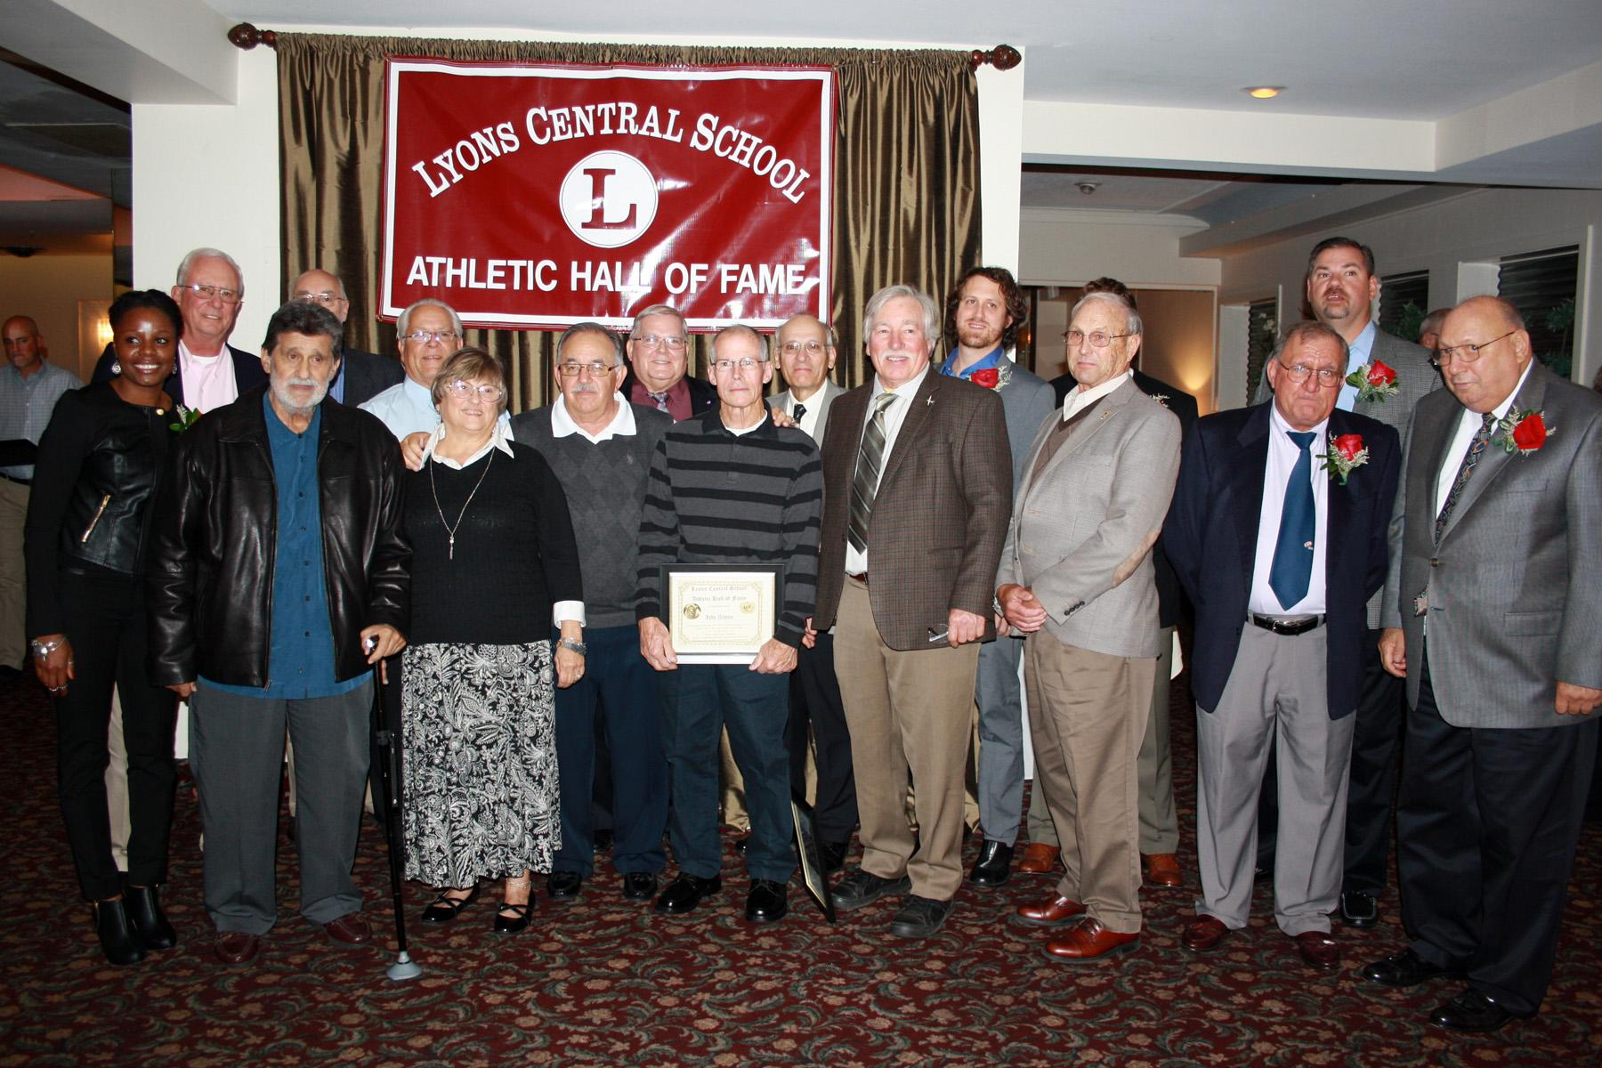
Inductees:
Peter Patanzo
David Alena
Tim Blaisdell
Geoff Grambo
Frank Lisco
Patrice Coney Maxim
1961 Football Team

Slide 489
Peter “Chip” Patanzo

Slide 490
Peter “Chip” Patanzo
Peter “Chip” Patanzo played football, basketball and baseball at all levels from 7th grade until his graduation in 1965. He earned six varsity letters, and was named Male Co-Athlete of the Year in 1965.
Chip played offensive and defensive tackle for LHS. He received Honorable Mention for the Wayne-Finger Lakes All Conference team his junior year. He was the only unanimous selection to the Wayne-Finger Lakes Football All-Conference 1st team his senior year.

Slide 491
Peter “Chip” Patanzo
Chip was a varsity basketball starter his junior and senior years. He led the team in rebounds both years. He was awarded Best Clutch Performance of the Section V AA basketball tournament, scoring 4 points in the last seconds of the game to lead Lyons over Brockport in the semi-final game. Chip was named to the All-Tournament 2nd Team AA.

Slide 492
Peter “Chip” Patanzo
Chip was more than just an athlete in high school. He won the VFW Essay Contest on patriotism, and wrote for the school newspaper. He had the male lead in the senior play. Chip was the recipient of the Balfour Award, a graduation award given to the senior boy who contributed most to his class.

Slide 493
Peter “Chip” Patanzo
Chip went on to play football at Mansfield University starting every game for all four years. His junior year he received Honorable Mention for the Pennsylvania State Athletic Conference. He was named to the PSAC 2nd team his senior year. He graduated in 1969 with a BS in Education
After teaching for five years, Chip went into sales of heavy and highway construction equipment. He worked with local, state and federal governments throughout the United States.

Slide 494
Peter “Chip” Patanzo
Chip and his wife Mary Ann have been married for 47 years. MAry Ann was a former Home Economics teacher at Lyons High School. They have two children; their daughter Lisa Marie is currently an Accounts Payable manager, and their son Peter is a lawyer. They have one grandchild, Giada Marie.
Chip and Mary Ann are currently living in Hallandale Beach, Florida.

Slide 495
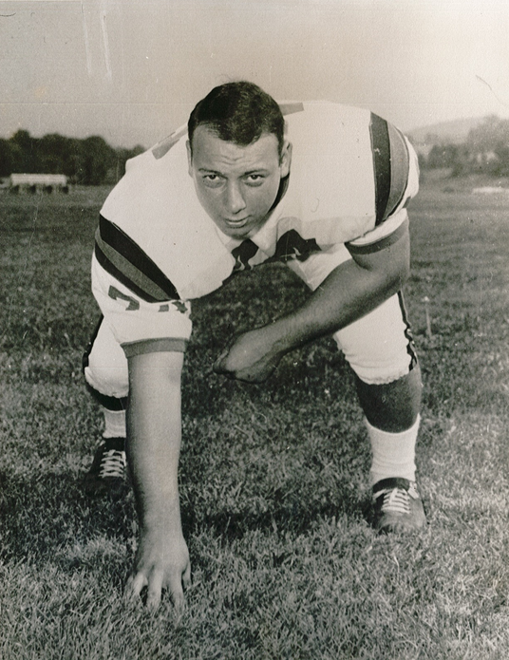
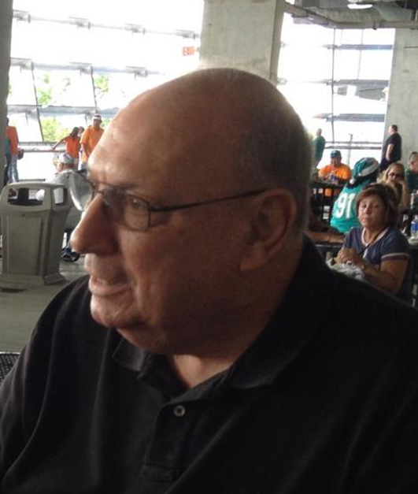

Slide 496
Coach David Alena

Slide 497
Coach David Alena
After graduating from Alfred University, Coach Alena began his career at the Lyons Central School District that August as a mathematics teacher and head JV football coach. After three successful seasons with the JV teams, Coach Alena was promoted to head varsity coach in 1972.

Slide 498
Coach David Alena
During his eleven year career as head coach, his team's’ accomplishments include:
71-27-1 record
44 game winning streak
5 consecutive league titles, 6 overall
Section V Class B Championship in 1977

Slide 499
Coach David Alena
Coach Alena’s individual honors include:
NYS Coaches Association as NYX Football Coach of the Year in 1979
2015 induction into Section V Football Hall of Fame
Three times Wayne-Finger Lakes Coach of the Year (‘74. ‘76, ‘78)
1978 Section V Class B Coach's Award

Slide 500
Coach David Alena
In 1978, Coach Alena married Lyons native Patricia Sculli, and together they have two sons. David Jr. is a computer programmer/Systems administrator of a small company in Syracuse, and Nicholas, who is Associate Director of Graduate Admissions at Northwestern University in Chicago. Nick is also a member of the Hall of Fame, inducted in 2013. Patty manages the H.G. Hotchkiss Peppermint Museum in Lyons, where Coach Alena helps with routine maintenance when he is not playing golf at Wayne Hills Country Club.

Slide 501
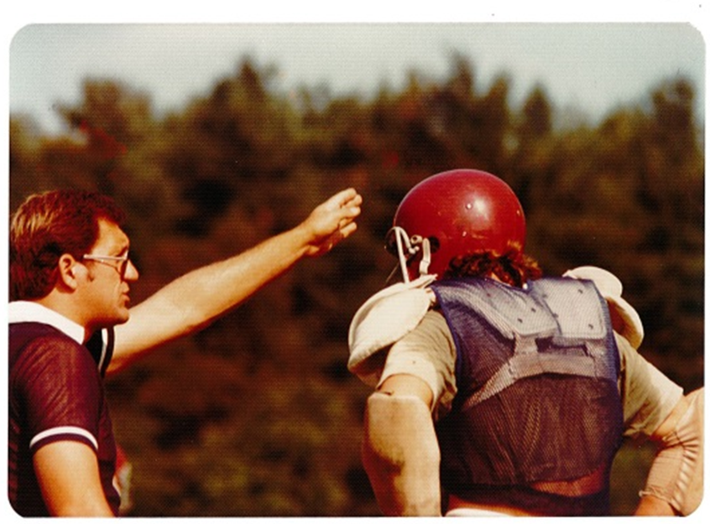

Slide 502
Tim Blaisdell

Slide 503
Tim Blaisdell
Tim Blaisdell, a 1985 Lyons High School graduate, was an outstanding three sport athlete and a straight A student.
Tim was a three year starter on the varsity basketball team. He scored over 800 points and had over 500 rebounds playing center. His senior year he averaged 20.6 ppg and 10 rpg. His team went to three straight Section V championship games and Tim was named to the Section V All-Tournament team all three years. His senior year he was also 1st team All Wayne County and All-Greater Rochester. He played on the collegiate level at RIT and Ithaca.

Slide 504
Tim Blaisdell
Tim also played three years on the varsity baseball team. He was a pitcher and played first base. His junior year, he was named to the All-Wayne County 2nd team as a pitcher. His senior year he was named to the All-Wayne County 1st team as a pitcher. Time was the #1 pitcher for Lyons both his junior and senior years. He also led the team in batting average his senior year. Tim was invited to the Cincinnati Reds tryout the summer of 1985 and was a walkon for RIT in 1986.

Slide 505
Tim Blaisdell
Tim’s football career was cut short by a broken jaw received while playing starting quarterback his junior year. Tim ended his high school career by being amed Male Athlete of the Year his senior year.

Slide 506
Tim Blaisdell
Tim currently lives in Wethersfield, Connecticut with his wife Kelly, who is a high school math teacher. They have two sons, Timmy and Jack. Tim is Vice President in charge of Business Development Strategy at MDS Aero Corporation.

Slide 507
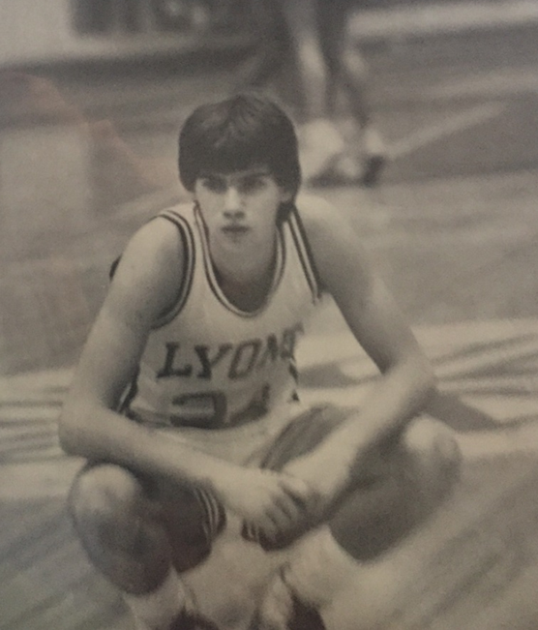
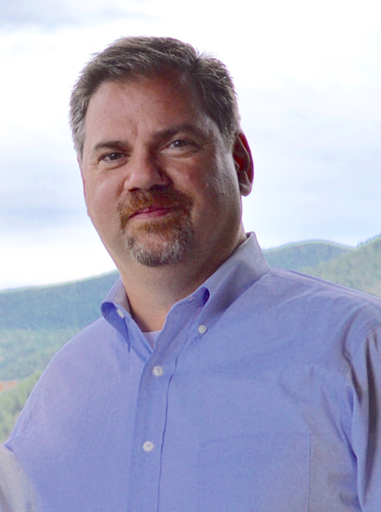

Slide 508
Geoffrey Grambo

Slide 509
Geoff Grambo
Geoff Grambo excelled at athletics at Lyons High School and at St. Lawrence University. He was a three sport athlete at Lyons, participating in football, wrestling and track.
Geoff was a three year starter on the football team. He was named Section V Class C Outstanding Offensive Lineman in 2002. The team won the Section V Class C Championship in both his junior and senior years. Geoff played in the Eddie Meath All-Star game in 2004.

Slide 510
Geoff Grambo
Geoff was a varsity wrestler all four years in high school. He finished 4th in Sectionals in 2003 and 3rd in SEctionals in 2004. He qualified for Super-Sectionals in both 2003 and 2004. As much as Geoff enjoyed wrestling and football, track was where he really excelled.

Slide 511
Geoff Grambo
Geoff helped the team to Section V Class C Championships in 2002-04. He was the individual Section V Class C Champion in shot put in 2002 and 2004, taking second place in 2003. He was runner-up in discus in 2003 and 2004. Geoff was named to the Section V Class C All-Conference 1st team shot put in 2004. He was Wayne County All-Conference in the shot put in 2002-04. Geoff participated in the Empire State Games in shot put in 2003. He was named Co-Male Athlete of the Year at Lyons High School in 2004.

Slide 512
Geoff Grambo
Geoff continued his success in track at St. Lawrence University. He was four time Liberty League Champion, two time NYS Champion and one time ECAC Champion. Geoff was a NCAA Division III All-American in shot put in 2008. He still holds the record in shot put at St. Lawrence University.

Slide 513
Geoff Grambo
Geoff went on to earn his MBA at William Woods University in Fulton MO, where he was also a graduate assistant track coach. Geoff is currently employed at Klein Steel in Rochester and is an Assistant Track and Field coach at St. John Fisher College. He has coached one National Champion, two All-Americans and four National Qualifiers. Geoff also is still an active competitor in Olympic Weightlifting. He has qualified four times for the American Open 2012-15, and this year qualified for the National Olympic Weightlifting Championship.

Slide 514
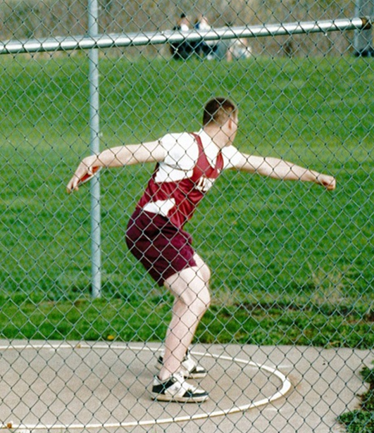

Slide 515
Frank M. Lisco

Slide 516
Frank M. Lisco
Frank M. Lisco, a 1996 Lyons graduate, excelled in both basketball and baseball. He played both sports at the varsity level for all four years of his high school career.

Slide 517
Frank M. Lisco
Frank was a three-time captain of the varsity basketball team. He led the team to 49 straight wins against Section V opponents, two straight Section V Championships and two straight appearances in the Far West Regionals. Along the way, he scored 1299 points. Frank was a three year 1st team Wayne County All-Star and played in the Ronald McDonald All-Star game.Grank accomplished all of this with style and class and was awarded the Section V Class C Sportsmanship Award twice.

Slide 518
Frank M. Lisco
As a starting pitcher and shortstop, Frank led the Lyons baseball team to three straight Wayne County Championships. He batted .435 during his four year career and was chosen a 1st team Wayne County All-Star at shortstop three times. He stole 74 bases and was only caught four times. As a pitcher, Frank posted a record of 15-2, with an ERA of 2.13.

Slide 519
Frank M. Lisco
Frank was named Co-Male Athlete of the Year his senior year. He graduated from SUNY Fredonia in 2001 with a major in English. In 2007, Frank followed his heart and attended and graduated from the ATlanta Institute of Music.

Slide 520
Frank M. Lisco
Frank currently lives in Atlanta with his wife, Natalie, who is a 3rd grade teacher. He teaches guitar and bass at Music Matters and gives private lessons. He also performs asa guitarist with a number of different bands as well as doing solo acoustic performances at various venues.

Slide 522
Patrice Coney Maxam

Slide 523
Patrice Coney Maxam
Patrice Coney graduated from Lyons High School in 2003. She was a very successful student and an amazing athlete.
Patrice was a starter on the varsity volleyball team all four years, serving as captain in her junior and senior years. Her senior year, the team was undefeated in the Wayne County League and won the championship for the first time since 1984. Patrice was named to the Section V Class C 1st team three times.

Slide 524
Patrice Coney Maxam
Patrice played basketball in 9th and 10th grade and then changed to indoor track as a junior. This proved to be a wise decision. As a junior, she was an Indoor Track All-Star, Sectional winner and a NYS Qualifier. As a senior, Patrice set school records in the 600m run and the high jump. She was a Sectional Champion in the long jump, 55m hurdles and 600m run. Patrice was named the Outstanding Women's Performer at Sectionals and she continued on to the state meet in the 55m hurdles.

Slide 525
Patrice Coney Maxam
Patrice was even more successful in outdoor track. She was a 4x4 Wayne County and Section V Champions in 10th, 11th and 12th grade. She was Wayne County and Section V champion in the pentathlon in her junior and senior years. She set the school record for the 800m and the pentathlon scoring over 3000 points. Patrice was named Female Athlete of the Year for 2003.

Slide 526
Patrice Coney Maxam
Patrice received the Bill Gates Millenium Scholarship which funded her four year education at the University of Buffalo. While there, Patrice was 5-time Mid-American Conference Champion in the indoor pentathlon and outdoor heptathlon. She was a 4-time regional qualifier. She set five school records: indoor 4x4, 60m hurdles, pentathlon, outdoor 4x4 and heptathlon. In 2008, she ranked in the top 20 in the country in heptathlon She was a team captain her junior and senior years.

Slide 527
Patrice Coney Maxam
Patrice earned a BS in nursing in 2008 and a Master’s Degree in 2012. She is currently working on her doctorate. She has worked as a registered nurse and a nursing professor and is currently employed by Caris Life Science, a bio-technology company.
Patrice married Darrel Maxam in 2014, a project engineer for EMG. Patrice attributes much of her success to the support of her family and friends.

Slide 529
1961 Football Team

Slide 530
1961 Football Team
The 1961 Lyons Varsity Football Team coached by Jake Burroughs and assisted by Frank Lawrence and Gene “Rip” DePorter was said to be the best ever to come out of Lyons. They had the first undefeated season since 1936, going 8-0.

Slide 531
1961 Football Team
They started the season with a convincing 32-7 win over Homer, scoring three touchdowns in the first quarter. Nest, they started Wayne-Finger Lakes competition against a powerful Mynderse Academy Team. With only two minutes remaining, Lyons scored on a 12 yard run by Paul DeJohn. Lyons won the game 6-0 and that touchdown proved to be the only points allowed by Mynderse the whole season. The team continued the season with victories over Mt. Carmel, Geneva, DeSales, Penn Yan and Waterloo.

Slide 532
1961 Football Team
The final game of the season was against arch-rival, the Clyde Blue Devils. It was a hard fought game, with the only score coming on a 40 yard pass from Joe Arnitz to Dave Fratangelo resulting in a 6-0 victory and an undefeated season. Lyons scored 144 points and only gave up 27 during the season.

Slide 533
1961 Football Team
Many players on the team went on to be named All-Conference members. Joe Holly was given Honorable Mention by the Sporting News National High School All-America Football Team.
Four members of the team have already been inducted into the Lyons Hall of Fame as individuals: Joe Arnitz, Dave Fratangelo, Joe Holly and Gary Tunnison.

Slide 535
Class of 2016
Thirteenth Annual
Athletic Hall of Fame Induction Dinner

Slide 536
Inductees:
Larry Bailey
Stephan Bailey
Philip Bauer
Laurie Wells Burnett
Jim Blandino
Roger Clark
2002 Football Team
2003 Football Team

Slide 538
Larry Bailey

Slide 539
Larry Bailey
Larry Bailey graduated from Lyons High School in 1972. He was dominating in football. Larry was All-Conference running back his junior and senior years, and All-Conference Defensive back his senior year. He played various positions on offense, defense and special teams. In a single game, Larry scored on a punt return, a kick-off return and on a running play from the live of scrimmage. He was team captain and received many awards, including the American Legion Football Award for Outstanding Player of the Year and the Black Glove Award.

Slide 540
Larry Bailey
Larry also starred in track and field. He participated in several events and was outstanding in the long jump, where he was the 1972 Sectional Champion. Larry ran anchor on the 800 relay team which set a Section V Class D record in 1972.

Slide 541
Larry Bailey
At the collegiate level, Larry attended RIT where he was a first string running back for Tom Coughlin.
After college, Larry moved to Vermont where he became very involved in tennis and skiing. He played many pro-am tournaments, winning doubles with Guillermo Vilas and Andres Gomez. Larry was a volunteer coach for Vermont Parks and Recreation for tennis and skiing with underprivileged your for many years.

Slide 542
Larry Bailey
Larry has resided in Palm Bay, Florida since 1996. He is a husband and proud father of a daughter, four sons and five grandchildren. Larry is a purchasing manager of Ecklers Industries/Mac Antique Auto, which is one of the largest suppliers of parts and accessories for Corvettes.

Slide 543
Stephan Bailey

Slide 544
Stephan Bailey
Steve Bailey graduated from Lyons HIgh School in 2004. His interest in sports began at a young age. He was a four year all-star in Lyons Little League. He played two years at the modified baseball level followed by being a four year varsity starter as a pitcher and shortstop. Steve holds a current NY state record of three home runs and 11 RBIs in one game. His batting average over four years in high school was .367, .460, .443, and .520.

Slide 545
Stephan Bailey
Steve pitched in sectional games as a freshman. Sophomore year he was a 1st team Wayne County All-Star pitcher. As a junior, his record was 5-1 with 2 saves, 55 K’s, and a 3.11 ERA, and was again named to the 1st team. In his senior year, Steve was team captain, Bird’s Eye Foods Player of the year for Wayne County, the league MVP and a Section V All-State Selection 4th team ss/pitcher. His record was 7-0 with 72 K’s and a 2.19 ERA.

Slide 546
Stephan Bailey
Steve started his football career playing quarterback in Clyde Vince Lombardi. He continued to play quarterback from 7th grade through 12th grade. His junior year, he was named Outstanding Offensive back in the Lyons Sectional Championship. Steve won the Piehler Motor Car Company Player of the Game in Lyons’ first win over Clyde-Savannah in 20 years. Steve was All-League Finger Lakes West 2002 1st Team Offense (QB), and 2nd Team Defense (OLB).

Slide 547
Stephan Bailey
In his senior year, Steve was team captain and led his team to their second straight sectional title and their 1st Western Regional Championship. He was named Most Outstanding Defensive Lineman Player of the Sectional Championship game and Defensive MVP for the state semifinals vs. Onondaga. During the season, Steve scored 96 points with five rushing touchdowns and 11 passing touchdowns.

Slide 548
Stephan Bailey
Steve attended Cortland where he played baseball as a walk on his freshman year and graduated with a degree in Physical Education. He teaches for the Syracuse City School District. He is a varsity football coach, a varsity baseball coach and a modified basketball coach. He is married to Lyons graduate Annie Porter and they reside in Syracuse, NY.

Slide 549
Philip H. Bauer

Slide 550
Philip H. Bauer
Phil Bauer graduated from Lyons HIgh School in 1995. He was a three sport athlete, participating in football, wrestling and track.
Phil played on the varsity football team his junior and senior years. He was named to the All-Conference 1st team as an offensive lineman his senior year. He was part of the offensive line that helped to set records for total rushing yards in a single season and the longest run from the line of scrimmage, 92 yards by Linwood Carswell.

Slide 551
Philip H. Bauer
Phil was a four year varsity letter winner in track. His junior year, he placed 3rd in discus and 4th in shot put in sectionals. His senior year, he was 5th in discus and 6th in shot put at sectionals. Although he enjoyed the other sports, wrestling is where Phil really excelled.

Slide 552
Philip H. Bauer
Phil was on the varsity wrestling team for four years. He was a member of the 50 point club at 215 pounds his junior year. His senior year, he was Section V Class D Champion at 250 pounds, a first for Lyons. Phil was named 1995 Finger Lakes Wrestler of the Year. His record was 24-2 and he won three tournaments that year. Perhaps his greatest accomplishment was winning Super Sectionals and advancing to the NYS Tournament. There was only one tournament back then for all classes, AA-D, so this was an amazing accomplishment. Phil finished 4th in New York State.

Slide 553
Philip H. Bauer
After high school, Phil joined the US Army. He served as a scout with the 3rd Armored Cavalry Regiment. On November 2, 2013, his chinook helicopter was shot down by a surface-to-air missile near Fallujah, Iraq. In 2009, Phil joined the Wounded Warrior Program, where he received his 1st service dog, Reese. He worked for the non-profit ECAD (Educated Canines Assisting with Disabilities) where he raised and trained service dogs.

Slide 554
Philip H. Bauer
In 2015, Phil moved back to Lyons. He has four amazing children, Nick, Rian, Jackson and Joslyn. He recently received his second service dog, Champ.

Slide 555
Laurie Wells Bennett

Slide 556
Laurie Wells Bennett
Laurie Wells graduated from Lyons in 1993. She was a three sport athlete and excelled in all three.
Laurie played JV volleyball as a 7th grader and was named MVP. She played on the varsity team for the next five years as a hitter/spiker and setter. She was MVP her senior year and was named to the Wayne County All-Star 1st Team.

Slide 557
Laurie Wells Bennett
Laurie played point guard on the JV basketball team as a 7th grader, and was named MVP and best defensive player that year. From 8th grade on she was a point guard and shooting guard on the varsity team. As a senior she had the highest average on the team at 25 ppg. She also had the record for most points in a single game at 37. Laurie scored over 1000 points in her career and was named co-MVP with Kristin Schott.

Slide 558
Laurie Wells Bennett
Laurie started on the track team for six years. As the only 7th grader on the 4x100m relay team, they won the State Championship. Laurie also won many 1st place medals for the 100m dash, 200m dash and the high jump. She made it to state qualifiers every year for at least one event.

Slide 559
Laurie Wells Bennett
After graduation, Laurie went on to FLCC where she played point guard on the basketball team both years. She had the most three pointers in a single season andthe highest scoring average at 23 ppg. She was also named MVP. Laurie earned and A.S. in Business Administration and has continued her education online with Capella University.

Slide 560
Laurie Wells Bennett
Laurie has worked with Walmart Stores US for more than 20 years. She has steadily moved up the ladder until today she is General Manager and has been selected to participate as a member of the Regional Lead Team for Walmart. She also owns her own business, “Kona Ice,” and has recently added an additional truck to her fleet. She lives in southern Maryland with her husband and highschool sweetheart, George Bennett, and their beautiful daughter Milani and their dog Dutchess.

Slide 561
James (Jim) Blandino

Slide 562
Jim Blandino
Jim Blandino graduated from Lyons High School in 1956. He played varsity football, basketball and baseball. He served active duty in the US Army rom 1957-59. He served as Postmaster in Clyde, Lyons and Newark from 1984-2000. Jim served as a Lyons Town Justice from 1999-2010, and on the Lyons Village Board of Trustees in 2014-15.

Slide 563
Jim Blandino
Besides being a civil servant, Jim’s true love was always sports. He was a sports writer for local newspapers covering Lyons football and basketball games, but was most well-known for being in charge of the chain gang for over 40 years.

Slide 564
Jim Blandino
Jim volunteered in many areas of sports for both school and community teams. He as a Little League umpire and coached for 15 years. He also coached community center basketball, was president of the Lyons Football/Cheerleading league, umpired for the Wayne County Girls Softball League and refereed modified soccer and basketball.

Slide 565
Jim Blandino
Jim was one of the original Lyons Football Booster Club organizers in 1970. The booster club built the field house and concession stand and was instrumental in getting lights on the football field. Jim organized and was master of ceremonies for many banquets from 1970-1994. He was a charter member of the Hall of Fame Committee, chosen because of his knowledge of Lyons sports history. He was Lyons Citizen of the Year in 2013.

Slide 566
Jim Blandino
Jim has been married to his wife Joanne for 57 years. They have two children, Dr. Doreen Blandino who teaches at St. Vincent College, and Michael who is Director of Information Systems at Johns Hopkins Clinical Practice.

Slide 567
Roger Clark

Slide 568
Roger Clark
Roger Clark graduated from St. Bonaventure University where he played three years of varsity baseball and soccer. His senior year he was captain, MVP and All-American nominee for soccer. He coached basketball for eight years before coming to Lyons. He started coaching in Lyons in 1975. Roger began the first ever Cross Country program in Lyons that year. He coached the team for 11 seasons and served as League Coordinator. During that time, they had six individual conference champions and two state meet representatives.

Slide 569
Roger Clark
In 1975, Roger began coaching outdoor track and field at Lyons as an assistant , working with Ron Wheat. He became the boys’ head coach in 1981 until 2006, when the program became co-ed. He has coached the co-ed program from 2006 to the present. During that time, he won 12 sectional titles, four as an assistant and eight as head coach. Also, there were multiple Conference Championships with a run of five straight from 1993-97. Rogers has coached multiple individual sectional champions and many of his athletes have gone on to compete at the collegiate level.

Slide 570
Roger Clark
In 1999, Roger started the Indoor Track and Field program and he has coached this from its inception to the present. The team is highly successful and has produced eight overall individual Section V Champions, eight State Meet representatives, three National Merit participants, multiple individual Sectional Class Champions, and one girls’ Sectional Team Class Championship.

Slide 571
Roger Clark
Roger was selected Section V Coach of the Year twice and was honored by the Wayne-Finger Lakes Officials Association for 25 years of outstanding service. In 2010, he organized the Lyons Track and Field Invitational and has been the meet director for the past seven seasons. He was also instrumental in hosting Section V Class Championships at Lyons in 2014 and 2016.

Slide 572
Roger Clark
Roger is married to Rita and together they own and operate the Lyons Floral Shoppe and Memorials. He has two daughters, Karen (Brian) and Elizabeth (Chris) and three grandchildren, Ethan, Audrey and Elijah. Roger also serves as a lay trustee at St. Joseph the Worker Parish and is chair of the Pastoral Council.

Slide 573
2002 Football Team

Slide 574
2002 Football Team
Under first year Coach Randy Wadhams, the Lyons Lions won their first Section V Class D title since the 1970’s. The team had an exceptional year finishing wit ha 9-2 record and being named the Finger Lakes West Champions. The team also received the Scholar Athlete Team Award. Strong assistant coachers - John Lawson, Pat Maddock, Tony DeLork, Shawn Solomon, Hugh Spink, Dana Ford and Ed Bailey, and JV coaches Dean Schott II and Dominic Monacelli aided in the successful season.

Slide 575
2002 Football Team
Highlights of the season indluded defeating arch rival Clyde-Savannah, not once but twice, for the first time in 20 years (35-0 and 53-8). The team played at Ralph Wilson stadium in the State Quarterfinals.
Sectional Honors: MVP - Nick Alena
Most Outstanding Offensive Lineman: Geoff Grambo

Slide 576
2002 Football Team
Sectional Honors:
MVP - Nick Alena
Most Outstanding Offensive Lineman: Geoff Grambo
Most Outstanding Offensive Back: Steve Bailey
Most Outstanding Defensive Back: Matt Wurzer

Slide 577
2002 Football Team
End of Year honors:
Ontario Honda Section V Class D Payer of the Year: Nick Alena
Ontario Honda Section V Class D Coach of the Year: Randy Wadhams

Slide 578
2002 Football Team Members:
Nick Alena, Steve Bailey, Erick Byork, Jordan Cinelli, Michael Danzey, DJ Dean, Ryan Durham, Ryan Evans, Geoff Grambo, Tom Horton, Clarence Jackson, Ron Johnson, Robbie Kelley, Bryan Maddock, Jason Rosario, Levi Schutt, Randolph Scott, Ira Smith, Ron Smith, Luke Stoep, Gino Tricarico, Mike Weimer, Josh Wunder and Matt Wurzer
Managers: Anthony DeLork, Tony Heid and Greg Maddock

Slide 579
2003 Football Team

Slide 580
2003 Football Team
The 2003 Lyons varsity football team had an extremely successful year. They had a 9-3 record. They were SEction V Class D Champions for the second year in a row. They qualified for state competition and defeated previously undefeated Randolph High School (32-30). The 2003 team was a NYSPHAA State semifinalist, advancing further than any team in Lyons history. The team finished the season ranked 4th in the state.

Slide 581
2003 Football Team
Head coach Randy Wadhams credits the hard work of his coachers: John Lawson, Pat Maddock, Dominic Monacelli, Tony DeLork, Ed Bailey, Dean Schott II, High Spink, Dana Ford and Marc Vitticore for the team’s success.
The team also earned the Scholar Athlete Team Award.

Slide 582
2003 Football Team
Section V Awards:
MVP: Randolph Scott
Outstanding Offensive Lineman: Mike Weimer
Outstanding Defensive Lineman: Steve Bailey
State honors went to Randolph Scott.

Slide 583
2003 Football Team Members
Steve Bailey, Bryan Maddock, Michael Sherman, Randolph Scott, John Loson, Clarence Jackson, Johnny Eckert, John Sergent, Ron Smith, Chancer Brown, Justin Lucia, Tom Conaway, Brenton Davis, Ron Johnson, Tom Horton, Ryan Evans, Kurt Simmons, Gino Tricarico, Levi Schutt, Mike Hockenbruckner, Kyle Ruckdeschel, Josh Stoep, Steven Darcangelis, Ryan Durham, Zach Aunkst, Geoff Grambo, Chad Roegiers, Mike Weimer, Brian Ocque, Jordan Cinelli, Darius Greene, Joe Mastracy and Mike Emmel

Slide 584
Class of 2017
Fourteenth Annual
Athletic Hall of Fame Induction Dinner

Slide 585
Inductees:
Sean McFaul
Santo DeSain
Greg Herbst
George Lawrence
Kevin Maine
Ron Smith Jr.
Gino Tricarico
1981-82 Boys Basketball Team
1995 Cross Country Team

Slide 587
Sean McFaul

Slide 588
Sean McFaul
Sean McFaul was a 3-year starter on the varsity basketball team, 2 time captain and team MVP his senior year. Sean led the ‘94-‘95 team to a 25-1 record and a section V title. He averaged 17 points and 10 rebounds on a team whose starters all averaged double figures in points. Sean was selected to the 1995 NYS Class C All-State Basketball team, Wayne County All-Star team, Finger Lakes Times’ ‘Fab Five’ and the Rochester Ronald McDonald All-Star game.

Slide 589
Sean McFaul
Sean was also a 3-year starter on the varsity baseball team specializing as a pitcher and first baseman. During Sean’s three years, the team had a combined record of 51-10, including the 1995 team which Sean captained to a 18-2 record. Sean finished his career as an accomplished hitter batting .355 with 57 RBI’s and 5 HR’s. His favorite baseball position was pitching where he finished with an 11-1 career record including a 5-0 senior season where he posted a 0.54 ERA with 4 shutouts. He was a 2-time Wayne County All-Star selection.

Slide 590
Sean McFaul
In addition to his athletic accomplishments, Sean was selected as a delegate to Boys’ State by the American Legion, awarded the U.S. Army Reserve’s Scholar Athlete of the year, selected as a member of the National Honor Society and included in 1995’s Who’s Who among American High School Students.

Slide 591
Sean McFaul
After graduation, Sean began his college athletic career at Roberts Wesleyan where he played basketball under athletic and academic scholarships. Sean transferred after his freshman year to SUNY Geneseo where he played an additional year of basketball. He graduated from Geneseo in 1999 with a BA degree, majoring in communications and minoring in business. He continued his education after college with certification programs in risk management, business continuity and real estate. He currently works for Vertex Pharmaceuticals in Boston as Sr. Director of Business Continuity and Global Real Estate.

Slide 592
Sean McFaul
In 2016 Sean was a finalist for national risk manager of the year and was recently awarded Vertex’s outstanding contribution award. He has been married 16 years to his lovely wife Andrea and they are proud parents of three children Clare (8), Juliette (5) and Christian (2).
In addition to Sean’s professional work he has also been active in his community coaching basketball, soccer, teaching religious education, Life Teen ministry and serving as a lector and Eucharist minister.

Slide 593
Sean McFaul
#22

Slide 595
Sean McFaul in upper right hand corner being inducted into the Lyons Honor Society.

Slide 596
Santo DeSain

Slide 597
Santo DeSain
Santo DeSain was a three year starter in varsity football in 1962, 1963, and 1964, varsity baseball 1963, 1964, and 1965, and lettered in varsity basketball. He also served as co-captain his senior year for varsity football and baseball. Santo received All-Conference recognition his junior and senior years in football and received the American Legion Baseball Award his senior year.
One of Santo’s fondest memories was when his brother, Tony, a senior, blocked a Geneva punt and Santo, a sophomore, recovered the ball in the end zone for the only score of the game.

Slide 598
Santo DeSain
In 1969, Santo earned a Bachelor of Science Degree from SUNY Brockport and a Masters Degree from the University of Buffalo in 1976. In 1971, Santo joined the staff at Erie Community College as an instructor, administrator, and coach. Santo began his coaching career at Erie by guiding the baseball team to its first NJCAA Region III Championship in 1977. In 1980, Santo became the Head Womens Softball and Basketball coach. Santo coached fastpitch softball from 1980 to 1993. During this time his teams compiled a 404 and 92 record, won two NJCAA National Championships , seven NJCAA Regional III Titles and 12 Conference Championships.

Slide 599
Santo DeSain
Under his direction, the softball program produced 19 NJCAA All-Americans, 42 NJCAA All Region III and 39 All-Conference Players. Santo was twice named NJCAA National Softball Coach of the year. In 1994 the Penn-York Conference Championship trophy was named in his honor and in 2008 the softball field at Erie Community College was named the Santo DeSain Softball Field.

Slide 600
Santo DeSain
Santo coached Women’s Basketball from 1977 to 1986. His team won six consecutive Conference Championships while compiling an overall record of 151 to 41. Santo was honored by being named NJCAA Region III Basketball Coach of the Year for the ‘80-’81, ‘81-’82, and ‘82-’83 seasons. Santo was inducted into the Western New York Softball Hall of Fame in 1993, NJCAA National Coaches Hall of Fame in 1999, and the Erie Community College Hall of Fame in 2008. In 2012, two National Championship teams which he coached were also inducted into the Erie Community College Hall of Fame.

Slide 601
Santo DeSain
Santo and his wife,Kathy, a retire teacher and a 1965 Lyons High School graduate, have been married for 48 years. “All accomplishments and awards are shared 100% with Kathy. It is her love and support that make it all possible.” Kathy and Santo are most proud of the three children, Kristin, Kelly and jason, and their six grandchildren.

Slide 603
Gregory Herbst

Slide 604
Gregory Herbst
Greg Herbst was a three sport athlete at Lyons Central School Playing football, wrestling and baseball.
Greg was a starter on the varsity football team for three years. He received 1st Team All-League Honors his junior and senior years. He was team co-captain in his senior year. Greg was chosen to participate in the Eddie Meath All-Star football fame the summer following his graduation.

Slide 605
Gregory Herbst
Greg was on the varsity wrestling team for three years. He earned All-League honors his junior and senior years. He was a champion in the Newark Tournament in 1984. He was team co-captain his senior year.
Greg was also a three year starter on the varsity baseball team. He received All-League honors in his junior and senior years. Again, he was team co-captain his senior year. In 1984, he was the Male Athlete of the Year.

Slide 606
Gregory Herbst
After graduation, Greg attende St. Lawrence University and played four years of college football. He led the team in receiving in 1987. While there he earned his Bachelor's Degree in Education.
Greg was a Physical Education teacher, K-12, for over 10 years at Canandaigua. He coached numerous seasons in high school football, wrestling and track. Greg has been an administrator with the Newark Central School District for over ten years.

Slide 607
Gregory Herbst
Greg has been married to his wife, Marie, for 25 years. They are the proud parents of three sons, Preston, Maxwell and Nicholas. He enjoys spending time with his family skiing, golfing, boating and reading.

Slide 608
George Lawrence

Slide 609
George Lawrence
George Lawrence was a teacher at Lyons Central School from 1968 to 1987. He taught American History to juniors and Syracuse University Advanced American Government to seniors.
George was head coach of the varsity football team from 1968 to 1971. George helped to revive the football program, and to start the Football Booster Club. He was instrumental in getting lights installed on the football field.

Slide 610
George Lawrence
George was the boys track head coach from 1969 to 1971. They won both the League and Sectional title in 1971.
George returned to Lyons coaching as the girls track head coach from the 1970’s until he retired in 1987. He established the program as a county and sectional powerhouse, winning six overall County Championships and four Sectional Championships.

Slide 611
George Lawrence
One of Coach Lawrence’s highlights was the year they upset East High School in the 400 meter relay which qualified them to represent Section V in the State Meet.
He coached LCS Hall of Famers Larry Bailey, Roger Bernhardt, Louis Morris, Maureen Nolan-Decillis, Michelle Lewis, Heidi Blackwell and Lauren Felker. In addition to his teaching and coaching duties, George was also the County Girls Track Chairman for many years.

Slide 612
George Lawrence
After retirement, George and his wife, Louise, moved to Cape Cod, Massachusetts and spent winters in Florida. In 2015, they moved permanently to Clearwater where they currently reside. They are the proud parents of four children, Kim, Kathy, Chip and Kara, and the proud grandparents of Kyle, Maggie, Brittany, Karissa, Will, Miles and Jason.

Slide 613
Kevin Maine

Slide 614
Kevin Maine
Kevin Maine played guard for three years on the varsity basketball team. He was named 1st Team Wayne-Finger Lakes All-League, averaging 17.4 points per game in 1967. He scored 31 points in a 55-53 victory over Canandaigua, including free throws in the closing seconds to preserve the win.
Kevin played varsity baseball for all four years as a pitcher and outfielder. Kevin was a starter and major contributor on a senior laden team that made the Class AA Finals.

Slide 615
Kevin Maine
Kevin was president of Varsity Club his junior year. He was awarded the American Legion Athletic Award as MVP for both basketball and baseball.
In 1969, after graduation from high school, Kevin signed with the New York Mets in the 22nd round as a pitcher. He played in three different levels in the Mets farm system.

Slide 616
Kevin Maine
After graduating from the University of Rochester with a BA in English and doing graduate work at the University of Virginia, he began his career as a high school English teacher in the Stafford County Virginia school system for 31 years. He also coached many teams through the years.

Slide 617
Kevin Maine
Kevin was married for 45 years to Melody Harris, and was the proud father of his daughter, Shannon, and twin sons, John and Justin. His son John played in the major leagues as a pitcher for the Baltimore Orioles and the New York Mets for five years. Kevin also had five wonderful grandchildren.
In 2015, Kevin succumbed to cancer at the age of 65. Upon being inducted into the Lyons Hall of Fame, he now shares this honor with his two older brothers, Tommy and David, thus completing the Maine boys’ legacy.

Slide 618
Ron Smith

Slide 619
Ron Smith
Ron Smith was a three sport athlete: football, Basketball and track.
In football, Ron played both sides of the ball. His coach, Randy Wadhams, said, “Ron was the guy that would do anything you asked him to do.” He was All-Conference Defensive Back 2nd Team his junior year, and 1st Team as a senior. He averaged 5-6 tackles per game. On offense, he was a running back averaging 4 yards per carry as a junior and 5 yards per carry as a senior.

Slide 620
Ron Smith
Ron was also a very good basketball player. As a junior, the team won their 14th Section V Title, a record 9th for Coach Dean Schott. As a senior, the team was Wayne County League Champions with a record of 19-2. Ron was 1st Team All-League, Honorable Mention Fab 5, and named to the Sectional All-Tournament Team. He finished with 77% completion from the free throw line, averaged 12 points per game, six rebounds per game and had 33 steals.

Slide 621
Ron Smith
Ron really excelled in track. His sophomore year he was 1st Team All-League in the discus, 2nd in discus at Sectionals, County Champ in discus, and his team won the Class CC Sectional Title. His junior year he was 1st Team All-League in the discus, 2nd Team 200 meters and County Champ in the discus. In Class C Sectionals, he was 3rd in the 200 meters, 3rd in the 100 meters, 1st in the 4x100 relay and the team won Sectionals. In his senior year Ron qualified for states in discus and the 4x100 relay. He was 1st Team All-League discus, 1st Team 4x100 relay, County Champ in discus and Class C Sectional Champion in discus. During his four years the team won three Sectional Championships and was runner-up once. Ron was co-athlete of the year his senior year.

Slide 622
Ron Smith
Ron graduated from Alfred University with a Bachelor’s Degree in Business Administration. He just recently graduated from EMT and Fire Academy and is employed as a Firefighter/EMT with the Brevard County Fire Rescue.
None of us would be here tonight if it wasn’t for Ron Smith. For his senior benchmark project he worked with Eric Kuhn to create the Lyons Athletic Hall of Fame. In the past 14 years we have honored hundreds of athletes all because of his idea.

Slide 624
Gino Tricarico

Slide 625
Gino Tricarico
Gino can best be described in the words of the coaches that he works with.
“Gino is the biggest Lyons Sports fan that I know. He comes to every game and is a well respected member of the coaching staff. His relationship with our student athletes is very special and a good experience for both sides,” describes Zac Young, basketball coach.
“Gino has always been dedicated to the staff and the players. He values Lyons athletics and exemplifies what is great about high school sports,” said Matt Barr, baseball coach.

Slide 626
Gino Tricarico
Football coach Randy Wadhams states, “Gino helps me with equipment and gets stuff out for us. He can always make you laugh. He keeps me sane.”
Dean Schott II, basketball and baseball coach says, “Gino has the biggest heart of any kid I know. The kids all love him and they show him the respect he deserves.”

Slide 627
Gino Tricarico
Gino played football in his junior and senior years at Lyons. He was on two Section V Championship teams. Gino won the hearts of all the coaches, teammates, and fans when he made an inspirational touchdown in the Marcus Whitman game in 2004.
Since graduation, Gino has been the team manager for football, basketball and baseball. He works with his father installing carpet and at the Lyons Community Center. Gino is also an altar server at the Lyons Catholic Church.

Slide 628
Gino Tricarico
As Gino’s beloved grandmother, Tina, stated in her nomination, “Throughout his life Gino has always persevered and given 100%. He is an inspiration to all students to do their best to follow through and graduate from high school and lead a productive life.” As Matt Barr says, “Anyone that knows Gino and his dedication would know that he belongs in the Lyons Hall of Fame.”
Gino is the son of Steve and Jodi Tricarico. Gino has a sister, Jackie, who currently lives in South Carolina.

Slide 630
1981-82 Boys Basketball Team

Slide 631
1981-82 Boys Basketball Team
The varsity basketball team carried on its winning tradition by finishing the regular season with an undefeated record. They won most of their games by double digits, only being challenged by Clyde, 53-49, and Sodus, 61-57. They easily won the Section V Class B Final against Marion with a score of 82-29.

Slide 632
1981-82 Boys Basketball Team
The excitement of the undefeated season continued as the Lions Lyons defeated Charlotte in an unbelievable finish for the chance to challenge Section VI in Class C of the state tournament. After defeating the Falconers, the Lions handed Trumansburg its first loss of the season and earned a place at the New York State Tournament Finals at Glens Falls.

Slide 633
1981-82 Boys Basketball Team
Even though the team lost in the finals with a score of 68-65, they brought great honor to Lyons Central School and themselves, finishing with a 25-1 record. Paul Amrose was named MVP in Section V, Class B and was named to the 2nd All-Greater Rochester team. Teammates Mike Kemp and Tim DiSanto were also named as Honorable Mention to that team. Coach Dean Schott, in his first full season as varsity coach, had his team seeded #1 in Class B Section V and was named Coach of the Year.

Slide 634
Team Members:
Paul Amrose
Tony Clack
S Cooper
Tim DiSanto
James Johnson
Mike Kemp
Tim Lead
Travis Pentycofe
Clarence Potter
Stan Quetchenbach
Randolph Scott
Jessie Williams
Coach Dean Schott

Slide 635
1995 Cross Country Team

Slide 636
1995 Cross Country Team
The 1995 Lyons Cross Country Team excelled both in athletic competition and in the classroom. The team posted a school record of 32 wins in the very competitive Wayne-Finger Lakes League. The league included traditional Wayne County schools, plus all the Finger Lakes schools, such as Canandaigua, Newark, Victor and Geneva. As one of the smallest schools in the league, the team’s record is even more impressive.

Slide 637
1995 Cross Country Team
The team won the West Division Championship, the second of four consecutive division championships from 1994-1997. All-League performers included Mike Irwin and Mike Atkinson. The team scored victories over powerhouse programs from Victor and Newark, signaling Lyons’ arrival as a very strong program in a very strong league.

Slide 638
1995 Cross Country Team
The Sectional victory was the first of its kind for cross country. The team was led by individual sectional shield winner Mike Irwin, who finished second overall. As a result of its performance, finishing second out of 42 teams, the team also qualified for the State Meet for the only time in program history.

Slide 639
1995 Cross Country Team
In addition to the victories on the field of competition, the team earned Scholar-Athlete recognition in one of the top scholastic performances for Section V. The team had a Scholar-Athlete cumulative average of 93.53, sixth-highest in Section V, regardless of school classification.
Division Champions. Sectional Champions. State Meet Representative. Scholar-Athlete Team. The 1995 Cross Country Team was exceptional by and standard, athletic or academic, and has rightly earned inclusion into the Lyons Athletic Hall of Fame.

Slide 640
1995 Cross Country Team Members:
Mike Atkinson
Hillary Cardin
Brian Carnevale
Brett Crandall
Jeremiah DeWolf
Joe Hoyt
Mike Irwin
Wesley Johnson
Jason McIntyre
Justin Paliotti
Matt Rohrer
Coach
John Morrissey

