Slide 1
Introduction to Biology

Slide 2
Skills for the Biologist
1. Data table:
The data table is used to record numerical data.
The information is organized by arranging observations into columns with appropriate headings.

Slide 3
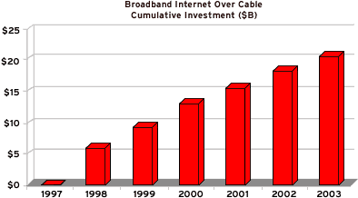
Skills for the Biologist
2. Bar Graph(Histogram): A bar graph allows a scientist to compare data.

Slide 4
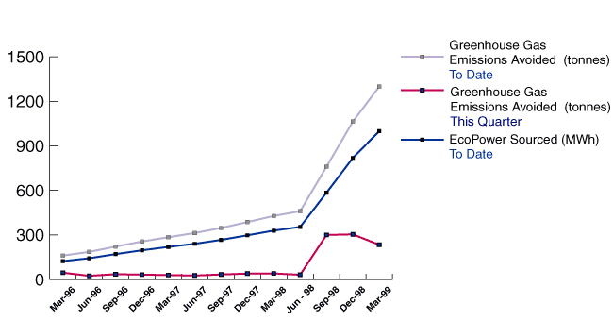
Skills for the Biologist
3. Line Graph: A line graph is used to show relationships between two or more variables.

Slide 5
Skills for the Biologist
Independent variable: is placed on the horizontal (bottom) or X axis
Independent variables are usually the variables that the scientist controls.
Ex. Temperature, amount of light, etc.
Dependent variable: is placed on the vertical (side) or Y-axis.
Dependent variables depend on the changes in the independent variable.

Slide 6
Skills for the Biologist
a) Independent variable: is placed on the horizontal (bottom) or X axis
Independent variables are usually the variables that the scientist controls.
Ex. Temperature, amount of light, etc.
b) Dependent variable: is placed on the vertical (side) or Y-axis.
Dependent variables depend on the changes in the independent variable.

Slide 7
The Scientific Method
The Scientific Method
The technique used by scientists to solve problems and gain scientific information.
The Scientific Method is a process of logical thinking.
Steps of the scientific method:
1. Problem
2. Hypothesis - Claim
3. Experimentation
4. Observations - Evidence
5. Conclusions

Slide 8
The Scientific Method (cont.)
Problem:
A problem must be stated.
It is a question for which a scientist is trying to find an answer.
Ex. Will a plant grow in complete darkness?
Hypothesis:
An educated guess about the answer to the problem.
The hypothesis is based on information which has been learned about the problem.
It is your CLAIM to a possible answer to the problem
Ex. I think that...

Slide 9
The Scientific Method (cont.)
Experimentation:
set up a controlled experiment that will test the hypothesis.
a) Controlled experiment: an experiment which tests only one factor.
Ex. 2 of the same species plant, one grown in complete darkness, and the other grown in regular light
Variable:
Is the factor to be tested
Ex. amount of light

Slide 10
Variables
Independent Variable –
something that is changed by the scientist
Controlled by the scientist
What is tested
What is manipulated
Dependent Variable –
something that might be affected by the change in the independent variable
Changes because of the experiment
DATA
What is observed
What is measured
The data collected during the investigation

Slide 11
Variables
Independent Variable –
Dependent Variable –
Controlled Variable
a variable that is not changed
Also called constants
Allow for a “fair test”
A exact duplicate experiment without the variable.

Slide 12
Identify the variables in this investigation.
Students of different ages were given the same jigsaw puzzle to put together. They were timed to see how long it took to finish the puzzle

Slide 13
What was the independent variable?
Ages of the students
Different ages were tested by the scientist

Slide 14
What was the dependent variable?
The time it to put the puzzle together
The time was observed and measured by the scientist

Slide 15
What was the control?
Same puzzle
All of the participants were tested with the same puzzle.
It would not have been a fair test if some had an easy 30 piece puzzle and some had a harder 500 piece puzzle.

Slide 16
Draw the Data Table

Slide 17
Identify the variables in this investigation.
An investigation was done with an electromagnetic system made from a battery and wire wrapped around a nail. Different sizes of nails were used. The number of paper clips the electromagnet could pick up was measured.

Slide 18
Independent variable:
Sizes of nails
These were changed by the scientist

Slide 19
Dependent variable:
Number of paper clips picked up
The number of paper clips observed and counted (measured)

Slide 20
Controlled variables:
Battery, wire, type of nail
None of these items were changed

Slide 21
Draw the Data Table

Slide 22
The Scientific Method (cont.)
Observations / Claims:
Measurements, notes, records of things seen, heard, felt, during the experiment.
Usually, observations are made using units of measure.
Conclusions:
explanations of the problem based on the observations. True conclusions must be backed up by observations and data from the experiments. USE DATA
Ex. I conclude that ………….. because …………...

Slide 23
The Life Processes
Life Functions
There is not simple definition for life. However many characteristics of living things have been defined.
Life Processes
Transport: Absorption and distribution of materials within an organism. (Circulation)
2. Excretion: Removal of waste products that the organism itself has made.
3. Nutrition: All activities that an organism does to get materials from the environment and prepare them for use.

Slide 24
The Life Processes
Reasons for Nutrition:
Energy: all living things need energy
Raw materials: all living things need raw materials for growth and repair
Steps in Nutrition:
Ingestion: taking material (food) in from the environment
Digestion: breakdown of food materials into simpler forms that an organism can use
Egestion: getting rid of food wastes (feces)
Types of nutrition
Autotrophic: (self feeder) an organism that can synthesize its own food (plants)
Heterotrophic: (other eater) an organism that cannot synthesize its own food (humans)

Slide 25
The Life Processes
4. Growth: Using the products of synthesis to increase cell size or number
5. Respiration: Chemical process by which an organism obtains ENERGY from food materials in order to maintain life functions.
Respiration in this case refers to Cellular Respiration, not breathing
6. Regulation: The coordination and control of the activities of an organism and the response to its environment using nerve impulses or hormones

Slide 26
The Life Processes
7. Reproduction: The production of new individuals. This must occur in order for a species to survive, however, an individual organism does not need to reproduce in order to survive.
8. Synthesis: The process by which an organism builds large molecules from smaller ones Ex: waxes, drugs, poisons, mucus
All of the chemical reactions responsible for the life functions, occurring in an organism are known as that organism’s Metabolism…

Slide 27
The Life Processes
The goal of these chemical reactions and the life
functions is to maintain “Homeostasis” or a
“Same State”.
Keeping a constant internal environment.
Examples:
House Thermostat
Body temp remains relatively constant (37 degrees C)
The amount of glucose (sugar) in the blood needs to be within a certain range.

Slide 28
Key Vocabulary
Length: the distance from point to point
Mass: describes an amount of matter
Volume: describe the space occupied by matter
Temperature: measures the average kinetic energy in matter
Gram: a small amount of mass used to measure small objects
Kilogram: a large amount of mass used to measure large objects
Meter: the basic unit of length
Centimeter: a small unit of measurement used for small distances
Kilometer: a large unit of measurement used for large distances
Liter: the basic unit of volume
Graduated cylinder: an instrument used to measure volume
Celsius: the Metric system for recording temperature
Fahrenheit: the English system for recording temperature

Slide 29
Key Vocabulary
Assumption: a possibility based on observations
15) Bias: tendency to favor, prejudice
16) Conclusion: decision about an experiment based on results and hypothesis
17) Controlled Experiment: all variables are the same except for the tested one
18) Data: collected results from tests during experiments
19) Variable: one factor different from the conditions found in the control
20) Dependent variable: what is measured because of the independent variable
21) Independent variable: the factor that influences the dependent variable
Evidence: support for something that is true or not true
23) Experiment: series of tests to support or refute a hypothesis
24) Hypothesis: an educated guess based on available information
25) Inference: a conclusion based on observations
26) Law: a fact based on proven evidence
27) Model: representation to explain a process or structure
28) Observation: information collected with the senses
29) Research Plan: initial stage of an experiment
30) Testing: to try something based on research
31) Theory: accepted as true that may or may not be true
32) Control: standard of comparison

