Slide 1
Atmosphere Review

Slide 2
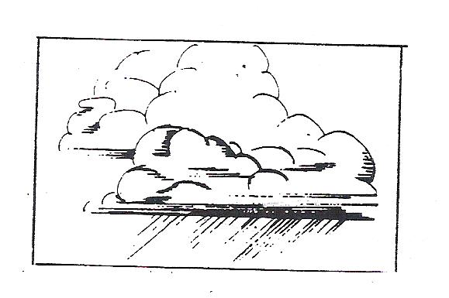
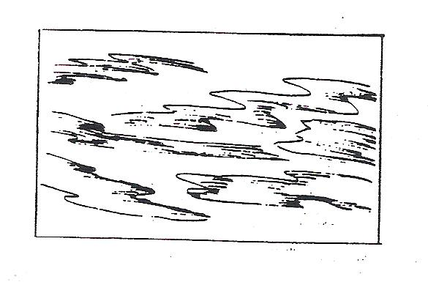
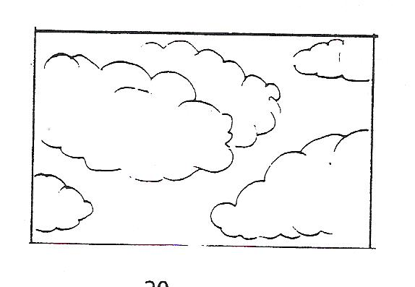
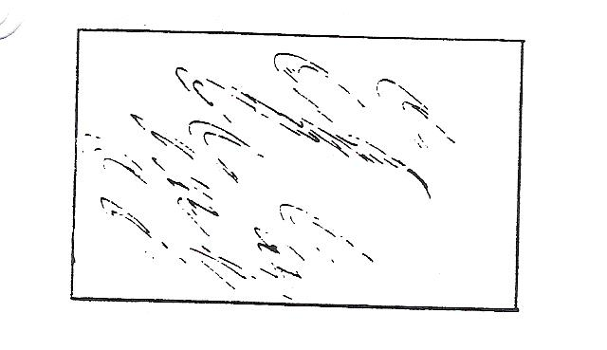
Name these clouds…

Slide 3
cumulonimbus
stratus
cumulus
cirrus

Slide 4
Name these clouds…

Slide 5
cumulonimbus
cirrus
stratus
cumulus

Slide 6
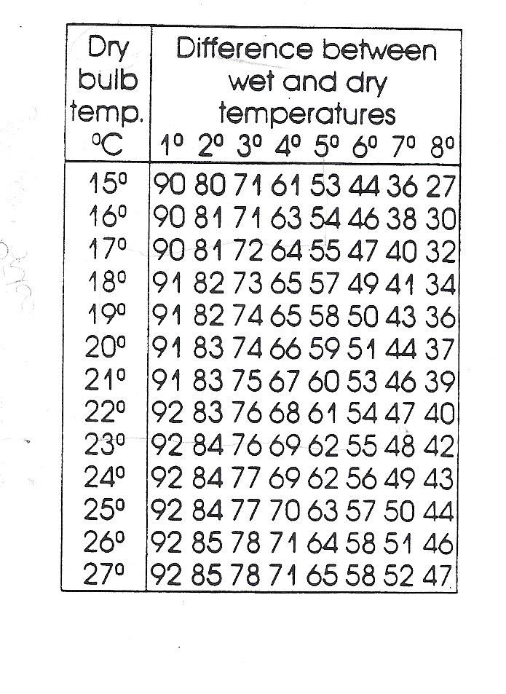
Find the humidity if the dry temperature is 24◦C and the wet temperature is 23◦C

Slide 7
92%

Slide 8
Find the humidity if the dry temperature is 25◦C and the wet temperature is 19◦C

Slide 9
57%

Slide 10
Find the humidity if the dry temperature is 20◦C and the wet temperature is 16◦C

Slide 11
66%

Slide 12
A. mixture of gases surrounding Earth B. parts of the Earth’s surface covered by water C. Contains the crust and upper mantle
Match: 1. hydrosphere 2. lithosphere
3. atmosphere

Slide 13
1 B…..……2 C……..3 A

Slide 14
Put these layers in order starting at Earth’s surface and ending out closest to space!
Mesosphere Stratosphere Troposphere Thermosphere

Slide 15
Troposphere Stratosphere Mesosphere Thermosphere

Slide 16
Now do it backwards!!!!
Mesosphere Stratosphere Troposphere Thermosphere

Slide 17
Thermosphere Mesosphere Stratosphere Troposphere

