Slide 1
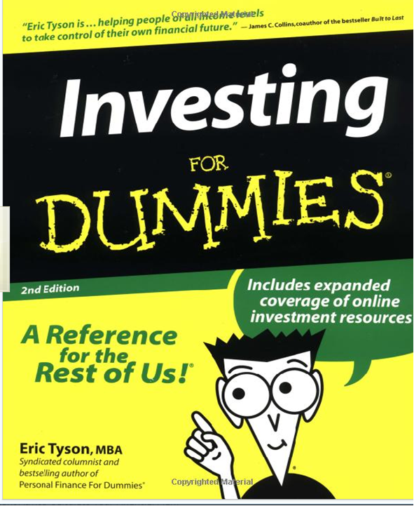

Slide 2
Abolitionists wanted to end ________________. Sojourner Truth, Frederick Douglass, John Brown and Harriet Tubman were abolitionists. Tubman was called a “conductor” on the _____________ ______________helping slaves escape to the north.
__________ ____________organized a slave revolt and broke into an arsenal in Harper’s Ferry, Virginia hoping to steal weapons to give to slaves.

Slide 3
Abolitionists wanted to end slavery. Sojourner Truth, Frederick Douglass, John Brown and Harriet Tubman were abolitionists. Tubman was called a “conductor” on the Underground Railroad helping slaves escape to the north.
John Brown organized a slave revolt and broke into an arsenal in Harper’s Ferry, Virginia hoping to steal weapons to give to slaves.

Slide 4
Harriet Beecher Stowe wrote a book, _______ ______ ______, which showed how evil slavery was. People in the North were outraged. This led to the Civil War.

Slide 5
Harriet Beecher Stowe wrote a book, Uncle Tom’s Cabin, which showed how evil slavery was. People in the North were outraged. This led to the Civil War.

Slide 6
The North and South had different ways of doing thing (like factories vs. farming). This is called _____________. People in the North that did not like the war were called “________________.”

Slide 7
The North and South had different ways of doing thing (like factories vs. farming). This is called sectionalism. People in the North that did not like the war were called “copperheads.”

Slide 8
Kansas was called “Bleeding Kansas” because pro-slavery and anti-slavery people both moved there. The Kansas-Nebraska Act said that slavery in any new territory would be decided by ____________ _____________.
Popular Sovereignty is when the people _________ and decide if they want slavery.

Slide 9
Kansas was called “Bleeding Kansas” because pro-slavery and anti-slavery people both moved there. The Kansas-Nebraska Act said that slavery in any new territory would be decided by popular sovereignty. Popular Sovereignty is when the people vote and decide if they want slavery.

Slide 10
At first, the Lincoln’s goal was to ______________ ___ ________(bring the country back together). Later he had a goal to end __________.

Slide 11
At first, the Lincoln’s goal was to preserve the Union (bring the country back together). Later he had a goal to end slavery.

Slide 12
The ___________ had better military leaders and was more familiar with their land. They also thought countries in ___________ would help them.

Slide 13
The South had better military leaders and was more familiar with their land. They also thought countries in Europe would help them.

Slide 14
The North had more resources: ____________ , ____________, _____________, and __________: men to fight. It was expected they would win quickly, but it really took about ___ years.

Slide 15
The North had more resources: weapons, railroads, factories and human resources: men to fight. It was expected they would win quickly, but it really took about 4 years.

Slide 16
The Southern states started to _______ as soon as Abraham Lincoln got elected in 1860. Their president was _________ ________.

Slide 17
The Southern states started to secede as soon as Abraham Lincoln got elected in 1860. Their president was Jefferson Davis.

Slide 18
_______ ________ was a slave who sued for freedom because his owner moved to a free state. The __________ _______ said he wasn’t even allowed to sue because he was a slave

Slide 19
Dred Scott was a slave who sued for freedom because his owner moved to a free state. The Supreme Court said he wasn’t even allowed to sue because he was a slave

Slide 20
The first battle of the Civil War was at _____ ________ in S.C.
The Civil War ended at ______________, Virginia in 1865 when General _____ (South = Confederate) surrendered to General ________ (Union = North).
The war showed the the central government was ___________ .

Slide 21
The first battle of the Civil War was at Fort Sumter in S.C.
The Civil War ended at Appomattox, Virginia in 1865 when General Lee (South = Confederate) surrendered to General Grant (Union = North).
The war showed the the central government was strong.

Slide 22
The south won many of the beginning battles, but the turning point was when the North won the Battle of _________________.

Slide 23
The south won many of the beginning battles, but the turning point was when the North won the Battle of Gettysburg.

Slide 24
The __________ _______ Law required citizens to capture and return slaves back to their owners if they escaped. Slaves were treated as ___________.

Slide 25
The Fugitive Slave Law required citizens to capture and return slaves back to their owners if they escaped. Slaves were treated as property.

Slide 26
The ______________ _______________ said that slaves in the ________ (rebel states that seceded) were free, not the border states though.
Lincoln issued this right after the Union won a victory at ____________. He also hoped European countries would help the north since their had already abolished slavery.

Slide 27
The Emancipation Proclamation said that slaves in the south (rebel states that seceded) were free, not the border states though. Lincoln issued this right after the Union won a victory at Antietam. He also hoped European countries would help the north since their had already abolished slavery.

Slide 28
General __________ (North = Union) used “______ ____” and destroyed everything (houses, railroads, civilians, animals,… ) in his path on his trip through ___________.

Slide 29
General Sherman (North = Union) used “total war” and destroyed everything (houses, railroads, civilians, animals,… ) in his path on his trip through Georgia.

